Slide 1
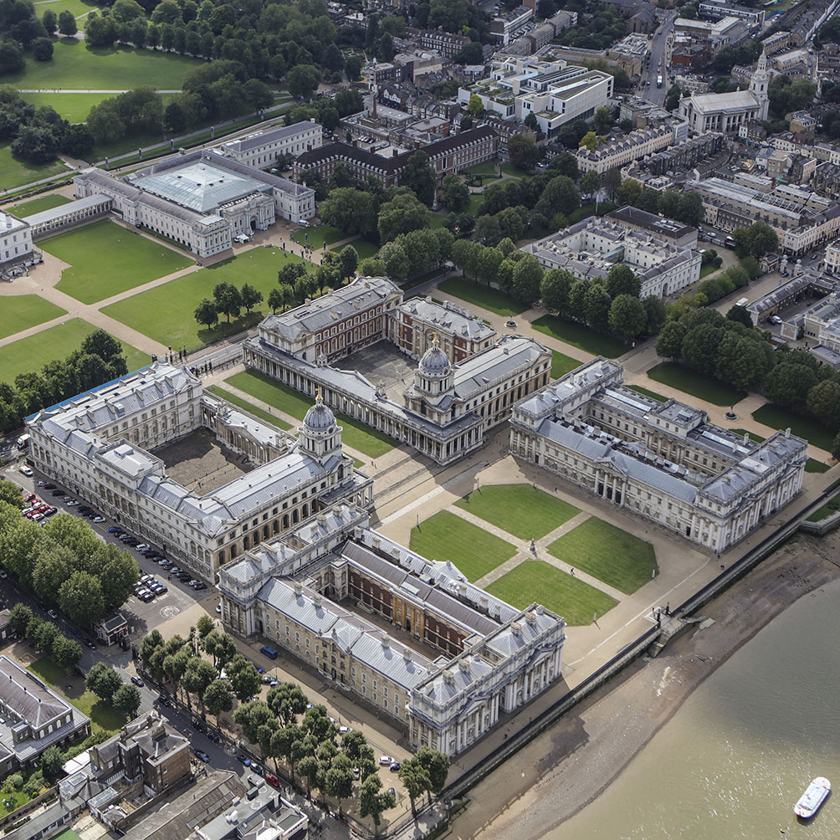
Introduction to Intellectual Property Rights
Tutorial Slides
BUSI 1764
Global Entrepreneurship and Innovation
Department: Executive Business Centre
Dr Sylvester Mujakperuo
Module Leader
170223

Slide 2
Learning Outcomes
.
To understand the meaning of IPRs and the Sources of Laws
To understand the UK Legislative Framework
To discuss the Hierarchy Of Civil and Criminal Courts
To Provide an Overview of Access to Justice in Case Of IPR Infringements
Highlights the duties of the Intellectual Property Enterprise Court (IPEC)
To understand the Copyright, Designs and Patents Act 1988
Trademarks Act 1994

Slide 3


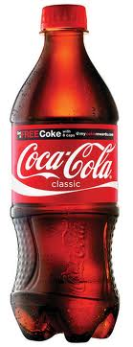
Introduction

Slide 4
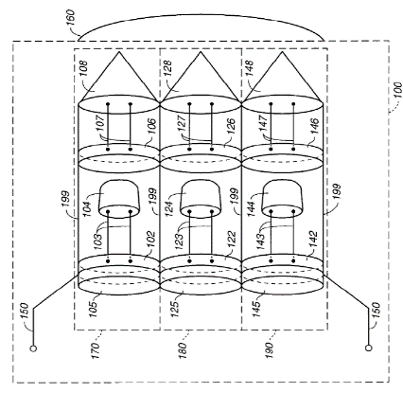
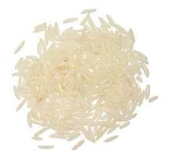

What are IPRs?
Regulates the creation, use and exploitation of mental or and creative labour
The term used for almost 150 yrs
It is territorial in nature
Covers 6 types of IPRs-
Copyrights [©],
Trademarks [™],
Designs [D],
Patents [P],
Trade Secrets [TS]
Geographical Indications [GIs]

Slide 5
What are IPRs? (cont)
All IPRs create property protection over intangibles like ideas, inventions, signs, and information.
For legal convenience, the rights are considered individually. But in practice, the area of their operation often overlap.
Bottle design protected as design rights
Coke ® TM
Literature on it protected as copyright
Formula for coke is trade secret

Slide 6


Intellectual Property Rights
Even though there is close relationship between intangible property and tangible objects in which it is embodied, IPRs offer distinct and separate property rights in the tangible property.
Mr B Mr C
Author and owner of expression in the letter Owner of paper

Slide 7
Justifications
Reward
Why justify? Land and physical property vs Ideas and information
2. Qs:
i. Should IPRS be protected as private rights or public property?
ii. Safeguards for public interest ?
3. No concrete scientific proof whether IPRs benefit or harm the society
4. Many theories. Main ones: Natural law theory, Utilitarian theory, Theory of
personality and Social policy theory
5. Distillation of all these theories:
Creation/Innovation
Incentive

Slide 8
UK Legislative Framework
The UK has 4 major IP legislation:
Copyright, Designs and Patents Act 1988 (CDPA)
Trademarks Act 1994
Registered Designs Act 1949
Patents Act 1977

Slide 9
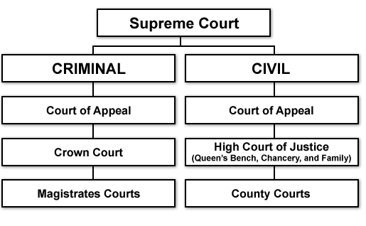
Hierarchy of Civil and Criminal Courts

Slide 10
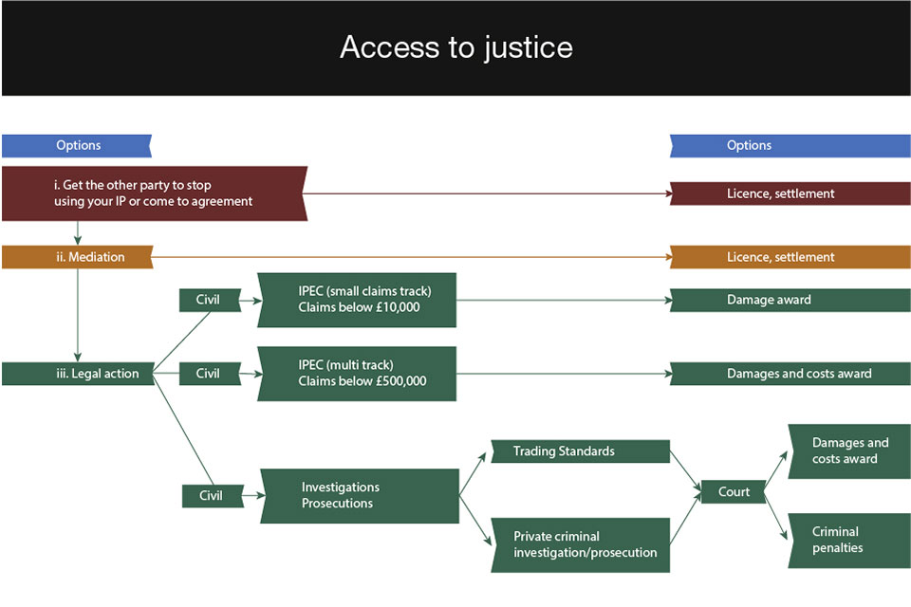
Overview of Access to justice
© Crown Copyright 2017

Slide 11
Intellectual Property Enterprise Court [IPEC]
Established in 2013 with the aim to provide affordable justice to SMEs and individuals on IPR cases.
2. It has two alternative procedures for making a claim: Multi-track and a small claims track system.
3. It has a jurisdiction to hear all types of IPR cases including:
Infringement of patents, designs, trademarks, copyright and other IPRs;
Revocation or invalidity of patents, registered designs and trade marks;
Patents amendments;
Declarations of non-infringement;
Misuse of trade secrets and other breaches of confidence, etc.

Slide 12
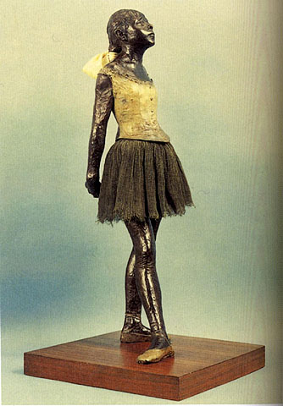




Copyright, Designs and Patents Act 1988
1. Protects 'works' that are original expression of ideas
Legislation-Copyright, Designs and Patents Act (CDPA) 1988, Parts I and II
http://www.legislation.gov.uk/ukpga/1988/48/contents

Slide 13
Copyright, Designs and Patents Act 1988
To copyright something, only three elements are required: (1) fixation, (2) originality, and (3) expression.
Fixation: a creative idea must be locked in a permanent state. To protect a song, for example, it must be written on paper or recorded onto tape or CD. To get copyright protection, you must fix your work “in a tangible medium.
Expression: Expression goes hand-in-hand with the fixation requirement. Ideas can’t be copyrighted, but “expression” of an idea can be copyrighted.
Originality: Creative work must meet a basic level of originality to be considered the product of an author. Direct copies of someone else’s work can’t be copyrighted, and neither can facts, short phrases, titles, etc. For example, the names and addresses in a phonebook can’t be copyrighted but the photo on its front cover most certainly can.

Slide 14

Copyright, Designs and Patents Act 1988
- No Registration required. Copyright assertion important. You get copyright protection automatically - you don’t have to apply or pay aright works in the UK.
© Mujakperuo 2024
- Duration- lifetime of the author + 70 Years pma (post mortem auctoris)

Slide 15
Copyright, Designs and Patents Act 1988
You automatically get copyright protection when you create:
An original literary, dramatic, musical and artistic work, including illustration and photography
An original non-literary written work, such as software, web content and databases
A sound and music recordings
A film and television recordings
A Broadcast
The layout of published editions of written, dramatic and musical works

Slide 16
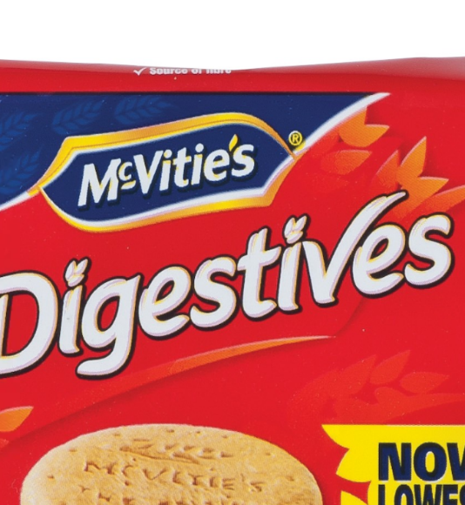
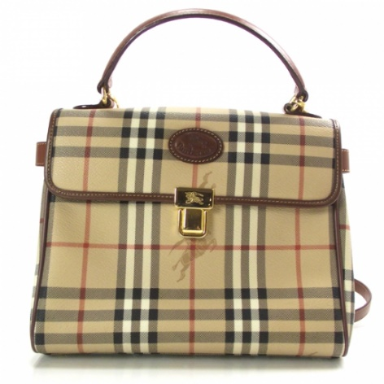

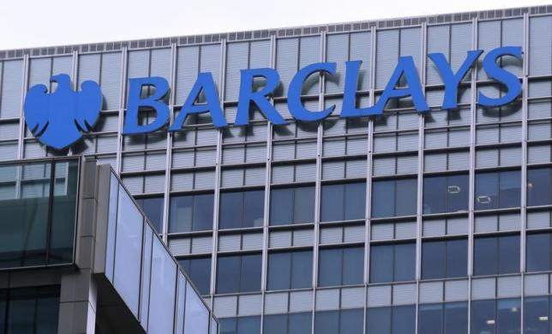
Trademarks Act 1994
Definition- Any word, phrase, symbol, design, combination of colours, product configuration, group of letters/numbers, or combination of all these elements, used by a company to identify its goods & services and distinguish from others.
Legislation- Trademarks Act 1994
http://www.legislation.gov.uk/ukpga/1994/26/contents

Slide 17
Trademarks Act 1994 (cont)
TMs need to be registered for protection and performs 4 functions:
Origin: It identifies the product and its origin
Guarantee function: It proposes to guarantee its quality
Advertising: It advertises the product. The trademark represents the product
Product differentiation: It creates an image of the product in the minds of the public particularly the consumers or the prospective consumers of such goods.

Slide 18
Trademarks Act 1994 (cont)
For a valid registration 4 requirements:
(a) should be capable of graphic representation
(b) has the capacity to distinguish the goods and services of one company from another
(c) must not fall within the absolute grounds of refusal
(d) must not fall within the relative grounds for refusal
(e) Duration is indefinite

Slide 19
Patents
Patent is an exclusive right granted for an invention
It is used to protect the way something works/the functionality, what it is made from, or used for or does
It is for a limited period, usually 20 years from filling
It gives the inventor the right to stop others from making, using or selling it without their permission.

Slide 20
Design protection
Gives you exclusive rights to the design
most important criterion for a design registration is the 'individual nature' of the design
In the UK there are rights that protect your unregistered designs and stop others using them without permission.

Slide 21
Geographic Indication
A GI designates that a product is of a certain nature, quality and reputation linked to where they are made, or characteristics linked to that place.
Some products, often food and drink, are synonymous with certain locations for their quality
E.g It means you cannot sell something as a ‘Scotch’ unless it originates from Scotland and is made a certain way

Slide 22
Video
https://www.youtube.com/watch?v=h_M2c9Ta6kY
Group task: Complete the case study

Slide 23
Tutorial Case Study
In groups examine:
Household Appliances Ltd. is a leading manufacturer of consumer goods. The company is about to launch a new kettle. The kettle is to be called the HOTTA and has an unusual shape. The kettle is more efficient in heating water and is safer for consumers to use, because when boiled it remains cool to touch. The reason for these two advantages is that instead of having a single wall, the kettle has a double wall, the gap between the two layers of metal being filled with a special gas. Because of the special properties of the gas, safety legislation obliges the company to supply a detailed instruction leaflet when selling the kettle. The gas is obtainable only from certain specialist suppliers and the company is concerned in case its competitors learn who these suppliers are.

Slide 24
Tutorial Questions
Identify the categories of IPRs protection that should be considered by the company in the case study above.
Identify the legislations under which such protection will be received.

Slide 25
Tutorial Answers
‘Household Appliances Ltd.’=Trade Mark protection under Trademarks Act 1994 as it is defined as any word, phrase, symbol, design, combination of colours, product configuration, group of letters/numbers, or combination of all these elements, used by a company to identify its goods & services and distinguish from others.
Name of the kettle ‘HOTTA’. Student can argue that it can receive dual protection, under Copyright and Trade Mark laws. It will be hard to protect it as Copyright under Copyright, Designs and Patents Act 1988 as leading case of Exxon Corp v Exxon Insurance Consultants International Ltd Chancery Division, 22 January 1981 doesn't support such an argument. There the court observed that if copyright protection is granted to such titles or short phrases, then, in spite of them being non-factual (recall facts can't be protected and remain in the public domain), it may lead to monopolisation of the basic building blocks a language. There will be a better chance to protect the name ‘HOTTA’ as a Trademark under the Trademarks Act 1994. This could be a particular model for ‘Household Appliances Ltd’. Again to protect ‘HOTTA’ , trademark definition needs satisfaction.
3. Kettle’s an unusual shape-Protected under Registered Designs Act 1949.

Slide 26
Tutorial Answers (Continued)
4. Kettle's working mechanism: ‘The kettle is more efficient in heating water and is safer for consumers to use, because when boiled it remains cool to touch. The reason for these two advantages is that instead of having a single wall, the kettle has a double wall, the gap between the two layers of metal being filled with a special gas.’
This will be protected under Patents Act 1977 as this performs a function/utility unlike copyrights that protect expression of set of ideas, trademarks chiefly inform the commercial origin or good/service, and design rights protect the external design of a good (that may/may not lend to its function).
5. ‘Special properties of the gas’-Could be protected under Patents Act 1977 for such utilitarian function mentioned above.
6. ‘Detailed instruction leaflet’ on the Kettle- It’s protection may be argued under as Copyright under Copyright, Designs and Patents Act 1988. Whether it will receive protection or not will depend on how this safety message is conveyed. If for eg, it has mere facts of gas’s properties and consequences of non-safe use of kettle, then no such protection will be received as they will be facts that should remain in the public domain.
7. ‘The gas is obtainable only from certain specialist suppliers and the company is concerned in case its competitors learn who these suppliers are.’-This list can be protected as a Trade Secret, like the famous eg of Coca Cola’s recipe.

Slide 27
PART 3
ASSIGNMENT 2 BRIEFING
170223

Slide 28
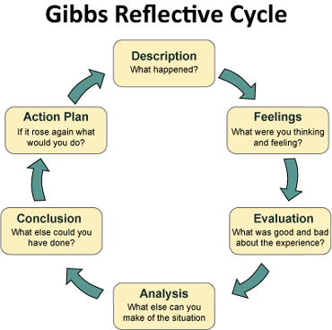

Slide 29
THE GIBBS REFLECTIVE CYCLE
Gibbs' Reflective Cycle was developed by Graham Gibbs in 1988 to give structure to learning from experiences. It offers a framework for examining experiences, and given its cyclic nature lends itself particularly well to repeated experiences, allowing you to learn and plan from things that either went well or didn’t go well. It covers 6 stages:
Description of the experience
Feelings and thoughts about the experience
Evaluation of the experience, both good and bad
Analysis to make sense of the situation
Conclusion about what you learned and what you could have done differently
Action plan for how you would deal with similar situations in the future, or general changes you might find appropriate.

Slide 30
DESCRIPTION
Here you have a chance to describe the situation in detail. The main points to include here concern what happened. Your feelings and conclusions will come later.
Helpful questions:
What happened?
When and where did it happen?
Who was present?
What did you and the other people do?
What was the outcome of the situation?
Why were you there?
What did you want to happen?

Slide 31
FEELINGS
Here you can explore any feelings or thoughts that you had during the experience and how they may have impacted the experience.
Helpful questions:
What were you feeling during the situation?
What were you feeling before and after the situation?
What do you think other people were feeling about the situation?
What do you think other people feel about the situation now?
What were you thinking during the situation?
What do you think about the situation now?

Slide 32
EVALUATION
Here you have a chance to evaluate what worked and what didn’t work in the situation. Try to be as objective and honest as possible. To get the most out of your reflection focus on both the positive and the negative aspects of the situation, even if it was primarily one or the other.
Helpful questions:
What was good and bad about the experience?
What went well?
What didn’t go so well?
What did you and other people contribute to the situation (positively or negatively)?

Slide 33
ANALYSIS
The analysis step is where you have a chance to make sense of what happened. Up until now you have focused on details around what happened in the situation. Now you have a chance to extract meaning from it. You want to target the different aspects that went well or poorly and ask yourself why. If you are looking to include academic literature, this is the natural place to include it.
Helpful questions:
Why did things go well?
Why didn’t it go well?
What sense can I make of the situation?
What knowledge – my own or others (for example academic literature) can help me understand the situation?

Slide 34
CONCLUSION
In this section you can make conclusions about what happened. This is where you summarise your learning and highlight what changes to your actions could improve the outcome in the future. It should be a natural response to the previous sections.
Helpful questions:
What did I learn from this situation?
How could this have been a more positive situation for everyone involved?
What skills do I need to develop for me to handle a situation like this better?
What else could I have done?

Slide 35
ACTION PLAN
At this step you plan for what you would do differently in a similar or related situation in the future. It can also be extremely helpful to think about how you will help yourself to act differently – such that you don’t only plan what you will do differently, but also how you will make sure it happens. Sometimes just the realisation is enough, but other times reminders might be helpful.
Helpful questions:
If I had to do the same thing again, what would I do differently?
How will I develop the required skills I need?
How can I make sure that I can act differently next time?

Slide 36

Conclusion

Slide 37
Thank you

Slide 38


Be inspired

