Slide 1
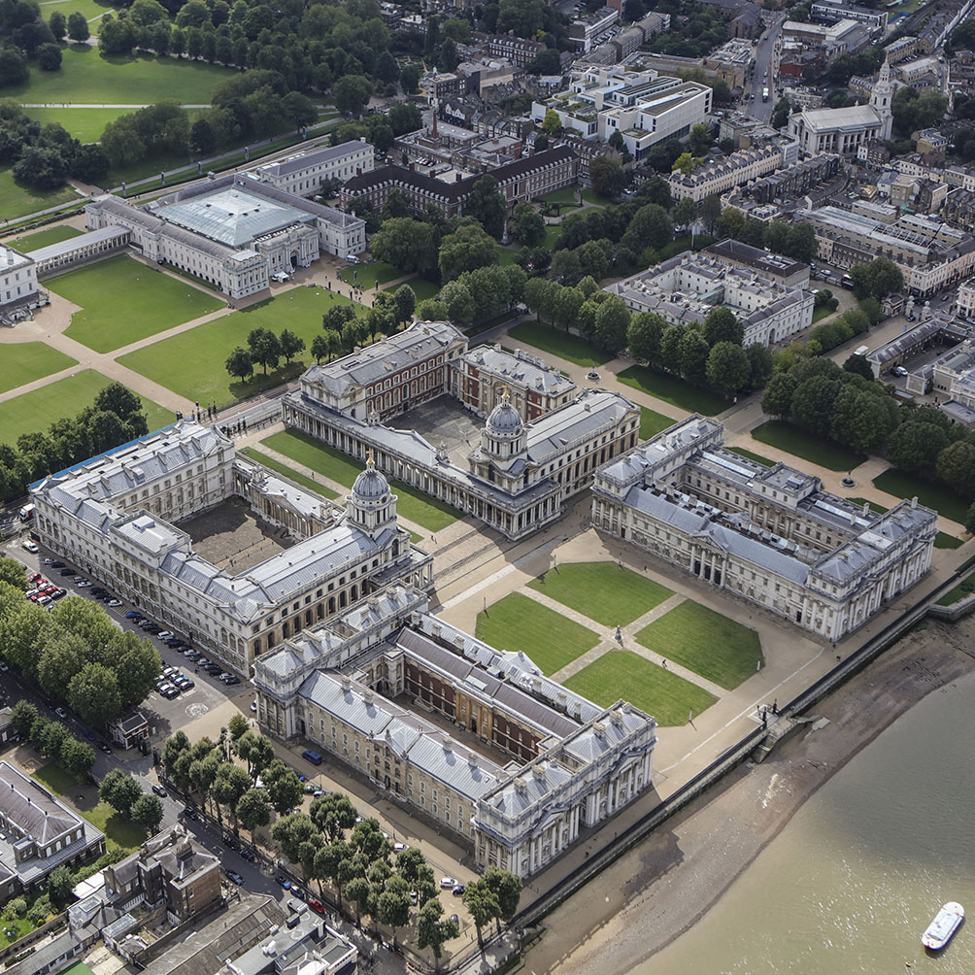
Introduction to Intellectual Property Rights
BUSI 1764
Global Entrepreneurship and Innovation
Department: Executive Business Centre
Dr Sylvester Mujakperuo
Module Leader
170223

Slide 2
Learning Outcomes
.
To understand the meaning of IPRs and the Sources of Laws
To understand the UK Legislative Framework
To discuss the Hierarchy Of Civil and Criminal Courts
To Provide an Overview of Access to Justice in Case Of IPR Infringements
Highlights the duties of the Intellectual Property Enterprise Court (IPEC)
To understand the Copyright, Designs and Patents Act 1988
Trademarks Act 1994

Slide 3

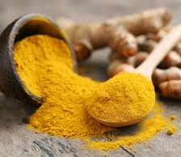
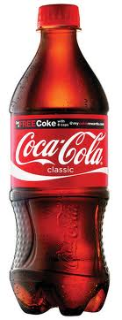
Introduction

Slide 4
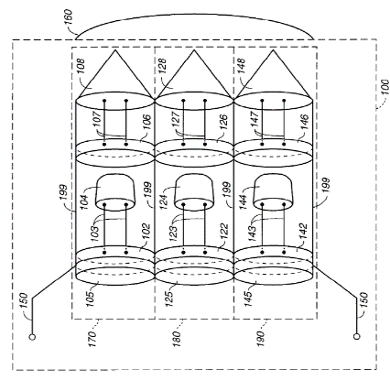
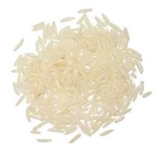

What are IPRs?
Regulates the creation, use and exploitation of mental or and creative labour
The term used for almost 150 yrs
It is territorial in nature
Covers 6 types of IPRs-
Copyrights [©],
Trademarks [™],
Designs [D],
Patents [P],
Trade Secrets [TS]
Geographical Indications [GIs]

Slide 5
What are IPRs? (cont)
All IPRs create property protection over intangibles like ideas, inventions, signs, and information.
For legal convenience, the rights are considered individually. But in practice, the area of their operation often overlap.
Bottle design protected as design rights
Coke ® TM
Literature on it protected as copyright
Formula for coke is trade secret

Slide 6


Intellectual Property Rights
Even though there is close relationship between intangible property and tangible objects in which it is embodied, IPRs offer distinct and separate property rights in the tangible property.
Mr B Mr C
Author and owner of expression in the letter Owner of paper

Slide 7
Justifications
Reward
Why justify? Land and physical property vs Ideas and information
2. Qs:
i. Should IPRS be protected as private rights or public property?
ii. Safeguards for public interest ?
3. No concrete scientific proof whether IPRs benefit or harm the society
4. Many theories. Main ones: Natural law theory, Utilitarian theory, Theory of
personality and Social policy theory
5. Distillation of all these theories:
Creation/Innovation
Incentive

Slide 8
Sources of the Law
1. UK law has been influenced by international conventions, treaties and European Community legislation. None of these international treaties/conventions are self executing.
2. World Intellectual Property Organisation (WIPO): Geneva
3. United Nations Educational Scientific and Cultural Organisation (UNESCO): Paris
4. World Trade Organisation (WTO) 1995: TRIPS- Most Favoured Nation and the Dispute
Settlement Mechanism
5. Council of Europe (Council): Strasbourg: Monitors 2 main conventions:
Strasbourg Convention on the Unification of Certain Points of Substantive law on Patents for Invention 1963 and the European Patent Convention (EPC) 1973.
Monitors the Universal Copyright Convention (UCC) that provides an alternative avenue of copyright protection for developing countries.
i

Slide 9
UK Legislative Framework
The UK has 4 major IP legislation:
Copyright, Designs and Patents Act 1988 (CDPA)
Trademarks Act 1994
Registered Designs Act 1949
Patents Act 1977

Slide 10
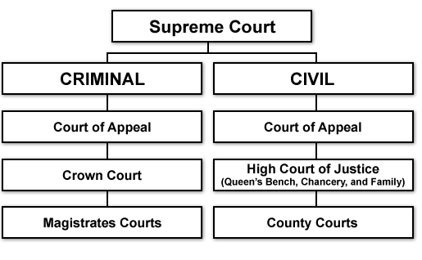
Hierarchy of Civil and Criminal Courts

Slide 11
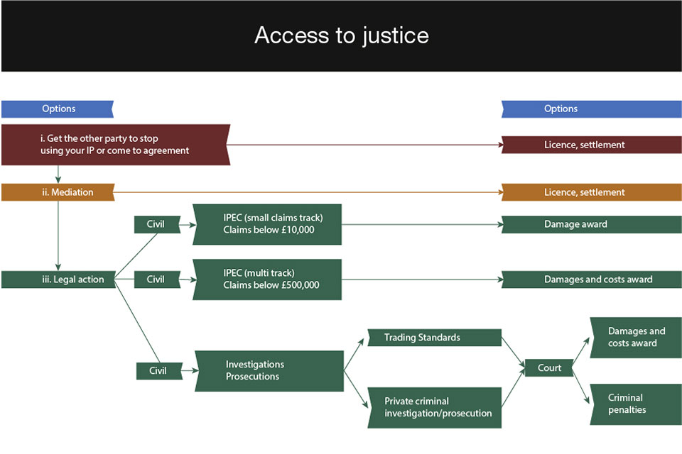
Overview of Access to justice
© Crown Copyright 2017

Slide 12
Intellectual Property Enterprise Court [IPEC]
Established in 2013 with the aim to provide affordable justice to SMEs and individuals on IPR cases.
2. It has two alternative procedures for making a claim: Multi-track and a small claims track system.
3. It has a jurisdiction to hear all types of IPR cases including:
Infringement of patents, designs, trademarks, copyright and other IPRs;
Revocation or invalidity of patents, registered designs and trade marks;
Patents amendments;
Declarations of non-infringement;
Misuse of trade secrets and other breaches of confidence, etc.

Slide 13
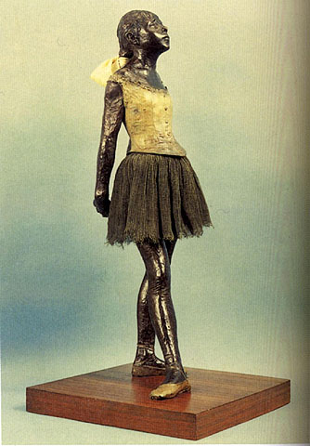




Copyright, Designs and Patents Act 1988
1. Protects 'works' that are original expression of ideas
Legislation-Copyright, Designs and Patents Act (CDPA) 1988, Parts I and II
http://www.legislation.gov.uk/ukpga/1988/48/contents

Slide 14
Copyright, Designs and Patents Act 1988
To copyright something, only three elements are required: (1) fixation, (2) originality, and (3) expression.
Fixation: a creative idea must be locked in a permanent state. To protect a song, for example, it must be written on paper or recorded onto tape or CD. To get copyright protection, you must fix your work “in a tangible medium.
Expression: Expression goes hand-in-hand with the fixation requirement. Ideas can’t be copyrighted, but “expression” of an idea can be copyrighted.
Originality: Creative work must meet a basic level of originality to be considered the product of an author. Direct copies of someone else’s work can’t be copyrighted, and neither can facts, short phrases, titles, etc. For example, the names and addresses in a phonebook can’t be copyrighted but the photo on its front cover most certainly can.

Slide 15

Copyright, Designs and Patents Act 1988
- No Registration required. Copyright assertion important. You get copyright protection automatically - you don’t have to apply or pay aright works in the UK.
© Mujakperuo 2024
- Duration- lifetime of the author + 70 Years pma (post mortem auctoris)

Slide 16
Copyright, Designs and Patents Act 1988
You automatically get copyright protection when you create:
An original literary, dramatic, musical and artistic work, including illustration and photography
An original non-literary written work, such as software, web content and databases
A sound and music recordings
A film and television recordings
A Broadcast
The layout of published editions of written, dramatic and musical works

Slide 17
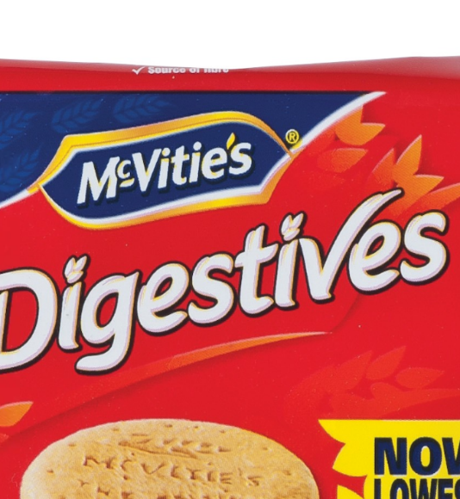
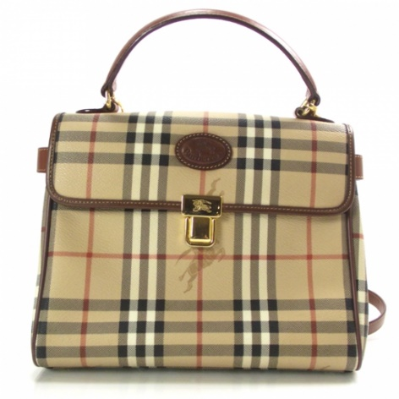

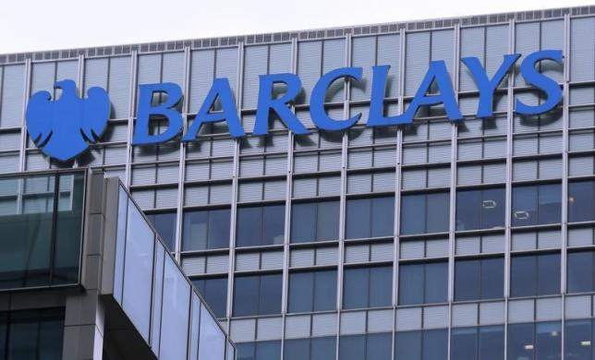
Trademarks Act 1994
Definition- Any word, phrase, symbol, design, combination of colours, product configuration, group of letters/numbers, or combination of all these elements, used by a company to identify its goods & services and distinguish from others.
Legislation- Trademarks Act 1994
http://www.legislation.gov.uk/ukpga/1994/26/contents

Slide 18
Trademarks Act 1994 (cont)
TMs need to be registered for protection and performs 4 functions:
Origin: It identifies the product and its origin
Guarantee function: It proposes to guarantee its quality
Advertising: It advertises the product. The trademark represents the product
Product differentiation: It creates an image of the product in the minds of the public particularly the consumers or the prospective consumers of such goods.

Slide 19
Trademarks Act 1994 (cont)
For a valid registration 4 requirements:
(a) should be capable of graphic representation
(b) has the capacity to distinguish the goods and services of one company from another
(c) must not fall within the absolute grounds of refusal
(d) must not fall within the relative grounds for refusal
(e) Duration is indefinite

Slide 20
Patents
Patent is an exclusive right granted for an invention
It is used to protect the way something works/the functionality, what it is made from, or used for or does
It is for a limited period, usually 20 years from filling
It gives the inventor the right to stop others from making, using or selling it without their permission.

Slide 21
Design protection
Gives you exclusive rights to the design
most important criterion for a design registration is the 'individual nature' of the design
In the UK there are rights that protect your unregistered designs and stop others using them without permission.

Slide 22
Geographic Indication
A GI designates that a product is of a certain nature, quality and reputation linked to where they are made, or characteristics linked to that place.
Some products, often food and drink, are synonymous with certain locations for their quality
E.g It means you cannot sell something as a ‘Scotch’ unless it originates from Scotland and is made a certain way

Slide 23

Conclusion

Slide 24
Thank you

Slide 25


Be inspired

