Slide 1
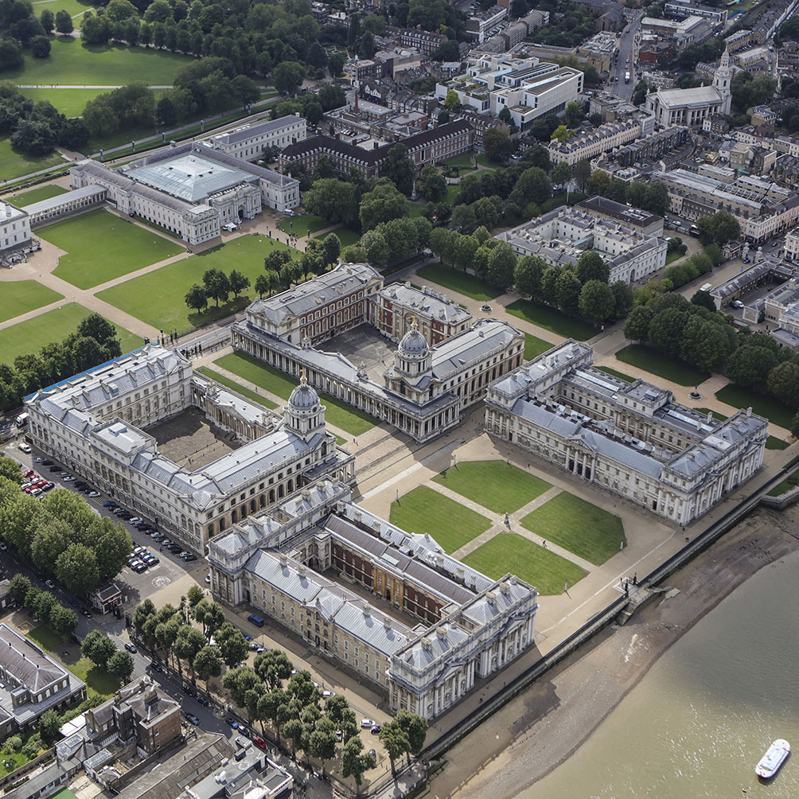
Building and Managing Networks
BUSI 1764:
Global Entrepreneurship and Innovation
Department:
Executive Business Centre
Dr Sylvester Mujakperuo
Module Leader
170223

Slide 2
LEARNING OUTCOMES
Understand the importance of networks
Understand the concept of social capital
Understand how network relationships and social capital influence the internationalisation process of INVs?

Slide 3
What are Networks?
A firm’s set of relationships, both vertical and horizontal with other organizations and entities (Gulati, Nohria and Zaheer, 2000 in Zucchalla, Hagen and Serapio, 2018)
Network relationships enable firms to gain access to a variety of resources held by others. E.g information which enables the identification and exploitation of opportunities
Source: Zucchella, Hagen and Serapio (2018)

Slide 4
Network Theory of Internationalisation
Another theory that has been commonly used to study the internationalisation of firms is the network model developed by Johanson and Mattsson (1988).
In this model it was demonstrated that firms used a variety of networks to assist their internationalisation.
The role of ties was highlighted in Johanson and Vahlne’s (1990) work; it was argued that ties between firms in various markets actually serve as bridges in order to facilitate foreign market entries.
Source: Zucchella, Hagen and Serapio (2018)

Slide 5
Importance of Network Ties
Why are network ties important to a business?

Slide 6
Importance of Networks
Access information (sometimes private)
Access to opportunities which are not available outside the network (Granovetter, 1973)
knowledge and trust are perceived as a competitive advantage (Coviello and Munro, 1995).

Slide 7
Importance of Networks Cont’d
Bridge to foreign markets
Facilitate exchange of ideas
Access to resource that a firm doesn’t have (e.g. diverse skills)

Slide 8
Ways to Network Effectively
Diagnose Your Network
Map your network
Develop social networks outside your cluster of friends or people of similar background

Slide 9
Ways to Network Effectively
Identify and use powerful brokers in your network – column 2 of your network map
Engage in shared activities – Sports clubs, charity foundations, interdepartmental activities e.t.c

Slide 10
Social Capital Definition
“the sum of the actual and potential resources embedded within, available through, and derived from the network of relationships possessed by an individual or social unit Nahapiet and Ghosal (1998:243)
Social capital comprises both the network and the assets that may be mobilised through the network”
Helps access both tangible and intangible resources held by other firms. E.g information on foreign markets
Source: Zucchella, Hagen and Serapio (2018)

Slide 11
Different Roles of Social Capital
.
Social capital
The efficacy role
The liability role
The serendipity role

Slide 12
The Efficacy Role of Social Capital
This relates to the effectiveness of the social capital of the firm.
When firms actively draw on and proactively exploit their social capital to enable internationalization Chetty and Agndal (2007)
The efficacy role helps firms to market entry and mode adaptation.
Source: Zucchella, Hagen and Serapio (2018)

Slide 13
The Serendipity Role of Social Capital
This refers to “the unexpected events arising from a firm’s social capital that trigger a mode change (Chetty & Agndal, 2007:11)
Entry mode change is not initiated by the firm but rather by serendipity
A wider network can bring more opportunities for unexpected events to initiate a mode change. Interactions within a social context can be a catalyst for new ideas and opportunities for serendipitous developments
Source: Zucchella, Hagen and Serapio (2018)

Slide 14
The Liability Role of Social Capital
This refers to “the trigger for change that occurs as a result of the high costs and amount of time required to monitor and sustain social capital poorly performing partnerships that do not accomplish the expected sales” (Chetty & Agndal, 2007:12)
Social capital may not always be beneficial, there may be risks associated with it
Over embeddedness or reliance only on the firm’s social network can limit the group’s access to new information and new ways of doing things, which can reduce its performance (Uzzi 1997).
Source: Zucchella, Hagen and Serapio (2018)

Slide 15
Strong Ties VS Weak Ties
Strong ties are people you know very well. It may be people you walk home with after work or visit on weekends or friends you interact with regularly
It could be your workplace bestie or close friend that you have known since high school
Source: Zucchella, Hagen and Serapio (2018)

Slide 16
Strong Ties VS Weak Ties
Weak ties are people you know but not very well. These are merely acquaintances
They are those you interact with at work or in your personal life only as much as you need to
If you categorize your interpersonal connections based on the above definitions, you will notice that your list of solid relationships will be much shorter than your weak ones.
Based on Granovetter’s hypotheses on social structures and information flow, doesn’t make your weak connections less valuable — they just serve a different function in your life.
Source: Zucchella, Hagen and Serapio (2018)

Slide 17
Case Study
The Bill Gates’s Network

Slide 18
Case Study Activity
The Bill Gates’s Network
What role did networks play for Bill Gates?
What type of tie/s are presented in the case study for individuals mentioned?
Diagnose and map own network

Slide 19
Case Study
The Bill Gates’s Network
Gate’s mother Mary Gates had social networks that included John Akers a high-level IBM executive (both were on the board of United Way (a charity)
She passed information to Akers about new small companies in the computer business
Microsoft eventually got invited to tender for IBM’s DOS contract which they won

Slide 20
Class Activity
Diagnose Your Network

Slide 21
Start Mapping your Network
Name of your contact | Who introduced you to the contact? | To whom did you introduce the contact to?

Slide 22
Class Activity
Network Mapping
Students to discuss their network map with group members
Students are to share with the class some of the challenges of building networks
What are the ways to overcome the identified challenges above?

Slide 23
Networking Video 1
Why is networking so important?
Networking Video 2
Expanding your network

Slide 24
CONCLUSION
170223

Slide 25
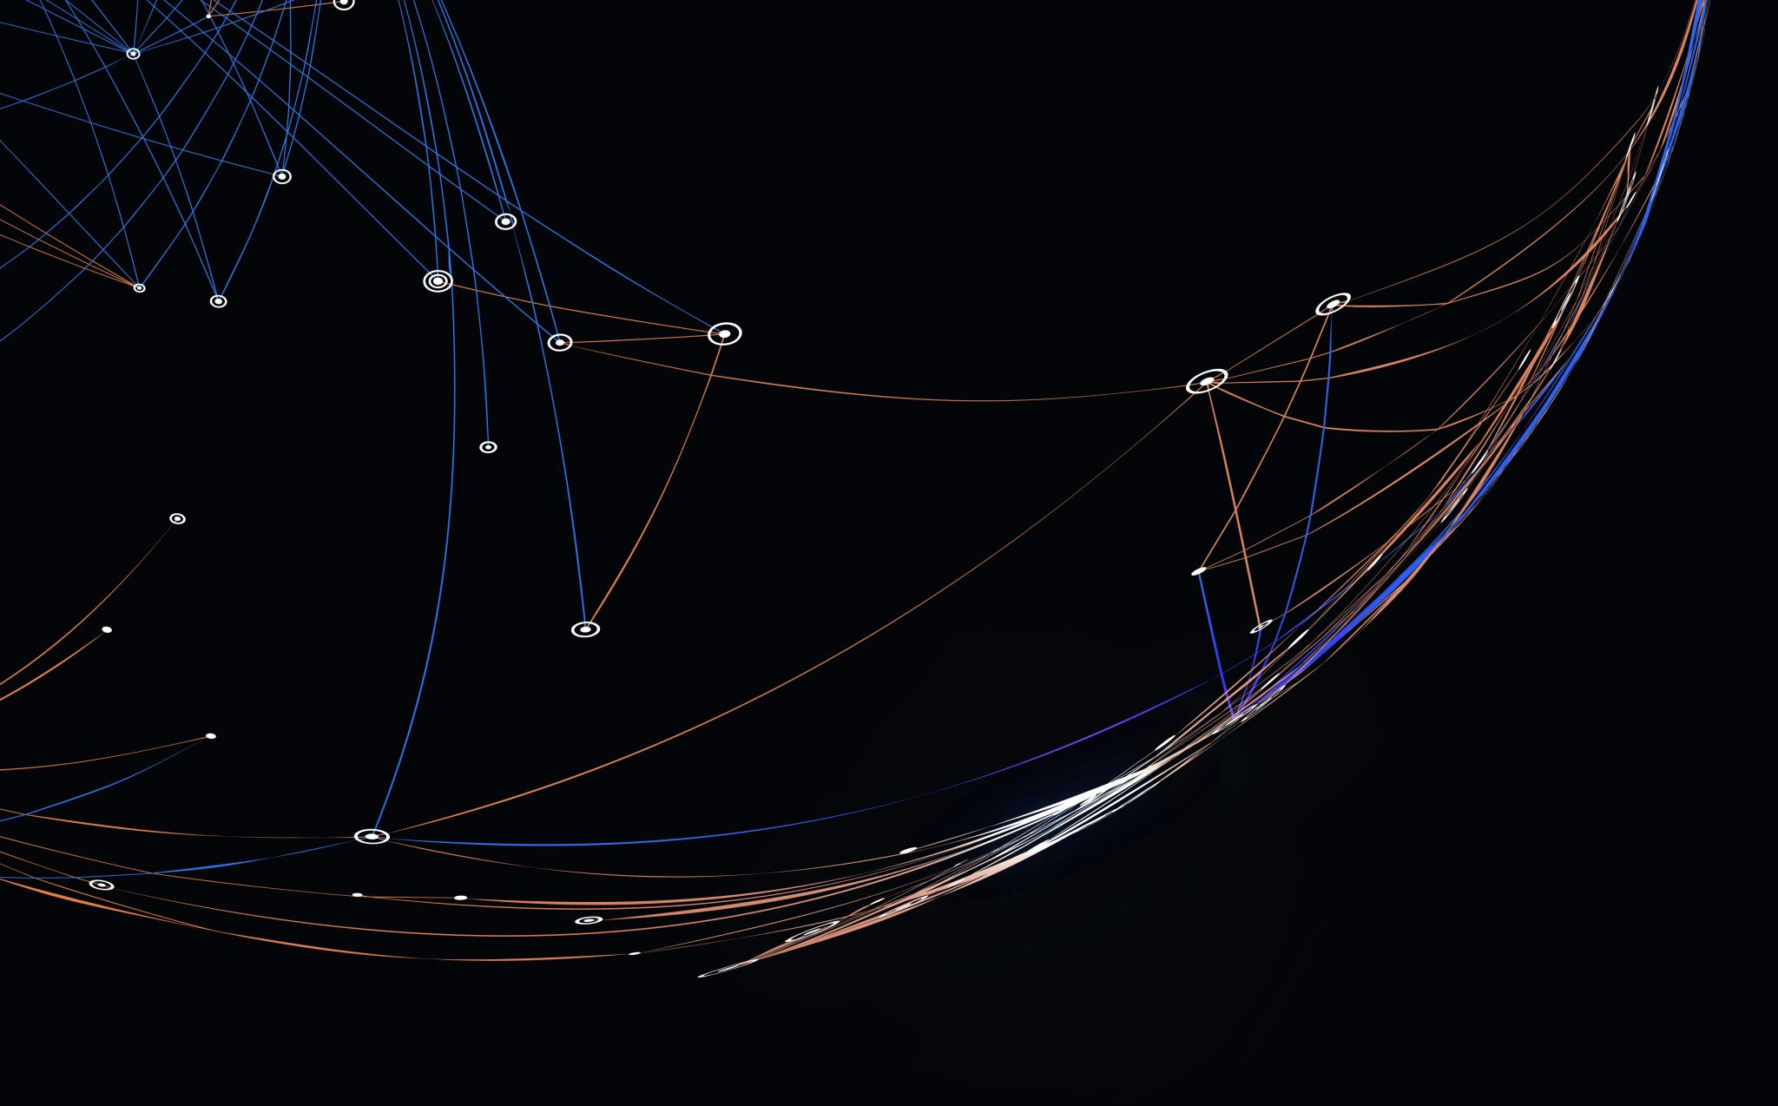
Thank you

Slide 26


Be inspired

