Slide 1

Building and Managing Networks
BUSI 1764:
Global Entrepreneurship and Innovation
Department:
Executive Business Centre
Dr Sylvester Mujakperuo
Module Leader
170223

Slide 2
LEARNING OUTCOMES
Understand the importance of networks
Understand the concept of social capital
Understand how network relationships and social capital influence the internationalisation process of INVs?

Slide 3
What are Networks?
A firm’s set of relationships, both vertical and horizontal with other organizations and entities (Gulati, Nohria and Zaheer, 2000 in Zucchalla, Hagen and Serapio, 2018)
Network relationships enable firms to gain access to a variety of resources held by others. E.g information which enables the identification and exploitation of opportunities
Source: Zucchella, Hagen and Serapio (2018)

Slide 4
Network Theory of Internationalisation
Another theory that has been commonly used to study the internationalisation of firms is the network model developed by Johanson and Mattsson (1988).
In this model it was demonstrated that firms used a variety of networks to assist their internationalisation.
The role of ties was highlighted in Johanson and Vahlne’s (1990) work; it was argued that ties between firms in various markets actually serve as bridges in order to facilitate foreign market entries.
Source: Zucchella, Hagen and Serapio (2018)

Slide 5
Network Theory of Internationalisation
The quantity/quality of weak and strong ties has a direct impact on the flow of resources. Weak ties enable new information, new ideas, new innovations, and new opportunities to enter the group (Granovetter, 1973)
Entrepreneurs with network ties abroad at the foundation of the business are more likely to internationalise
Source: Zucchella, Hagen and Serapio (2018)

Slide 6
Social Capital Definition
“the sum of the actual and potential resources embedded within, available through, and derived from the network of relationships possessed by an individual or social unit Nahapiet and Ghosal (1998:243)
Social capital comprises both the network and the assets that may be mobilised through the network”
Helps access both tangible and intangible resources held by other firms. E.g information on foreign markets
Source: Zucchella, Hagen and Serapio (2018)

Slide 7
Different roles of social capital
.
Social capital
The efficacy role
The liability role
The serendipity role

Slide 8
The Efficacy Role of Social Capital
This relates to the effectiveness of the social capital of the firm.
When firms actively draw on and proactively exploit their social capital to enable internationalization Chetty and Agndal (2007)
The efficacy role helps firms to market entry and mode adaptation.
Source: Zucchella, Hagen and Serapio (2018)

Slide 9
The Serendipity Role of Social Capital
This refers to “the unexpected events arising from a firm’s social capital that trigger a mode change (Chetty & Agndal, 2007:11)
Entry mode change is not initiated by the firm but rather by serendipity
A wider network can bring more opportunities for unexpected events to initiate a mode change. Interactions within a social context can be a catalyst for new ideas and opportunities for serendipitous developments
Source: Zucchella, Hagen and Serapio (2018)

Slide 10
Examples of Serendipity Role of Social Capital
A firm’s reputation might be strong enough to attract new unsolicited potential business partners that are not part of its existing network
Third party brokers or business partners might provide the firm with information, such as a tip about someone to contact or information about an unexploited market opportunity.
A third party, such as a government agency, a customer, or a distributor, might take a brokering role to introduce the firm to someone else.
Source: Zucchella, Hagen and Serapio (2018)

Slide 11
The Liability Role of Social Capital
This refers to “the trigger for change that occurs as a result of the high costs and amount of time required to monitor and sustain social capital poorly performing partnerships that do not accomplish the expected sales” (Chetty & Agndal, 2007:12)
Social capital may not always be beneficial, there may be risks associated with it
Over embeddedness or reliance only on the firm’s social network can limit the group’s access to new information and new ways of doing things, which can reduce its performance (Uzzi 1997).
Source: Zucchella, Hagen and Serapio (2018)

Slide 12
Examples of the Liability Role of Social Capital
The huge investments in time and money required to monitor and sustain social capital poorly performing partnerships may not be worth it (Chetty & Agndal, 2007:12)
The unexpected loss of a core network player can turn social capital from an asset into a liability (Uzzi 1997).
Source: Zucchella, Hagen and Serapio (2018)

Slide 13
Strong Ties VS Weak Ties
Strong ties are people you know very well. It may be people you walk home with after work or visit on weekends or friends you interact with regularly
It could be your workplace bestie or close friend that you have known since high school
Source: Zucchella, Hagen and Serapio (2018)

Slide 14
Strong Ties VS Weak Ties
Weak ties are people you know but not very well. These are merely acquaintances
They are those you interact with at work or in your personal life only as much as you need to
If you categorize your interpersonal connections based on the above definitions, you will notice that your list of solid relationships will be much shorter than your weak ones.
Based on Granovetter’s hypotheses on social structures and information flow, doesn’t make your weak connections less valuable — they just serve a different function in your life.
Source: Zucchella, Hagen and Serapio (2018)

Slide 15
Why are Ties Important for Firms?
Weak ties like ‘friends of friends’ can assist members of a network to access information and opportunities which are only available outside the network (Granovetter,1973; Boissevain, 1974)
Weak ties can be perceived as bridges to different sources of information and new ideas, especially when those sources do not belong to an entrepreneur’s close network (i.e. strong ties) Granovetter (1973) and Burt (2004) .
Source: Zucchella, Hagen and Serapio (2018)

Slide 16
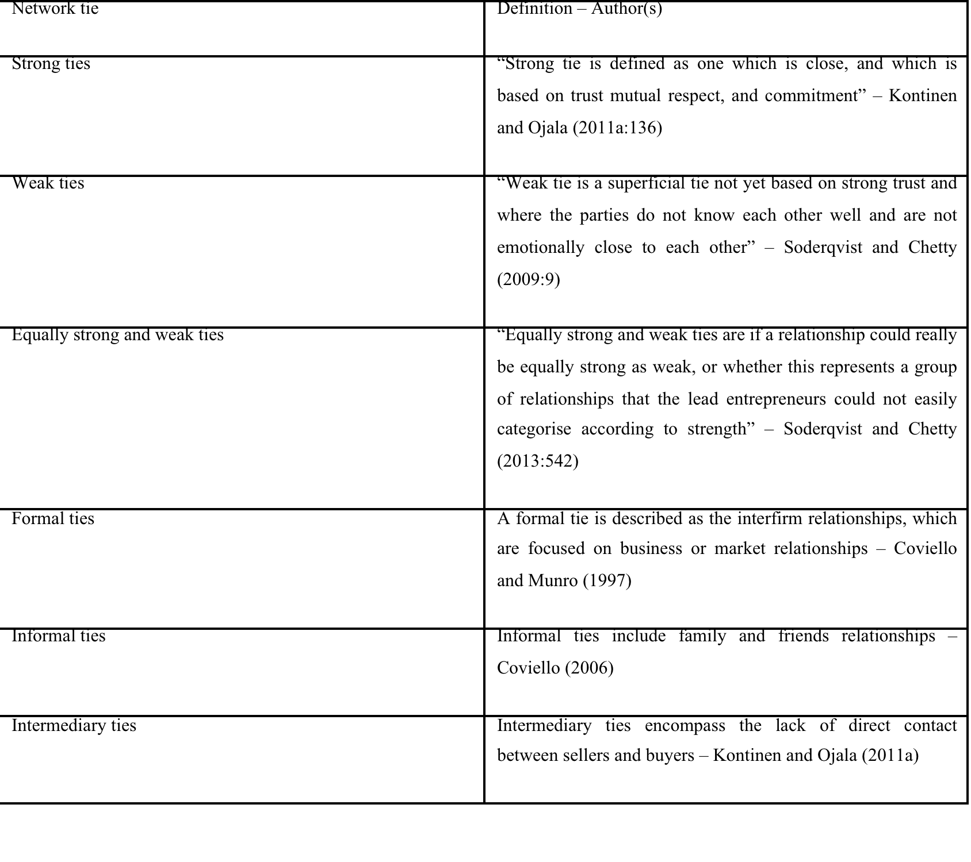
Notable Network
Ties Definitions

Slide 17
CONCLUSION
170223

Slide 18
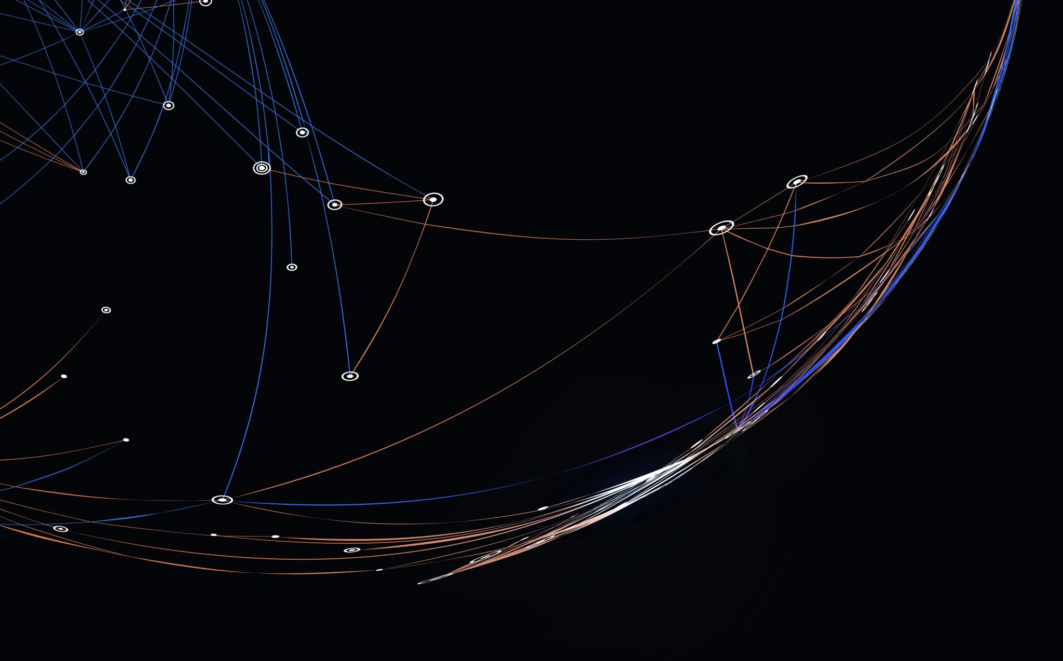
Thank you

Slide 19


Be inspired

