Slide 1

Building and Managing the International Entrepreneurial Firm
BUSI 1764 –
Global Entrepreneurship and Innovation
Week 6 Tutorial Slides
170223

Slide 2
LEARNING OUTCOMES
Understand how INVs build and sustain competitive advantage
Importance of entrepreneurial teams and governance structures
Evaluate sources of funding for entrepreneurial internationalisation

Slide 3
Building and Sustaining Competitive Advantage
Businesses need competitive advantage to be successful
Operating internationally brings a high level of competition
-There are sophisticated customers in foreign markets
-There are diverse and more advanced products
Source: Zucchella, Hagen and Serapio (2018)
Notes:
Competitive advantage refers to factors that allow a company to produce goods or services better or more cheaply than its rivals. These factors allow the productive entity to generate more sales or superior margins compared to its market rivals (https://www.investopedia.com/terms/c/competitive_advantage.asp)

Slide 4
How International Businesses Build and Sustain Competitive Advantage
By being the first mover into the new market. This has its advantages
Exposure to new technologies and industry ecosystems which can improve operations
Access to new partnerships and networks
Source: Zucchella, Hagen and Serapio (2018) www.bizjournals.com/bizjournals
Notes:
First mover advantage into new market - allows the business to build strong brand presence and customer base before competitors (https://www.bizjournals.com/bizjournals/how-to/growth-strategies/2017/12/5-benefits-of-international-expansion.html)

Slide 5
How International Businesses Build and Sustain Competitive Advantage
Differentiating products and services in the new market
Scale effect as internationalisation extends the market resulting in increase in sales value. This can help recoup fixed costs such as R&D and can increase profitability and competitiveness
Source: Zucchella, Hagen and Serapio (2018) www.bizjournals.com/bizjournals
Notes:
First mover advantage into new market - allows the business to build strong brand presence and customer base before competitors (https://www.bizjournals.com/bizjournals/how-to/growth-strategies/2017/12/5-benefits-of-international-expansion.html)

Slide 6
Choosing the right team

Slide 7
Founders of INVs – Characteristics and Competencies
Have a global mindset/international entrepreneurial orientation (usually from international experience in business or education-wise)
A composite of proactive, innovative and risk-taking behaviour makes INV founders alert to international opportunities and the ready to exploit them
Source: Zucchella, Hagen and Serapio (2018)

Slide 8
Alternative Governance Model

Slide 9
Alternative governance models
INVs often lack resources; therefore, they own small percentage of the resources required to succeed and expand internationally
INVs rely on alternative structures and modes of mobilizing resources and controlling their vital assets in order to address a triple liability:
-Liability of newness
-Liability of smallness
-Liability of foreignness
Source: Oviatt and McDougall, 1994 in Zucchella, Hagen and Serapio (2018)

Slide 10
International Entrepreneurial Finance

Slide 11
International Entrepreneurial Finance
Finance is the lifeblood of every company
For international entrepreneurial ventures, funding is particularly critical
Making the right financial decisions is critical to the development, growth, and sustained competitive advantage of the new venture.
Source: Zucchella, Hagen and Serapio (2018)

Slide 12
Sources of Funding for INVs
Family
Friends
Bootstrapping
Retained earnings
Bank Loan
WE WILL DISCUSS THESE IN A LOT MORE DETAIL WHEN WE COVER ENTREPRENEURIAL FINANCING IN WEEK 8
Source: Zucchella, Hagen and Serapio (2018)

Slide 13
Non-Traditional Sources of Funding - Crowdfunding
An example of non-traditional channels for new venture funding is crowdfunding
It is raising finance by asking a large number of people each for a small amount of money.
Crowdfunding is growing source of funding for start-ups
https://www.youtube.com/watch?v=8b5-iEnW70k
Source: Zucchella, Hagen and Serapio (2018) (https://www.ukcfa.org.uk/what-is-crowdfunding/)

Slide 14
Case Study Activity 1
(The Entrepreneur’s Access to Capital)

Slide 15
Case Study- Access to Capital for Entrepreneurs
Read…..
The Lula’s Story: Selling Kentucky Blue Snapper (page 23)
The Emily Reinhardt’s Story: A Main Street Entrepreneur (page 30)
Source: Zucchella, Hagen and Serapio (2018)

Slide 16
Case study 1- Access to Capital for Entrepreneurs
Case study questions.
What type of funding sources are described in the case studies?
What are the advantages and disadvantages of each?
Why was funding necessary at the stage that these businesses were at?
Source: Zucchella, Hagen and Serapio (2018)

Slide 17
Case Study Activity 2
(Airbnb)
Disrupting the Hotel Industry

Slide 18
Case study 2 - Airbnb
Students to read the Airbnb Case on pages 32 – 68
Case study questions.
What was unique about Airbnb that gave it a competitive edge in the industry?
In our lecture on feasibility analysis and writing a business plan, we explained that investors prefer to invest in teams rather than in ideas. Relate this to the initial investment of USD20,000 received by Airbnd and explain some of the important attributes of the founders that made the team successful
Source: Zucchella, Hagen and Serapio (2018)

Slide 19
Case Study Activity 3
(Uber)
Disrupting the Taxi Industry

Slide 20
Case study 3 - Uber
Students to read the Uber Case on pages 69 – 103
Case study questions.
Reflect on your learning on the various types of innovation as discussed in tutorial slide 1 and identify the kind of innovation at play in Uber. Explain with reasons why you think it cannot be one of the others?
Finance is lifeblood of many companies. What role did finance play to ensure the continued operation of Uber?
In your opinion, did the entrepreneurial and international experience of the founders play any role in its success?
Source: Zucchella, Hagen and Serapio (2018)

Slide 21
Video Guide on Assignment 1
(Learning Diary)
Available on the Module Page

Slide 22
For next week……
Ensure to Watch Pre-recorded Lecture on International Market Entry Strategies

Slide 23
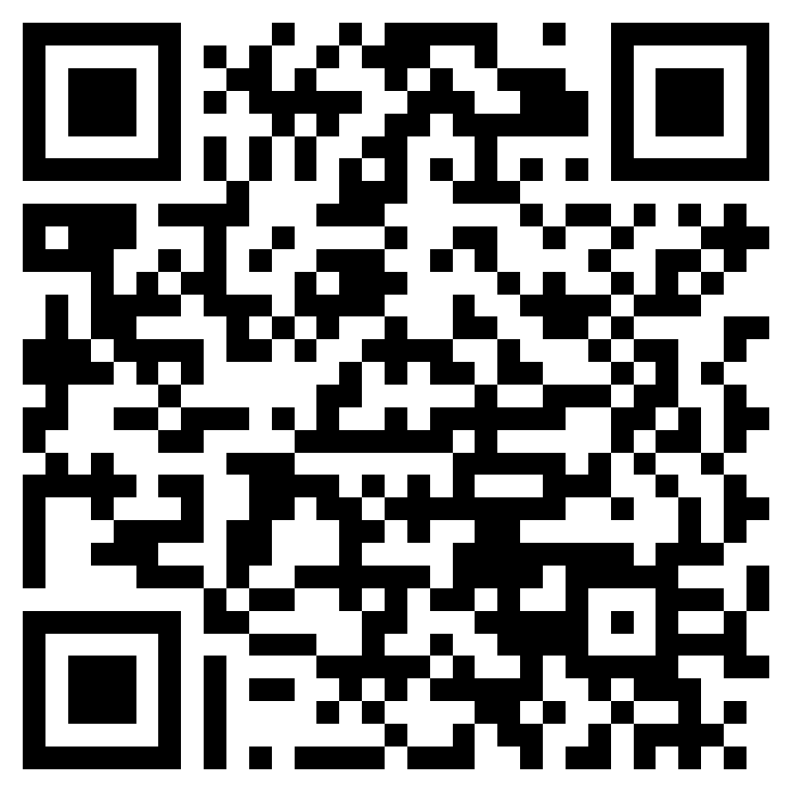
Early Module Feedback
Please take a few minutes to provide your feedback for the BUSI-1764 Module (Global Entrepreneurship and Innovation)
We highly value your feedback, and it will contribute towards improving the learning experience on the module. Thank you!
https://forms.office.com/e/krji31Eqki?origin=lprLink
Source: Zucchella, Hagen and Serapio (2018)

Slide 24
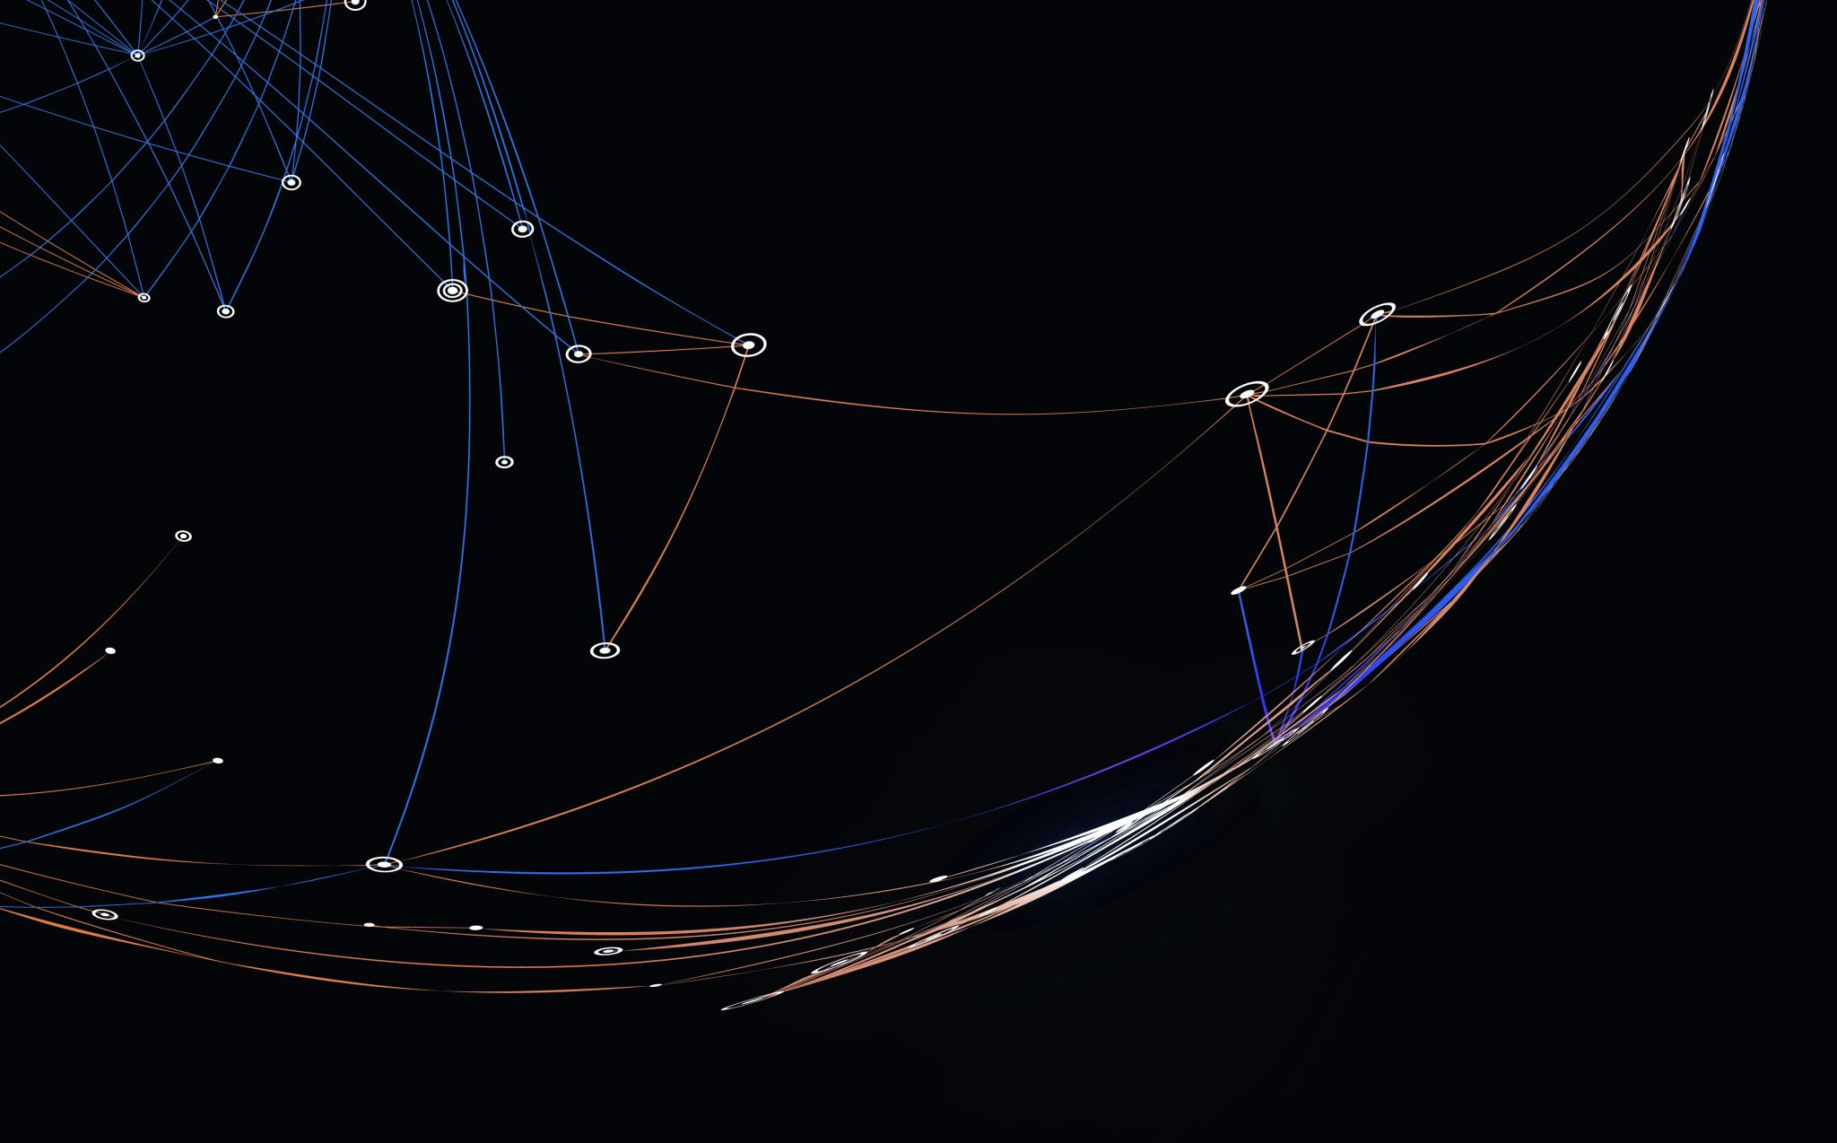
Thank you

Slide 25


Be inspired

