Slide 1
Part Two
Building and Managing the International Entrepreneurial Firm

Slide 2
Alternative Governance Model

Slide 3
Alternative governance models
INVs often lack resources; therefore, they own small percentage of the resources required to succeed and expand internationally
INVs rely on alternative structures and modes of mobilizing resources and controlling their vital assets in order to address a triple liability:
-Liability of newness
-Liability of smallness
-Liability of foreignness
Source: Oviatt and McDougall, 1994 in Zucchella, Hagen and Serapio (2018)

Slide 4
Alternative Modes of Mobilising Resources
Licensing
Franchising
INVs can generate resources with the use of networks
Networks in terms of governance depend on social (informal) control of behaviour through trust and moral obligation instead of formal contracts.
Source: Zucchella, Hagen and Serapio (2018)

Slide 5
Entrepreneurial Finance

Slide 6
International Entrepreneurial Finance
Finance is the lifeblood of every company
for international entrepreneurial ventures, funding is particularly critical
Making the right financial decisions is critical to the development, growth, and sustained competitive advantage of the new venture.
Source: Zucchella, Hagen and Serapio (2018)

Slide 7
Why Firms Need Funding
Cash flow challenges
Capital investments
Lengthy product development cycles
Source: Barringer and Ireland, 2016

Slide 8
Sources of Funding for INV
Bank loans
Friends/family/fools
Equity financing
Non-traditional sources such as peer-peer lending and crowdfunding
Source: Zucchella, Hagen and Serapio (2018)

Slide 9
CONCLUSION
170223

Slide 10
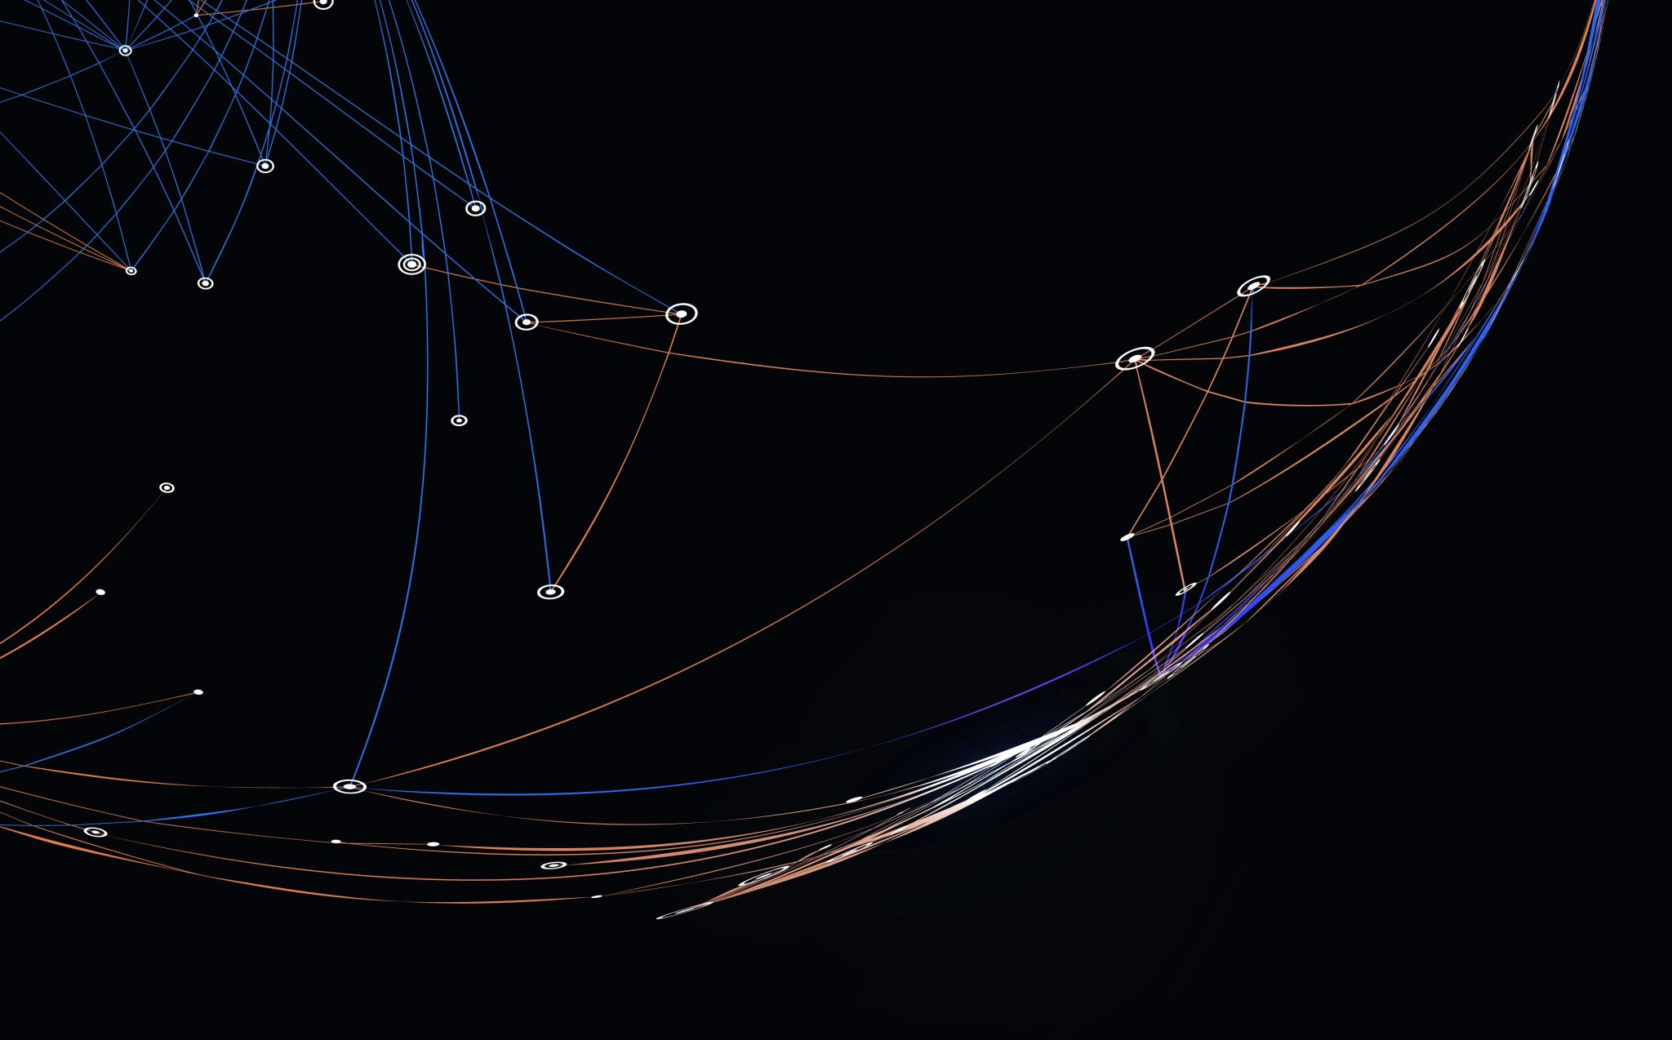
Thank you

Slide 11


Be inspired

