Slide 1

Feasibility Analysis and
Writing a Business Plan
BUSI 1764-
Global Entrepreneurship and Innovation
Department:
Executive Business Centre
Dr Sylvester Mujakperuo
Module Leader
170223

Slide 2
Learning Outcomes
To understand the importance of a feasibility analysis
To identify the stages of a feasibility analysis
To understand stages of a feasibility analysis
Understand what a business plan is
Understand who a business plan is for, and its importance
Demonstrate real life application of a business plan

Slide 3
Part One
Feasibility Analysis
170223

Slide 4
What is Feasibility Analysis?
When do we do it?
How does it differ from a business plan?

Slide 5
Importance of a Feasibility Analysis
Determine viability
Avoid substantial waste of resources and time
The big picture – ask important questions
May offer new opportunities/alternatives

Slide 6
Youtube video on importance of feasibility analysis - Google Search
170223

Slide 7
Key Stages of a Feasibility Analysis
Product/Service Feasibility
Industry/Target Market Feasibility
Organizational Feasibility
Financial Feasibility

Slide 8
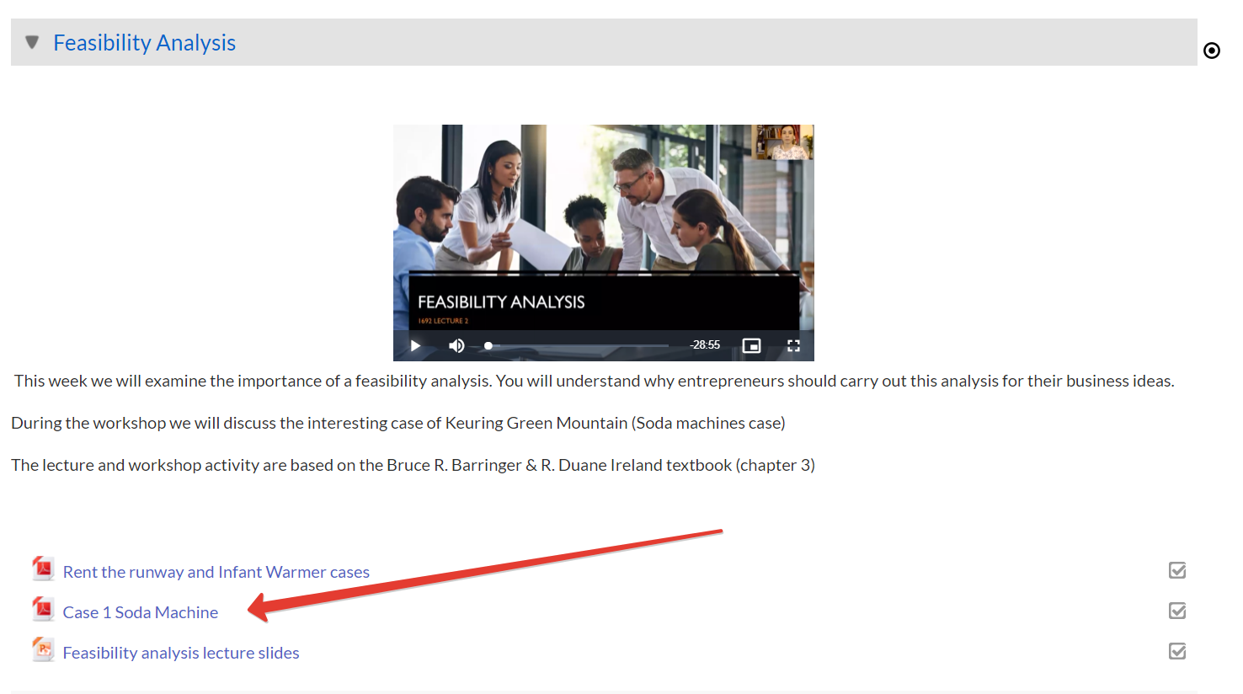
Open and read the Keurig At Home Soda Machines Case Study

Slide 9
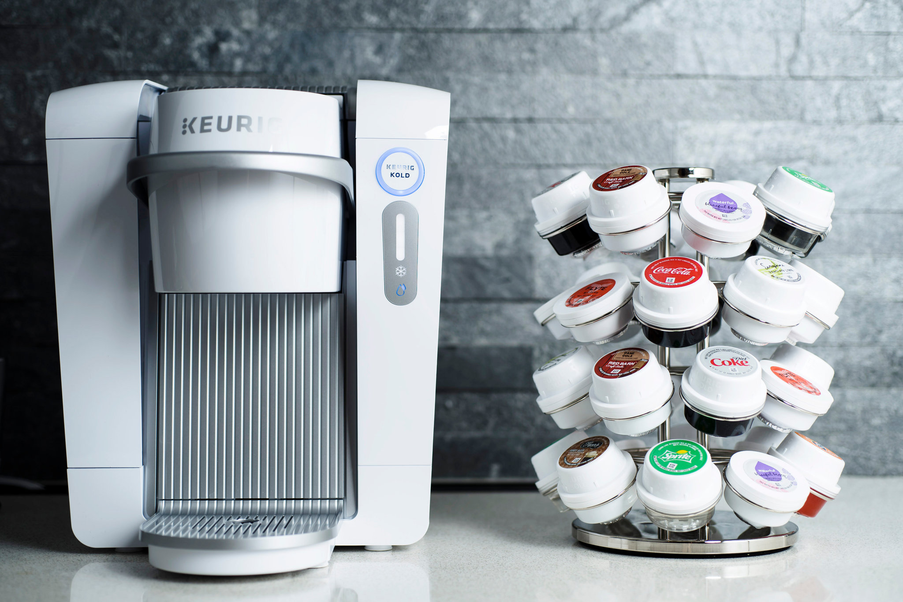
Keurig At-Home Soda Machine
1. Of all the five facts that contributed to Kold’s failure, which one do you think was the most damaging? Explain your answer.

Slide 10
Keurig At-Home Soda Machine
2. Describe the feasibility analysis that Keurig Kold should have conducted prior to the Kold’s debut.
3. Do you think Keurig would have produced the same product if they had followed your recommendations?
4. In what ways do you think the product would have been different?

Slide 11
Keurig At-Home Soda Machine
5. Why is it so difficult to change people’s behaviour? How would you have gone about convincing people that making soda in their home is a good idea?

Slide 12
Part Two
Writing a Business Plan
170223

Slide 13
Class Quiz
What is a Business Plan?
Why Write a Business Plan?
When do you write a business plan?
170223

Slide 14
What is a Business Plan?
It is a written narrative/document that describes:
What a new business plans to accomplish
How it plans to accomplish it.
Typically, 25 -35 pages long

Slide 15
Why Write a Business Plan?
Dual purpose - internal and external
Helps get employees’ ‘buy in’ in the vision, mission and goals of the organization
helps develop a “road map” to follow in executing its strategies and plans.
introduces the business to potential investors and other stakeholders
Helps ‘sell’ the business idea the firm is pursuing and how it plans to pursue it.

Slide 16
When to write a Business Plan
Towards the end of the entrepreneurial process titled “Moving from an Idea to an Entrepreneurial Firm.”
After feasibility analysis stage of investigating the merits of a potential new venture.
When you have substantial details about the new venture
It is a mistake to write a full business plan too early

Slide 17
Business Plan Outline
Executive Summary
Industry Analysis
Company Description
Market Analysis
The Economics of the Business
Marketing Plan
Product (or Service) Design and Development Plan
Operations Plan
Management Team and Company Structure
Overall Schedule
Financial Projections

Slide 18
Writing a business plan youtube video - Google Search
170223

Slide 19
Practical Application of a Business Plan
Case-Study Exercises
Each groups will discuss all 4 of the business scenarios below and present their answers to the entire class.

Slide 20
Practical Application of a Business Plan
Case 1:
A good friend of yours, Andrew Waters, has decided to leave his corporate job in order to launch a private SEO (search engine optimization) consulting firm. He is putting together a business plan for this venture and says the following to you, “I’ve read several books and articles about how to write a business plan, and there is a point about which I am still a bit confused. Is a business plan written more for learning and discovering or is it written more for pitching and selling?” What would you say to Andrew in response to his question?

Slide 21
Practical Application of a Business Plan
Case 2:
Josh White has a brilliant idea—an e-payment business using online payment kiosks. He is looking for investors to fund his business, and he has called on you for advice on writing a good business plan to do so. He needs a structured plan detailing how the potential of his ideas may be achieved and is anxious that it might look hastily put together. Advise Josh on some of the pitfalls that he should avoid while preparing the plan.

Slide 22
Practical Application of a Business Plan
Case 3:
Ginny Welch is proposing to start a wellness centre and needs to prepare a market analysis for her business plan for a loan provider. The analysis is due in the next two weeks, but she does not know what to write and who her target market is—all she knows is that her potential customers are those who seek a healthy lifestyle. She has completed her industry analysis but only recently learned the difference between market analysis and industry analysis. What is the next step she should take to complete the market analysis?

Slide 23
Practical Application of a Business Plan
Case 4:
Two co-founders have $100,000 each that they are prepared to invest in a new business venture. A third potential co-founder actually came up with the business idea but has no funds to invest in the business. How would you divide the equity in this instance when two of the partners have money to invest and the third has the idea and will actually be doing most of the work? Is this an issue that can make or break a new venture?

Slide 24
Be the Venture Capitalist
Two start-ups (Beyond Meat and Go-Jek) are pitching in front of investors. Your VC fund is assessing whether you will invest in the start-ups or not. Use a scorecard to evaluate all the criteria and explain your decision. Decide within your team whether you will invest in these companies or not.

Slide 25
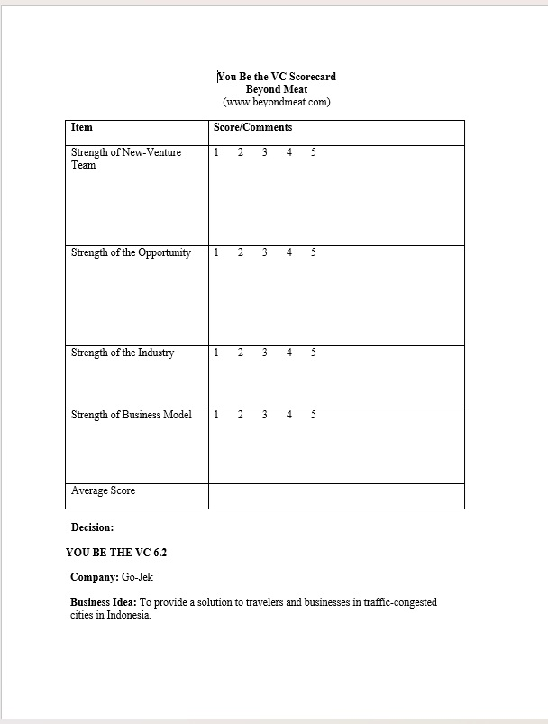
Student’s Scoreboard

Slide 26
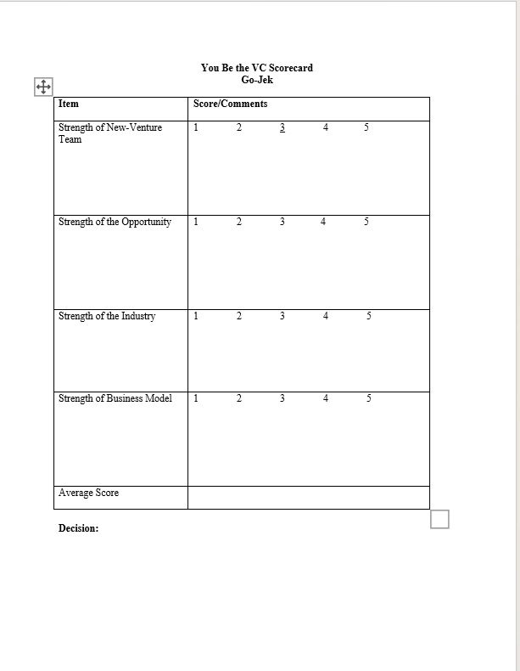
Student’s Scoreboard

Slide 27
Tutor’s Scoreboard

Slide 28
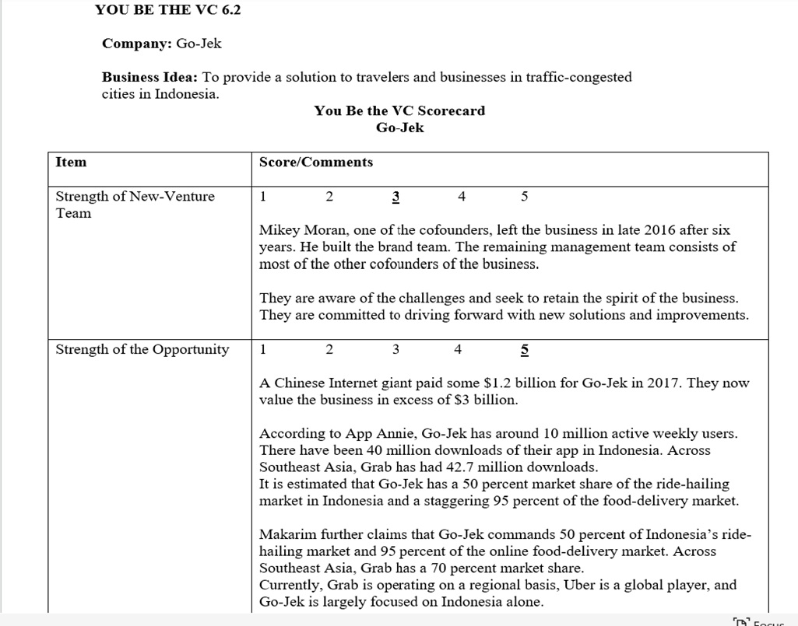
Tutor’s Scoreboard

Slide 29
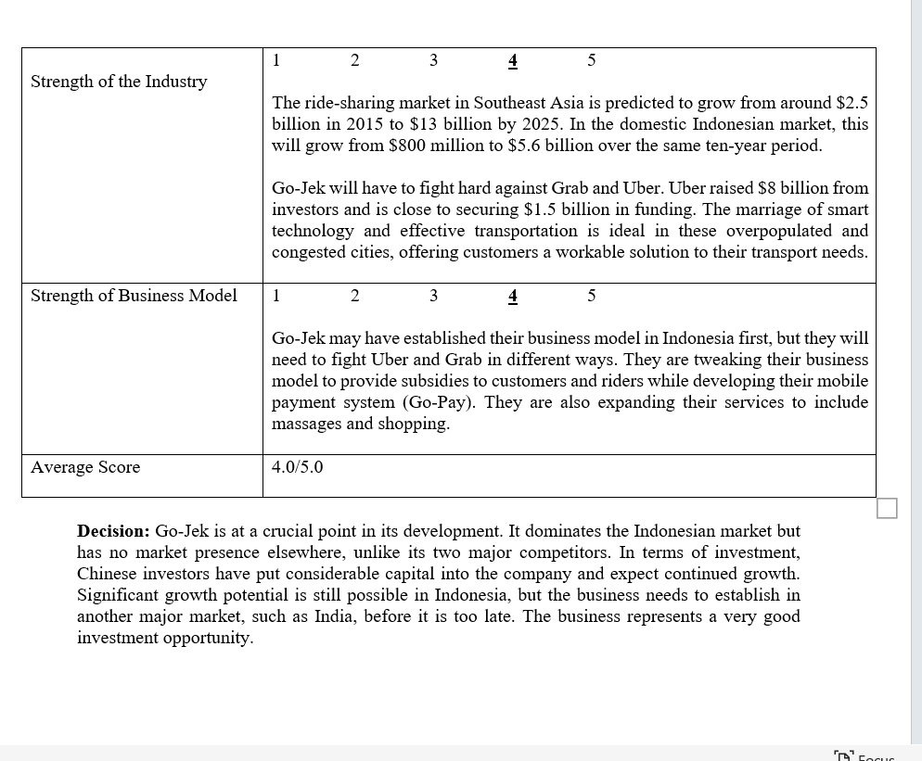
Tutor’s Scoreboard

Slide 30
Reflective report
Submit your one-page Reflective report by this Friday 23:30
Group Task:
Choose one case study (Either Infant warmers or Rent the Runway); answer questions after the case.

Slide 31
For Next Week…..
Watch the pre-recorded lecture on Building and Managing the International Entrepreneurial Firm before the tutorial

Slide 32

Thank you

Slide 33


Be inspired

