Slide 1
PART 2
WRITING A BUSINESS PLAN
170223

Slide 2
Learning Outcomes
Understand what a business plan is
Understand who a business plan is for and its importance
Understand the outline of a business plan

Slide 3
What is a Business Plan?
Business Plan
  A business plan is a written narrative, typically 25 to 35 pages long, that describes what a new business intends to accomplish and how it intends to accomplish it.
Dual-Use Document
  For most new ventures, the business plan is a dual-purpose document that is used both inside and outside the firm.

Slide 4

Who Reads the Business Plan—and What Are They Looking For?
A Firm’s Employees
Investors and other external stakeholders
A clearly written business plan helps the employees of a firm operate in sync and move forward in a consistent and purposeful manner.
A firm’s business plan must make the case that the firm is a good use of an investor’s funds or the attention of others.

Slide 5
Contents of a Business plan
The business plan should give clear and concise information on all the important aspects of the proposed venture.
It must be long enough to provide sufficient information yet short enough to maintain reader interest.
For most plans, 25 to 35 pages is sufficient.

Slide 6
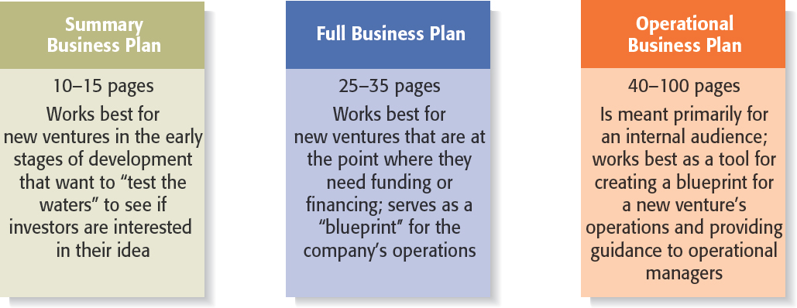
TYPES OF BUSINESS PLANS

Slide 7

THINGS TO CONSIDER
Recognizing the Elements of the Plan May Change
  It’s important to recognize that the plan will usually change while written.
  New insights invariably emerge when an entrepreneur or a team of entrepreneurs immerse themselves in writing the plan and start getting feedback from others.

Slide 8
BUSINESS PLAN OUTLINE
Executive Summary
Industry Analysis
.Company Description
Market Analysis
The Economics of the Business
Marketing Plan
Product (or Service) Design and Development Plan
Operations Plan
Management Team and Company Structure
Overall Schedule
Financial Projection

Slide 9
EXECUTIVE SUMMARY
  The executive summary is a short overview of the entire business plan.
  It provides a busy reader with everything that needs to be known about the new venture’s distinctive nature.
  An executive summary shouldn’t exceed two single-spaced pages.
  Even though the executive summary appears at the beginning of the business plan, it should be written last.
  The plan itself will evolve as it’s written, so not everything is known at the outset.

Slide 10
INDUSTRY ANALYSIS
  This section should begin by describing the industry the business will enter in terms of its size, growth rate, and sales projections.
  Items to include in this section:
  Industry size, growth rate, and sales projections.
  Industry structure.
  Nature of participants.
  Key success factors.
  Industry trends.
  Long-term prospects.

Slide 11
COMPANY DESCRIPTION
  This section begins with a general description of the company.
  Items to include in this section:
  Company description.
  Company history.
  Mission statement.
  Products and services.
  Current status.
  Legal status and ownership.
  Key partnerships (if any).

Slide 12
MARKET ANALYSIS
  The market analysis breaks the industry into segments and zeroes in on the specific segment (or target market) to which the firm will try to appeal.
  Items to include in this section:
    Market segmentation and target market selection.
    Buyer behavior.
    Competitor analysis.
    Estimate of the firm’s annual sales and market share.

Slide 13
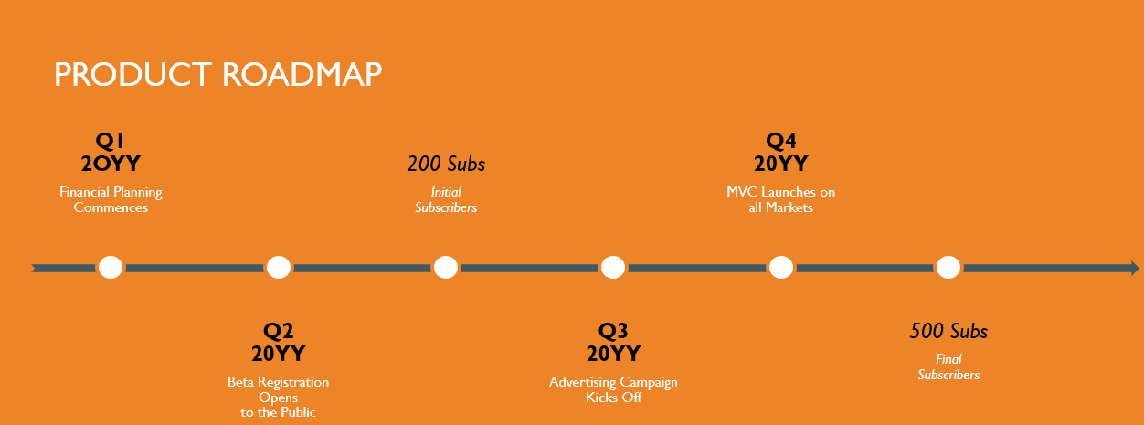
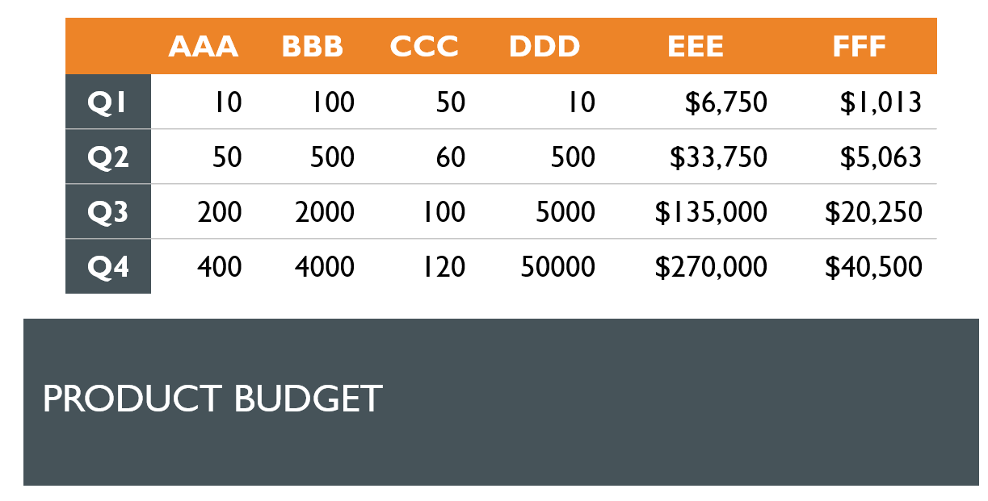
ECONOMICS OF THE BUSINESS
  This section addresses the basic logic of how profits are earned in the business and how many units of a business’s profits must be sold for the business to “break even” and then start earning a profit.
  Items to include in this section:
    Revenue drivers and profit margins.
    Fixed and variable costs.
    Operating leverage and its implications.
    Start-up costs.
    Break-even chart and calculations.

Slide 14
MARKETING PLAN OF THE BUSINESS
  The marketing plan focuses on how the business will market and sell its product or service.
  Items to include in this section:
    Overall marketing strategy.
    Product, price, promotions, and distribution.
    Sales process (or cycle).
    Sales tactics.

Slide 15
PRODUCT OR SERVICE DESIGN AND DEVELOPMENT PLAN
  If you’re developing a completely new product or service, you need to include a section in your business plan that focuses on the status of your development efforts.
  Items to include in this section:
    Development status and tasks.
    Challenges and risks.
    Projected development costs.
    Proprietary issues (patents, trademarks, copyrights, licenses, brand names).

Slide 16
OPERATIONS PLAN
  Outlines how your business will be run and how your product or service will be produced.
  A useful way to illustrate how your business will be run is to describe it in terms of “backstage” (unseen to the customer) and “front stage” (seen by the customer) activities.
  Items to include in this section:
    General approach to operations.
    Business location.
    Facilities and equipment.

Slide 17
MANAGEMENT TEAM &
COMPANY STRUCTURE
  The management team of a new venture typically consists of the founder or founders and a handful of key management personnel.
  Items to include in this section:
    Management team.
    Board of directors (if you have one).
    Board of advisors (if you have one).
    Company structure.
  .

Slide 18
OVERALL SCHEDULE
  A schedule should be prepared that shows the major events required to launch the business.
  The schedule should be in the format of milestones critical to the business’s success.
  Examples of milestones:
    Incorporating the venture.
    Completion of prototypes.
    Rental of facilities.
    Obtaining critical financing.
    Starting production.
    Obtaining the first sale.

Slide 19
FINANCIAL PROJECTIONS
  The final section of a business plan presents a firm’s pro forma (or projected) financial projections.
  Items to include in this section:
    Sources and uses of funds statement.
    Assumptions sheet.
    Pro forma income statements.
    Pro forma balance sheets.
    Pro forma cash flows.
    Ratio analysis.

Slide 20

Presenting the Business Plan to Investors
The Oral Presentation
  The first rule in making an oral presentation is to follow directions. If you’re told you have 20 minutes, don’t talk for more than the allotted time.
  The presentation should be smooth and well-rehearsed.
  The slides should be sharp and not cluttered.
Questions and Feedback to Expect from Investors
  The smart entrepreneur has a good idea of the questions that will be asked, and will be prepared for those queries.

Slide 21
12 PowerPoint Slides to Include in an Investor Presentation
Title Slide
Problem
Solution
Opportunity and target market
Technology
Competition
Marketing and sales
Management team
Financial projections
Current status
Financing sought
Summary

Slide 22

Thank you

Slide 23


Be inspired

