Slide 1

Feasibility Analysis
BUSI 1764
Global Entrepreneurship and Innovation
Department: Executive Business Centre
170223

Slide 2
Learning Outcomes
To understand the importance of a feasibility analysis
Identify stages of a feasibility analysis
To understand stages of a feasibility analysis

Slide 3
What is Feasibility Analysis?
Feasibility analysis is the process of determining whether a business idea is viable.
Preliminary evaluation of a business idea, conducted for the purpose of determining whether the idea is worth pursuing.
NOT A BUSINESS PLAN

Slide 4
When to Conduct a Feasibility Analysis
  Early on in thinking through the prospects for a new business.
  The thought is to screen ideas before you begin to commit resources to them

Slide 5
Importance of a Feasibility Analysis
Determine viability
Avoid substantial waste of resources and time
The big picture – ask important questions
May offer new opportunities/alternatives

Slide 6
Stages of a Feasibility Analysis
Product/Service Feasibility
Industry/Target Market Feasibility
Organizational Feasibility
Financial Feasibility

Slide 7
Outline of a Feasibility Analysis
Part 1: Product/Service Feasibility
Product/service desirability
Product/service demand
Part 2: Industry/Target Market Feasibility
Industry attractiveness
Target market attractiveness
Part 3: Organizational Feasibility
Management prowess
Resource sufficiency
Part 4: Financial Feasibility
Total start-up cash needed
Financial performance of similar businesses
Overall financial attractiveness of the proposed venture
Overall Assessment

Slide 8

1. Product/Service Desirability
Product desirability
Product demand

Slide 9
1.2 Product/Service Desirability
  There are three steps to assessing product/service demand.
  Step 1: Talking Face-to-Face with Potential Customers
  Step 2: Conducting a survey
  Step 3: Carrying out a Gumshoe Research
Notes:
Gumshoe Research is a method of analyzing the likely demand of a proposed product or service. Gumshoe is an investigator or detective that looks around for the information or clues wherever they can be found. They use their interaction with people, observation for analyzing the demand of the product.

Slide 10

2. Industry/Target Market Feasibility Analysis
Components of industry/target market feasibility analysis
Industry Attractiveness
Target Market Attractiveness

Slide 11
2.1 Industry Attractiveness
Characteristics of Attractive Industries
Are young rather than old.
Are early rather than late in their life cycle.
Are fragmented rather than concentrated.
Are growing rather than shrinking.
Are selling products and services that customers “must have” rather than “want to have.” (FMCG)
Are not crowded.
Have high rather than low operating margins.
Are not highly dependent on the historically low price of a key raw material, like gasoline or flour, to remain profitable

Slide 12
2.2 Target Market Attractiveness
  Must be large enough for the proposed venture but too small to attract larger competitors.
  Assessing the attractiveness of a target market is tougher than assessing the attractiveness of an entire industry.
  Ingenuity must be employed to find information to assess the attractiveness of a specific target market.

Slide 13

3. Organizational Feasibility Analysis
Components of organizational feasibility analysis
Management Prowess
Resource Sufficiency

Slide 14
3.1 Management Prowess
  Two of the most important factors in this area are:
    The passion that the sole entrepreneur or the founding members have for the business idea.
    The extent to which the sole entrepreneur or the founding team understands the markets in which the firm will participate.

Slide 15
3.2 Resource Sufficiency 1.1
  Test of resource sufficiency:
  A firm should list the 6 to 12 most critical nonfinancial resources that will be needed to move the business idea forward successfully.
    If critical resources are not available in certain areas, it may be impractical to proceed with the business idea.

Slide 16
3.3 Resource Sufficiency 1.2
Examples of nonfinancial resources that may be critical to the successful launch of a new business
Affordable office space.
Lab space, manufacturing space, or space to launch a service business.
Availability of contract manufacturers or service providers.
Key management employees (now and in the future).
Key support personnel (now and in the future).
Ability to obtain intellectual property protection.
Ability to form favorable business partnerships.

Slide 17

4 Financial Feasibility Analysis
.Components of financial feasibility analysis
Total Start-Up Cash Needed
Financial Performance of Similar Businesses
Overall Financial Attractiveness of the Proposed Venture

Slide 18
4.1 Total Start-Up Cash Needed
  This refers to the total cash needed to prepare the business to make its first sale.
  An actual budget should be prepared that lists all the anticipated capital purchases and operating expenses needed to generate the first $1 in revenues.
  The point of this exercise is to determine if the proposed venture is realistic given the total start-up cash needed.

Slide 19
4.2 Financial Performance of Similar Businesses
  Estimate the proposed start-up’s financial performance by comparing it to similar, already established businesses.
  There are several ways to doing this, all of which involve a little ethical detective work.
    First, there are many reports available, some for free and some that require a fee, offering detailed industry trend analysis and reports on thousands of individual firms.
    Secondly, conduct a simple observational research. For example, the owners of New Venture Fitness Drinks could estimate their sales by tracking the number of people who patronize similar restaurants and estimating the average amount each customer spends

Slide 20
4.3 Overall Financial Attractiveness of the Proposed Venture
Financial Factors Associated With Promising Business Opportunities
Steady and rapid growth in sales during the first 5 to 7 years in a clearly defined market niche.
High percentage of recurring revenue—meaning that once a firm wins a client, the client will provide recurring sources of revenue.
Ability to forecast income and expenses with a reasonable degree of certainty.
Internally generated funds to finance and sustain growth.
Availability of an exit opportunity for investors to convert equity to cash.

Slide 21
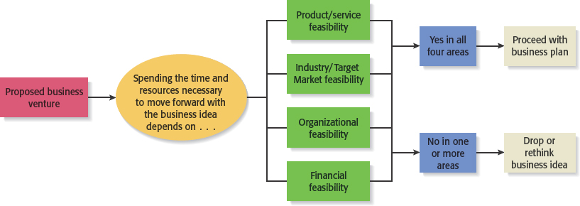
How important is Feasibility Analysis in Developing Successful Business Ideas?

Slide 22
CONCLUSION
170223

Slide 23
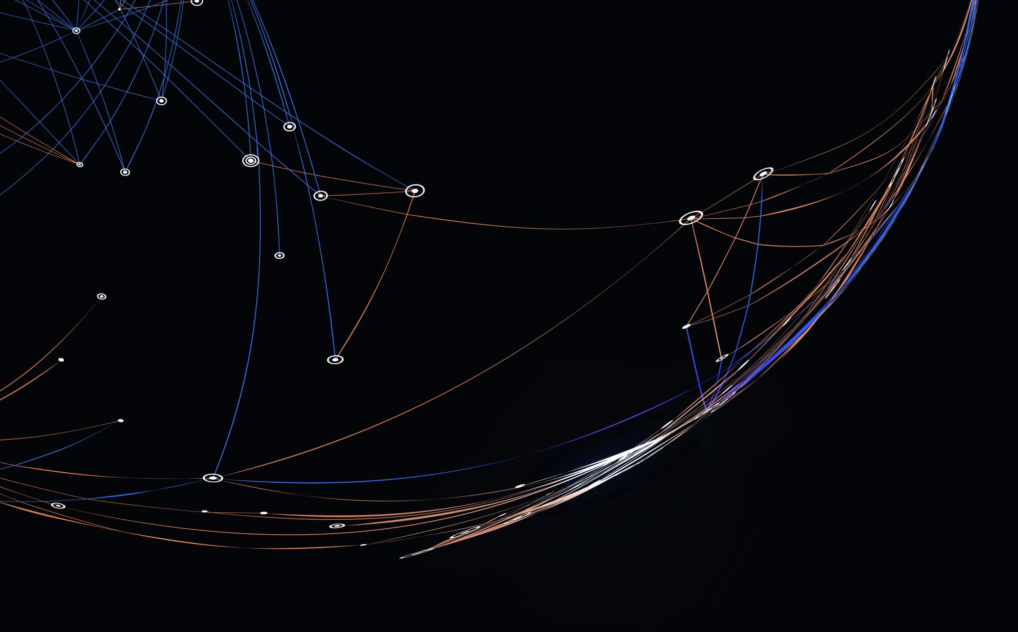
Thank you

Slide 24


Be inspired

