Slide 1

Social Entrepreneurship
BUSI 1764-
Global Entrepreneurship and Innovation
Week 4 Tutorials
Dr Sylvester Mujakperuo
Module Leader
170223

Slide 2
Learning Outcomes
To understanding the concepts of Social Entrepreneurship and International Social Entrepreneurship
Understand the importance and need for social entrepreneurs
To Identify some innovative ways of tackling social problems

Slide 3
Introduction
What is Social Entrepreneurship?
Who are Social Entrepreneurs?

Slide 4
WHAT IS SOCIAL ENTREPRENEURSHIP?
The organization of a business around specific social and environmental causes.
It includes both for-profit and non-profit organizations including charities
Social entrepreneurs differ from traditional entrepreneurs in that their main drive is to make a difference in the world or in their communities. They often have personal experience with the social causes that they support. This inspires their business mission.

Slide 5
WHAT IS SOCIAL ENTREPRENEURSHIP?
Animated video explaining social entrepreneurship

Slide 6
Examples of Social Problems

Slide 7
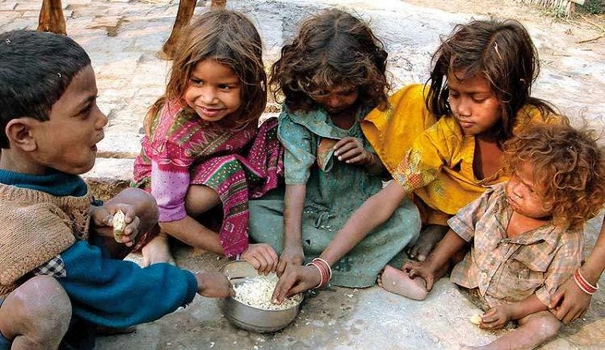
Tackling Poverty
Faces of some of the world’s poorest people
170223

Slide 8
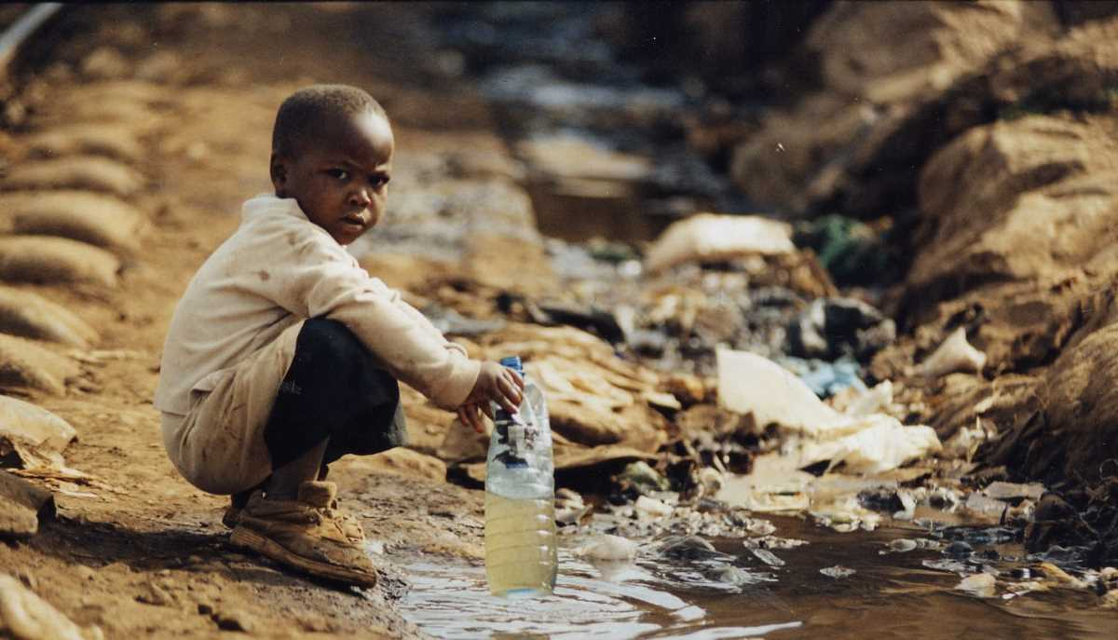
Faces of some of the world’s poorest people
LACK OF ACCESS TO SAFE DRINKING WATER
170223

Slide 9
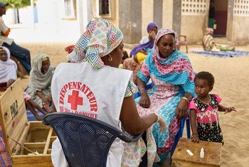
More than half of people around the world do not have access to the basic healthcare services
170223

Slide 10
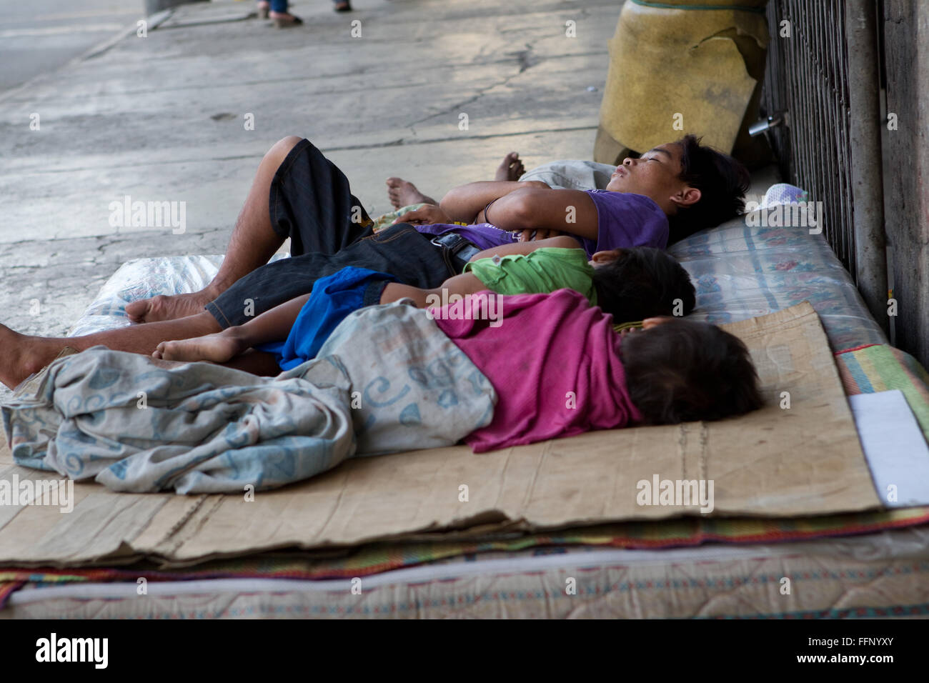
ABSENCE OF AFFORDABLE SHELTER
170223

Slide 11
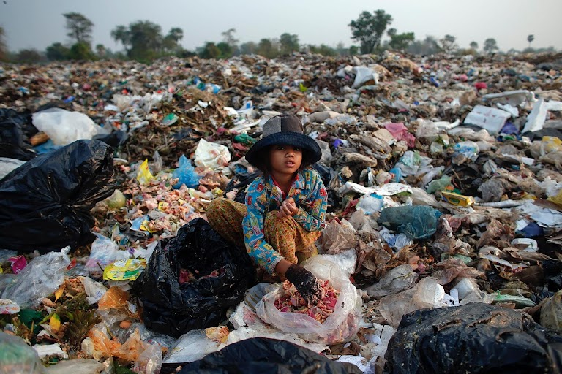
POVERTY
170223

Slide 12
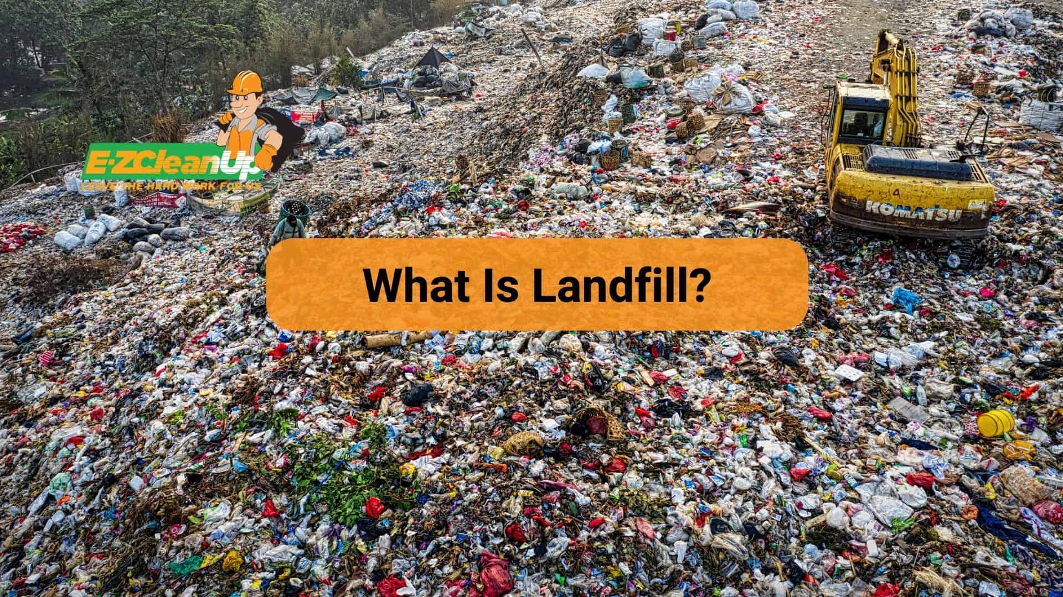
What are Landfills and why are they harmful to the environment?
The decomposing waste emit Methane which is a potent greenhouse gas harmful to the environment
170223

Slide 13
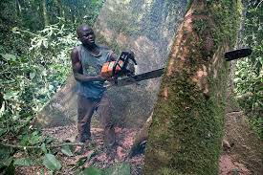
Deforestation in Sub-Saharan Africa:
What are the likely implications?
Loss of habitat for millions of plants and animal species and increasing the severity of global warming
170223

Slide 14

High Level of unemployment
170223

Slide 15
SOME USEFUL STATISTICS….
Over 3 billion people worldwide live on less than USD2.5 a day
One billion children around the world live in poverty
Over 1 billion people do not have access to clean water
1 in 7 children have no access to healthcare
1 in 3 children are without adequate shelter
22,000 children die everyday in the developing world from largely preventable illnesses/diseases

Slide 16
Now, we have a clear understanding of what social problems are.
So….
Who are Social Entrepreneurs?

Slide 17
SOCIAL ENTREPRENEURSHIP
(PIONEERING SOCIAL CHANGE)
https://www.youtube.com/watch?v=jk5LI_WcosQ

Slide 18
THE MUHAMMAD YUNUS STORY
(HIGHLIGHTS)
His observations in a Bangladesh village in 1974: Craftspeople were skilled but limited by credit availability
The opportunity he saw: Micro-loans, with no collateral and low interest, could improve their lives
The results: Very high loan repayment; Creation of the Grameen Bank; Nationwide adoption
The recognition: Professor Yunus won the 2006 Nobel Peace Prize; Grameen is a famous model of Social Entrepreneurship

Slide 19
USEFUL FACTS ABOUT SOCIAL ENTERPRISES
The goal is to alleviate some of society’s most pressing issues
Unlike other businesses, social enterprises directly addresses intractable social need
They are different from nonprofits organisations in that Social enterprises are commercial organisations with revenue drivers
While Nonprofits rely on funding through governmental organizations, grants, and donors, social enterprises create a source of
funding themselves through generating their own profit.

Slide 20
CREATIVITY AND INNOVATION OF SOCIAL ENTREPRENEURS
(CONSIDER SCHUMPETER’S CREATIVE DESTRUCTION)
Offer new product or service
Develop new process or technology for producing or delivering an existing product, service, program or project
Deliver existing product, service, program, or project to a new or previously underserved market
Use new source of supply of raw materials and resources
Design organization structure
Utilize new source of labour or other production inputs
Create new funding models

Slide 21
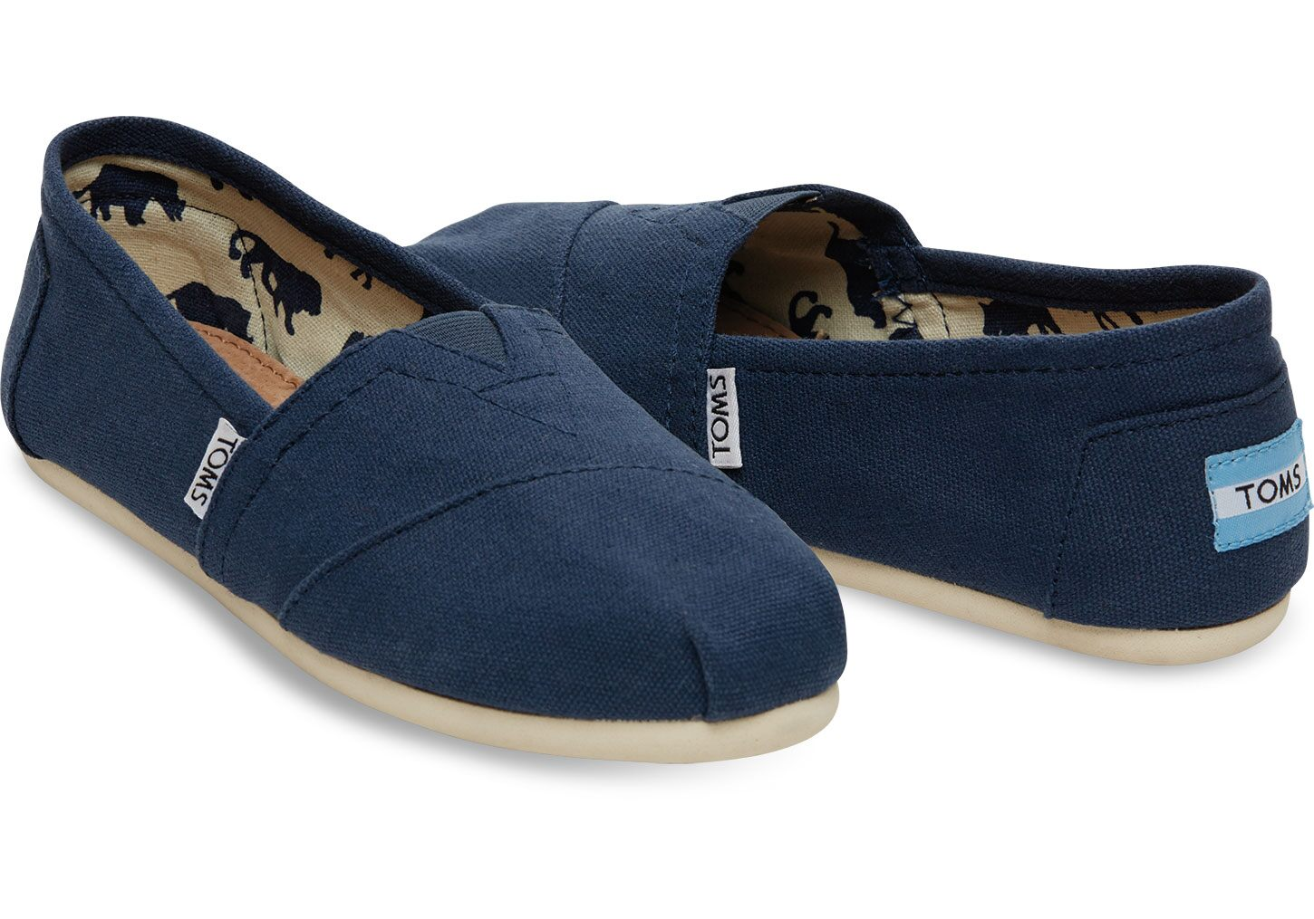
VIDEO EXPLAINING SOCIAL ENTREPRENEURSHIP
(TOMS)
https://www.youtube.com/watch?v=C4AXv-jFszs

Slide 22
Global ENTREPRENEURSHIP AND SOCIAL ENTREPRENEURSHIP
The analysis of approaches and models adopted by social enterprises to enter a foreign market with the aim of addressing a social need and being financially successful at the same time is particularly interesting

Slide 23
INTERNATIONAL SOCIAL ENTREPRENEURS (ISE)
ISEs need an in-depth understanding of the local context
For an ISE, networks are particularly important. Networks allow the flow of information and learning
Business model must be designed around the centrality of the social mission of the firm to guarantee success
Social Entrepreneurs also need mission-aligned partners on board for both the acquisition of resources and capabilities and for getting the addressed population’s trust and legitimacy

Slide 24
CLASS ACTIVITY
In groups, students are to discuss and identify at least one social problem that exist in their various localities back home and come up with an innovative way of tackling the problem whilst at the same time also making money from it.
How will the solution be replicated internationally?

Slide 25
PART 2
(GUIDANCE ON ASSIGNMENT 1)
SEE MODULE HANDBOOK

Slide 26
Next week’s Topic…..
Feasibility Analysis and Writing a Business Plan

Slide 27
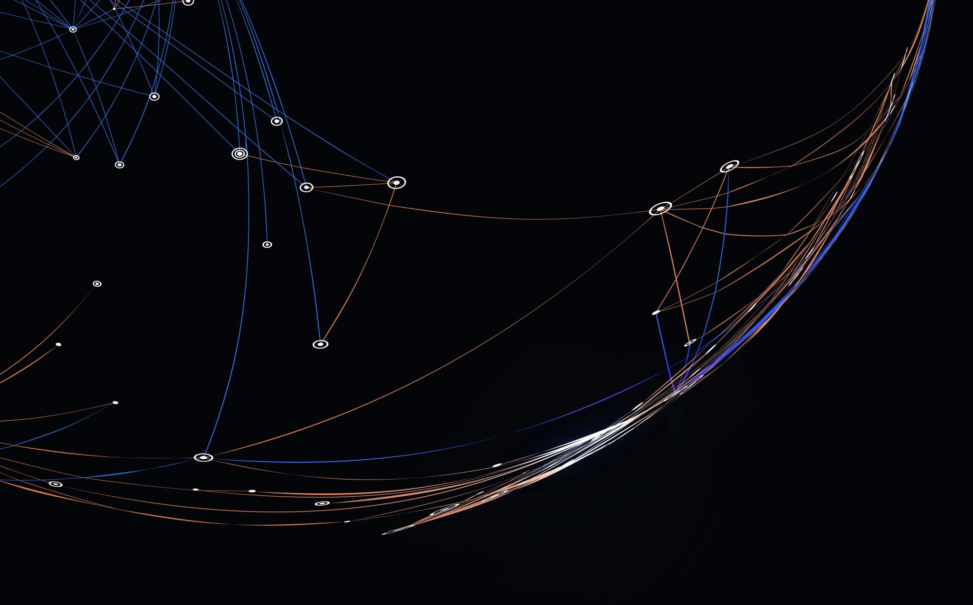
Thank you

Slide 28


Be inspired

