Slide 1



BUSI 1764
Global Entrepreneurship and Innovation
Dr Emilio Costales
Week 4: 16 October, 2024
Tutorial 4: Social Entrepreneurship and Social Change

Slide 2
Agenda
Overview of Social Entrepreneurship and Social Change
Case Study
Assessment 1

Slide 3
Session Objectives
Enhance understanding of the concept of social entrepreneurship and social change
Identify Innovative ways of tackling social problems by looking at institutional behaviour
Put it in practice

Slide 4
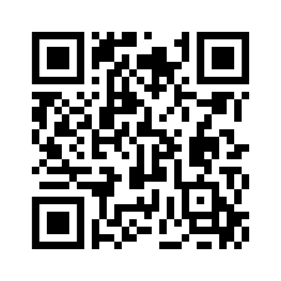
Recapping the Mini Lectures
Join at Menti.com
Use code: 7138 6525

Slide 5


Social Entrepreneurship
Organising around specific social causes
  American sociological school of thought
For-profit and non-profit organisations, charities, and for-profit social enterprises
  Social Enterprise School– market income of non-profit organisations
  Social Innovation School- innovative focus regardless of legal form
Social entrepreneurs’ main drive is to provide social value and make social change
  Often vicariously or lived experience (think Wonderbly)
  https://www.youtube.com/watch?v=1ecKK3S8DOE

Slide 6
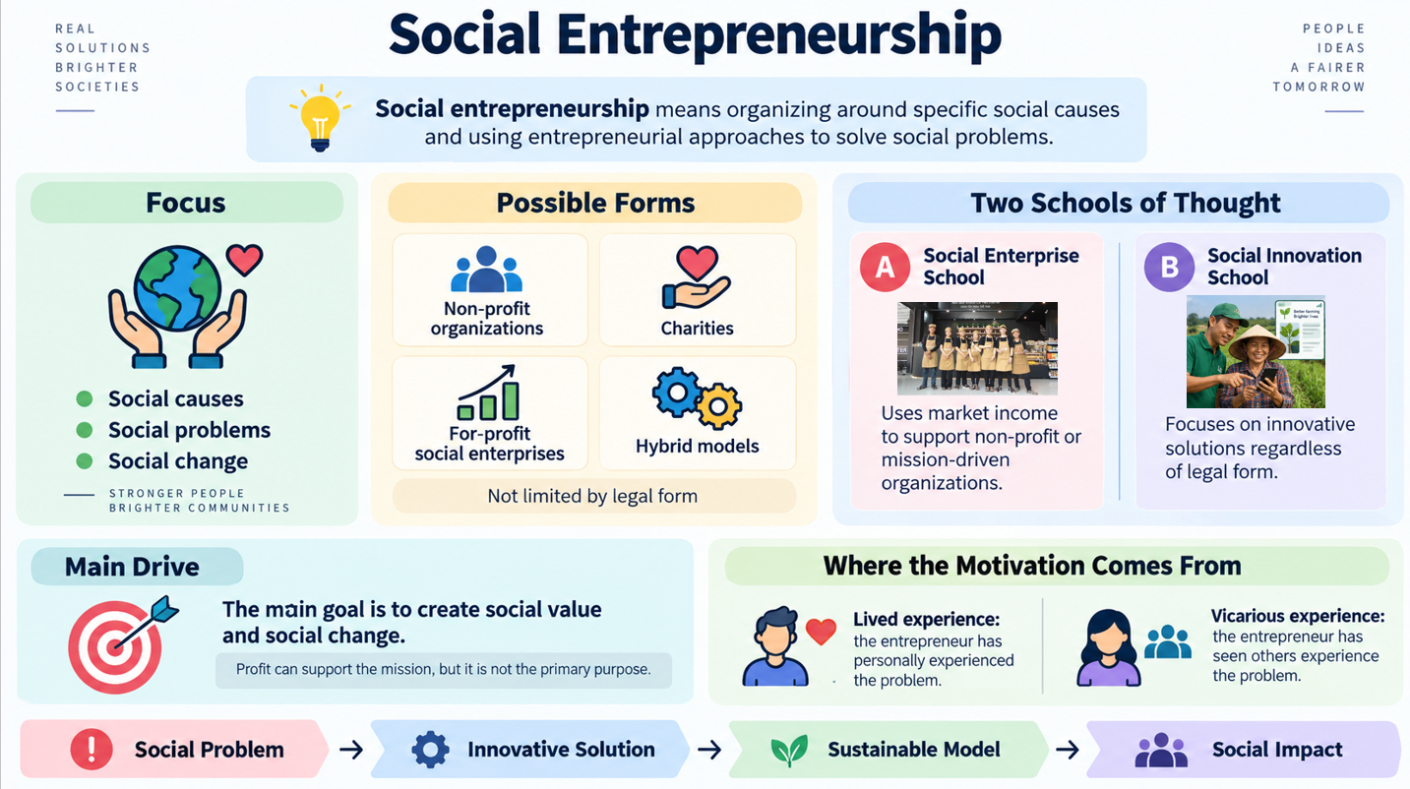

Slide 7
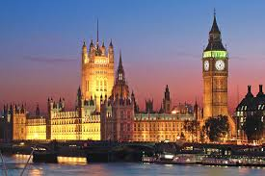
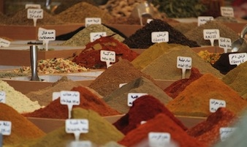
Society’s Problem Solving mechanisms
Our society has multiple mechanisms to solve problems and to fulfill essential tasks: our family, the solidarity of a (religious) community, neighborhoods, and similar structures. These are (still) important today.
However, in modernity there are two structures that have proven especially powerful to solve problems. These structures help our modern society to become high performing.
The state
The market

Slide 8
Why Social Entrepreneurship?
State
Market
Societal Problems
Social Entrepreneurship
Social entrepreneurship cannot substitute either the market or
the government but is a valuable stimuli for innovation. In other words,
it can be societies “R&D“ department.
Notes:
Trademarks are registered for specific goods or services within individual subjects, known as classes. It is possible for others to register identical or similar marks as long as it is in a different, unconnected class. For example Swan rental cars, Swan matches and Swan electrics. There are 45 classes to choose from, a list of which can be found

Slide 9
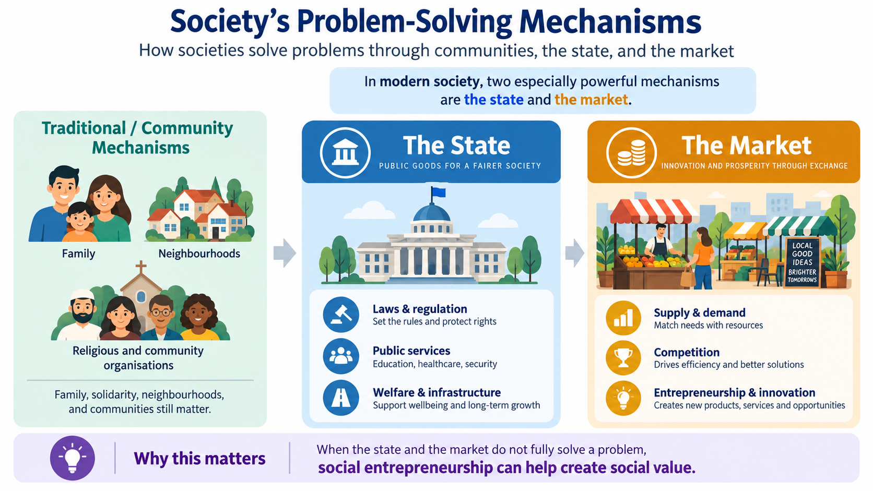

Slide 10
Same Goal, different approach
Social Service Provision
Social Entrepreneurship
Status quo
Social Activism
Direct
Form of Action
Indirect
Social Value
Social Change
(Martin & Osberg, 2007)
Extant System
Maintained and Modified
New Equilibrium
Created and Sustained
Notes:
Trademarks are registered for specific goods or services within individual subjects, known as classes. It is possible for others to register identical or similar marks as long as it is in a different, unconnected class. For example Swan rental cars, Swan matches and Swan electrics. There are 45 classes to choose from, a list of which can be found

Slide 11
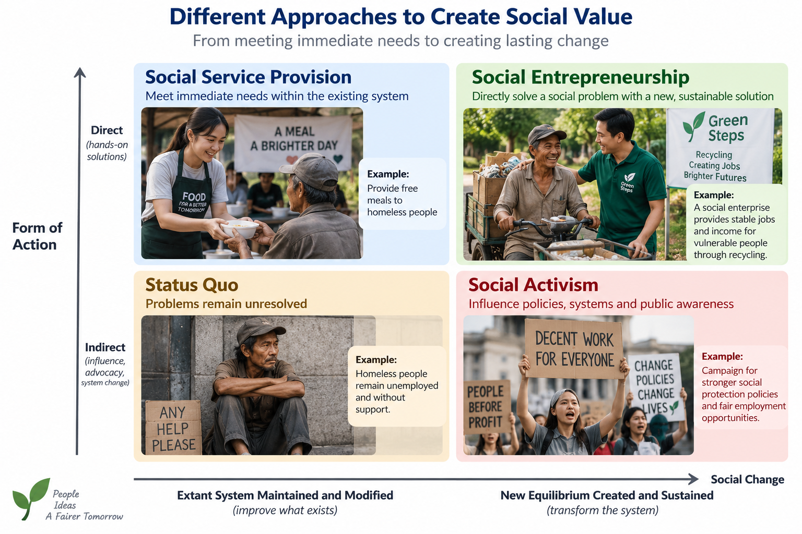

Slide 12
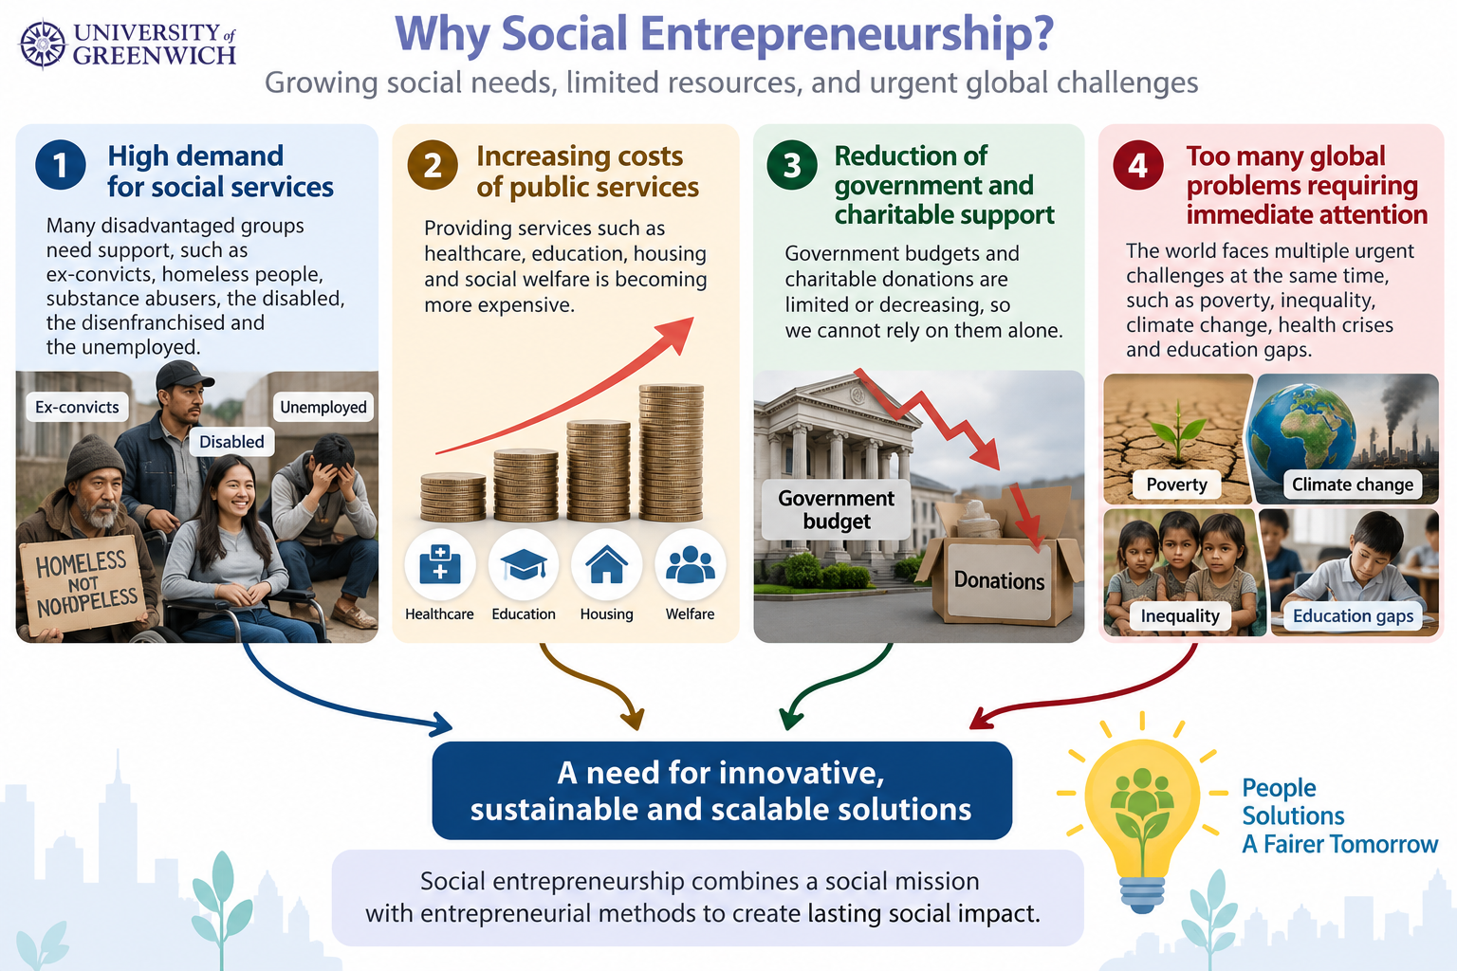

Slide 13


Slide 14
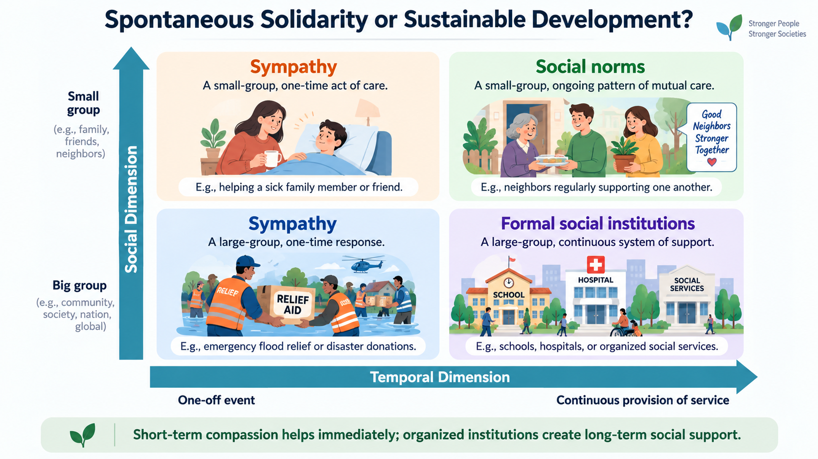

Slide 15

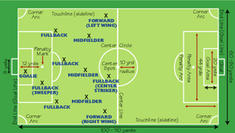
Institutions as society’s rules of the game
  “Institutions are the humanly devised constraints that structure political, economic, and social interactions. They consist of both informal constraints and formal rules” (North, 1990, 1992)
Game move
Distinction
Rules of the Game
Institutions!

Slide 16
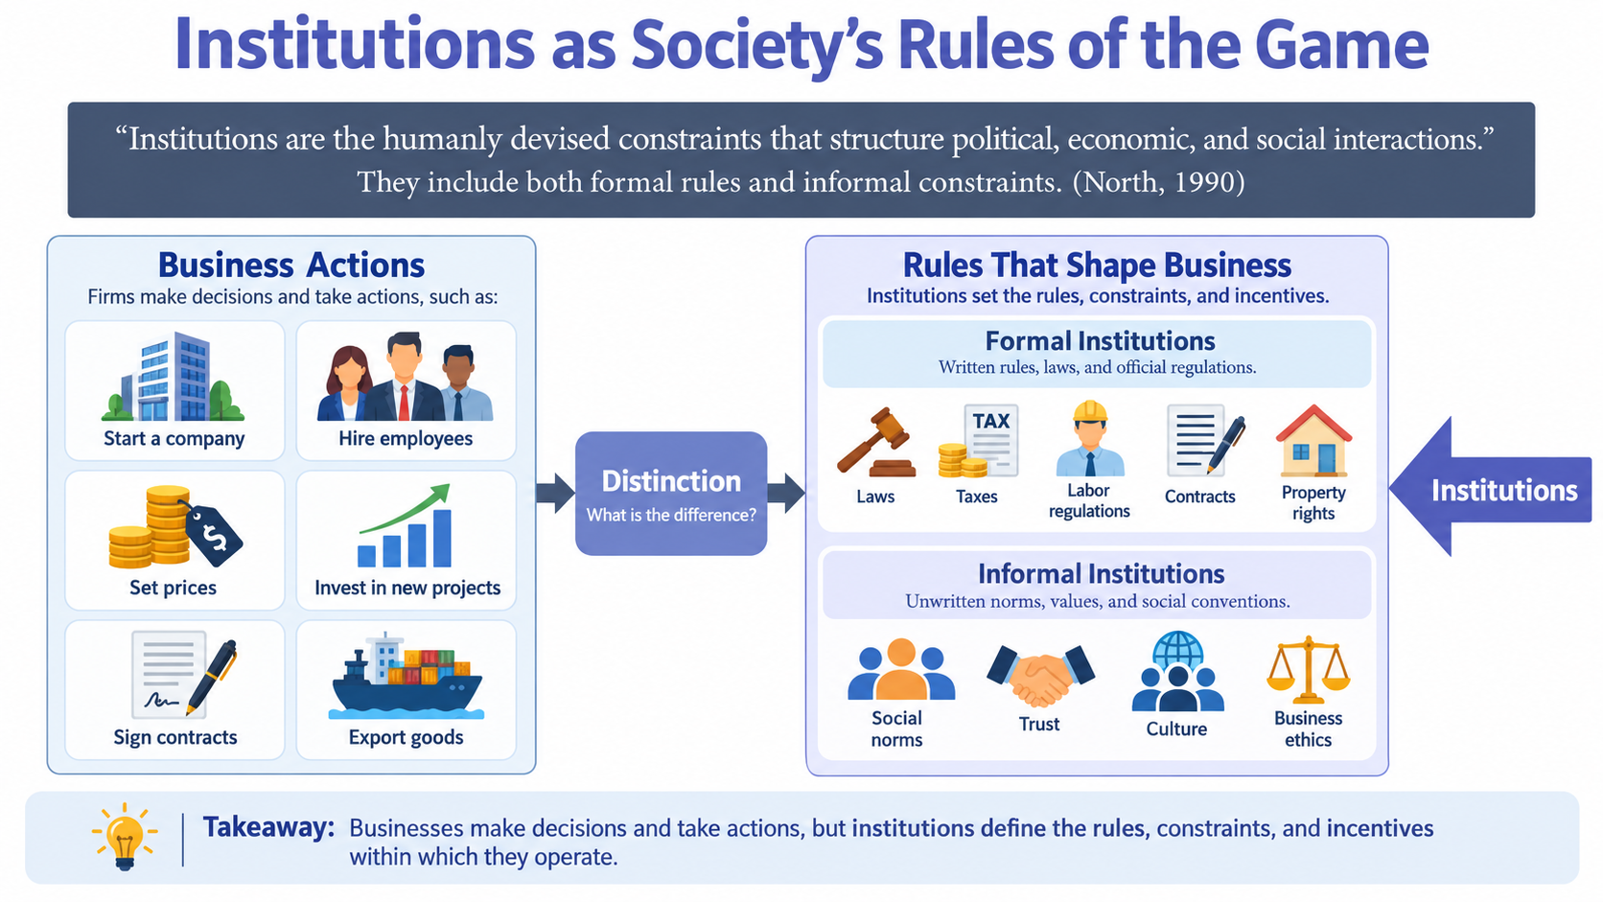

Slide 17
Creativity and Innovation
Creative Destruction (out with the old)
  New processes or technology for producing or delivering existing product, service, or project
New sources for supply of raw materials and resources
New organisation structure
New sources of labour or other production inputs
New funding models
Deliver existing product, service, program, or project to a new or previously underserved market (social innovation)
  Crossing sectoral boundaries and renegotiating norms
What are the Rules that Govern these??

Slide 18
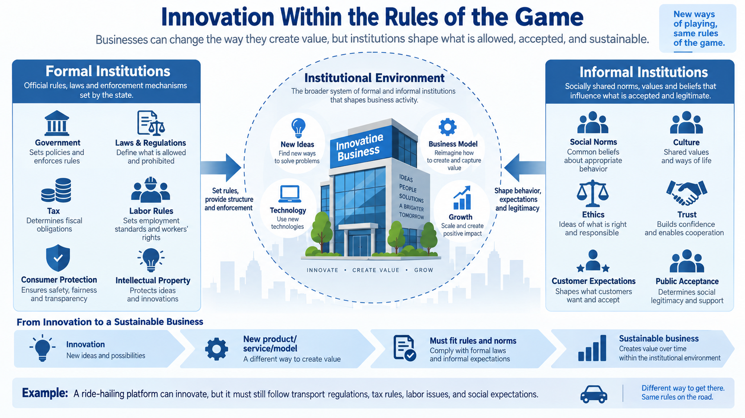

Slide 19

Case Example: Remembering Lammsbrau

Slide 20
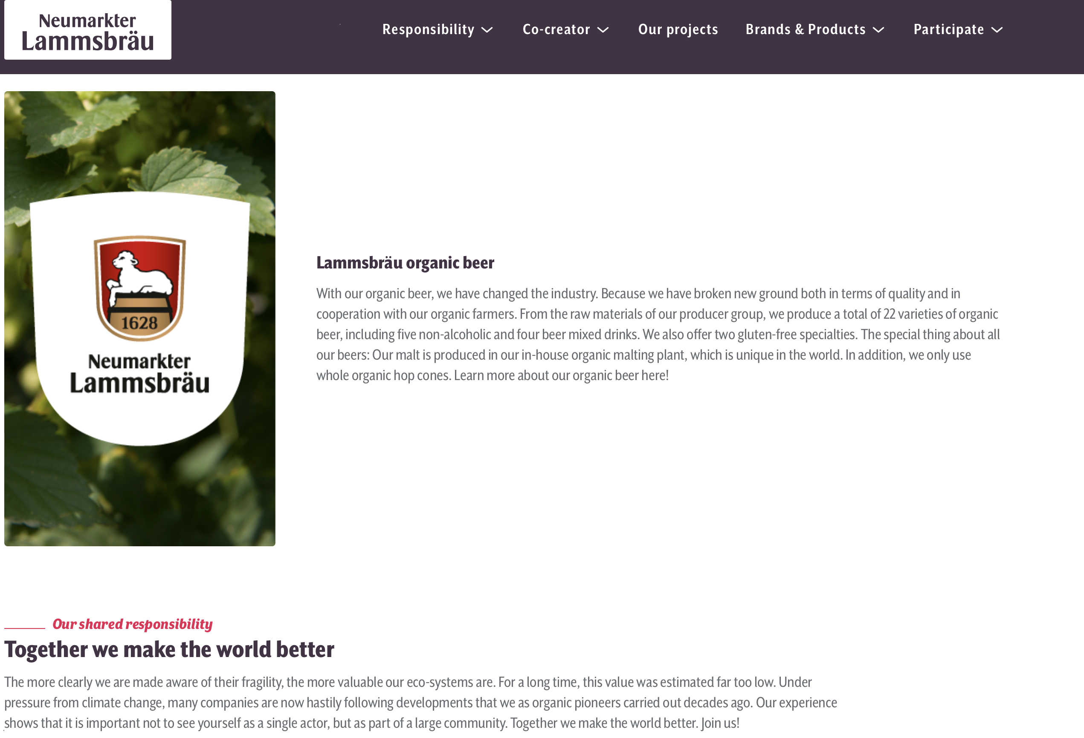
Thinking in Systems…with beer?
Source: www.lammsbraeu.de
Dr. Franz Ehrensperger: “Ecology is long-term economy“
The Goal? → create high quality beer, reduce emissions, secure local jobs, and source organic raw material
His idea? → create a positive-sum situation for all Lammsbräu stakeholders

Slide 21

Provide an Individual Self-Commitment
Lammsbräu
F
L
Organic hops, grain, yeast and water (in the 80s) runs the risk of higher cost and lower yield– very high risk for farmers
exploit
-2, 4
Go organic
Don’t exploit
2, 2
Not go organic
Farmers
0, 0
Solution to this Dilemma?
Lammsbräu self-commits
Lammsbräu initiates a long-term contract guaranteeing the purchase of organic brewing material at above market rate
Lammsbräu contracts an agricultural engineer to help farmers transform production to lower cost to farmers
Source: Beckmann, 2009

Slide 22
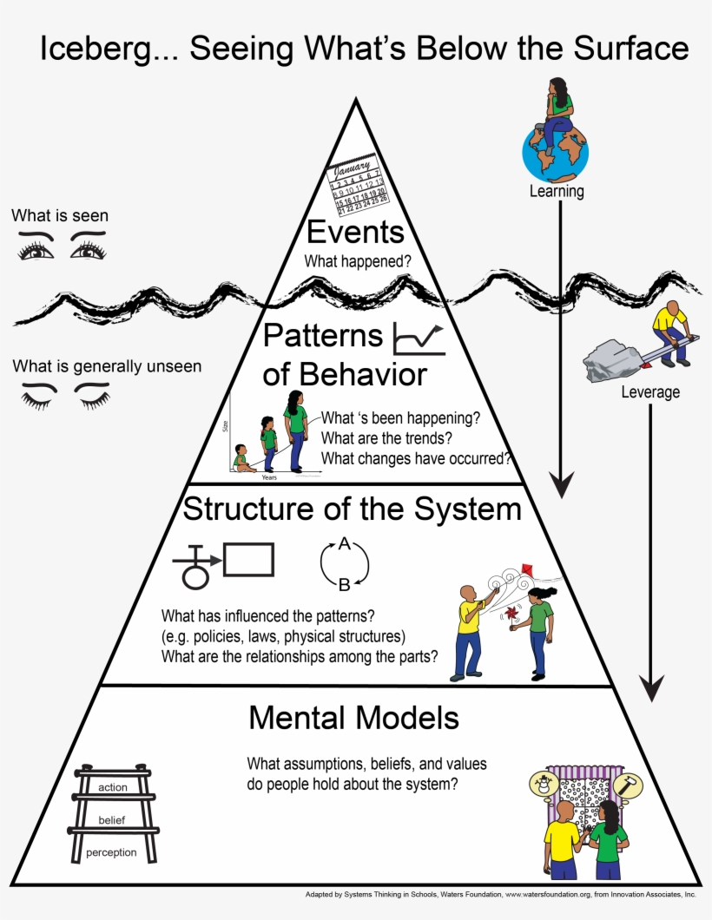
But the Farmers still said no!?– Contextualizing by thinking in Systems

Slide 23
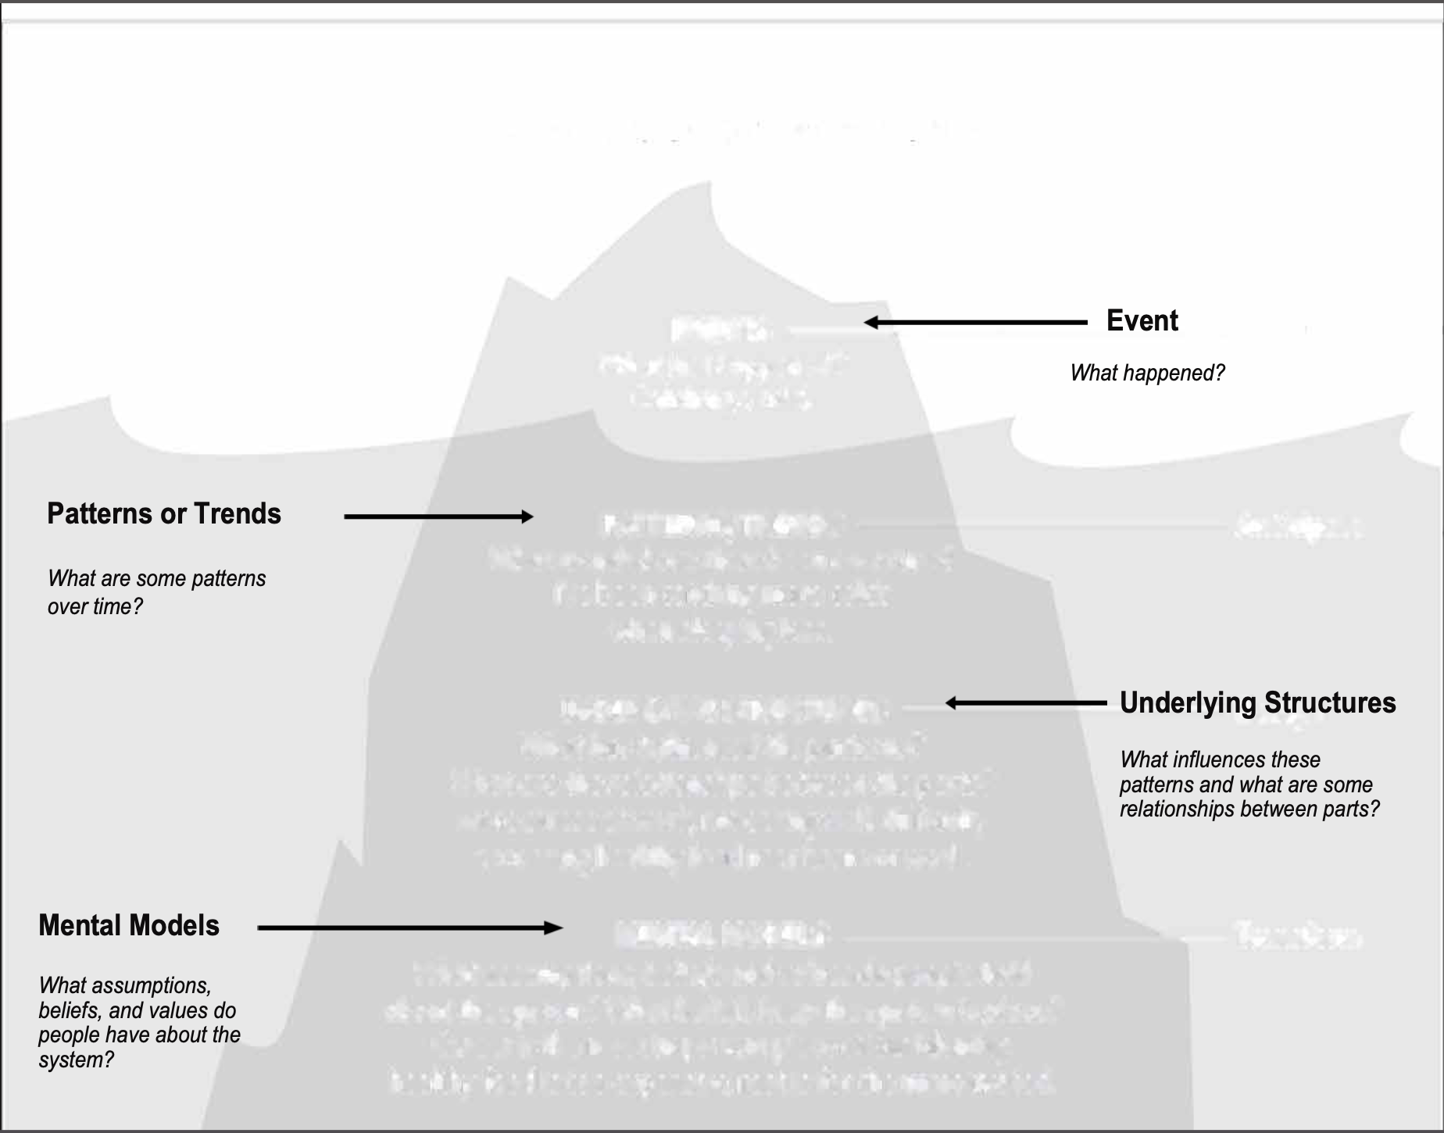

Non-organic farming
Our current farming provides a certain yield via traditional methods. Changing these methods risks bring about the same yields
Individual self-commitments
To maintain their livelihoods farmers must ensure that they receive sufficient recompense through the market mechanism to cover their costs

Slide 24
Encourage Collective commitment
Farmer B
Not cooperate
cooperate
Traditional competition between farmers undermines individually committed pricing agreements, creates uncertainty, and continues eroding Lammsbräu’s ecological goal
IV
I
cooperate
2, 5
4, 4
Farmer A
Not cooperate
2, 2
5, 2
III
II
Solution to this Dilemma?
Lammsbräu encourages cooperation for collective commitment among farmers
Lammsbräu initiates the “Growers Association for Organic Brewing Raw Materials”
Lammsbräu initiates the “Association of Organic Food Producers” and will only engage in contracts with members of this co-op

Slide 25
Where do we see Systems Change?
Non-organic farming
Our current farming provides a certain yield via traditional methods. Changing these methods risks bring about the same yields
Individual self-commitments
To maintain their livelihoods farmers must ensure that they receive sufficient recompense through the market mechanism to cover their costs
Initiation of Association of Organic Food Producers and Growers Association for Organic Brewing Raw Materials.
Capitalist rationality promotes competition. There is a lot of competition and my competitors will be incentivized to sell their goods before I sell mine

Slide 26
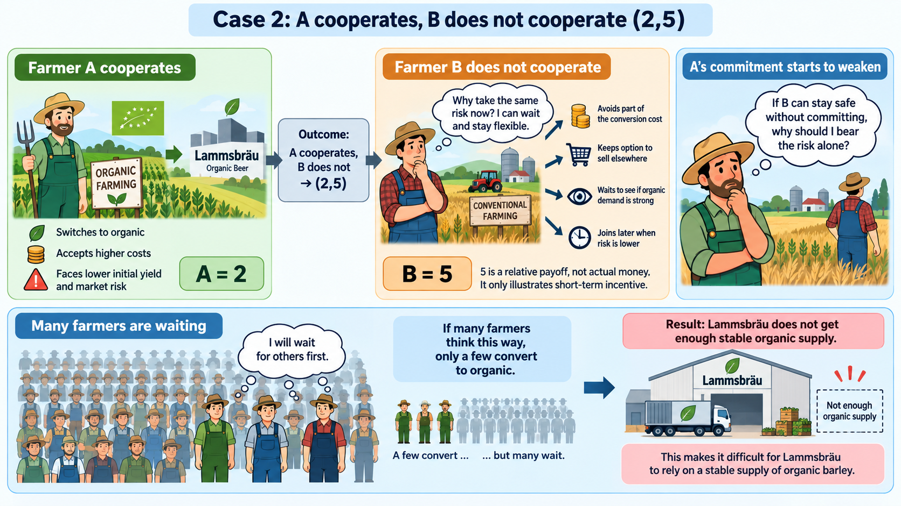

Slide 27
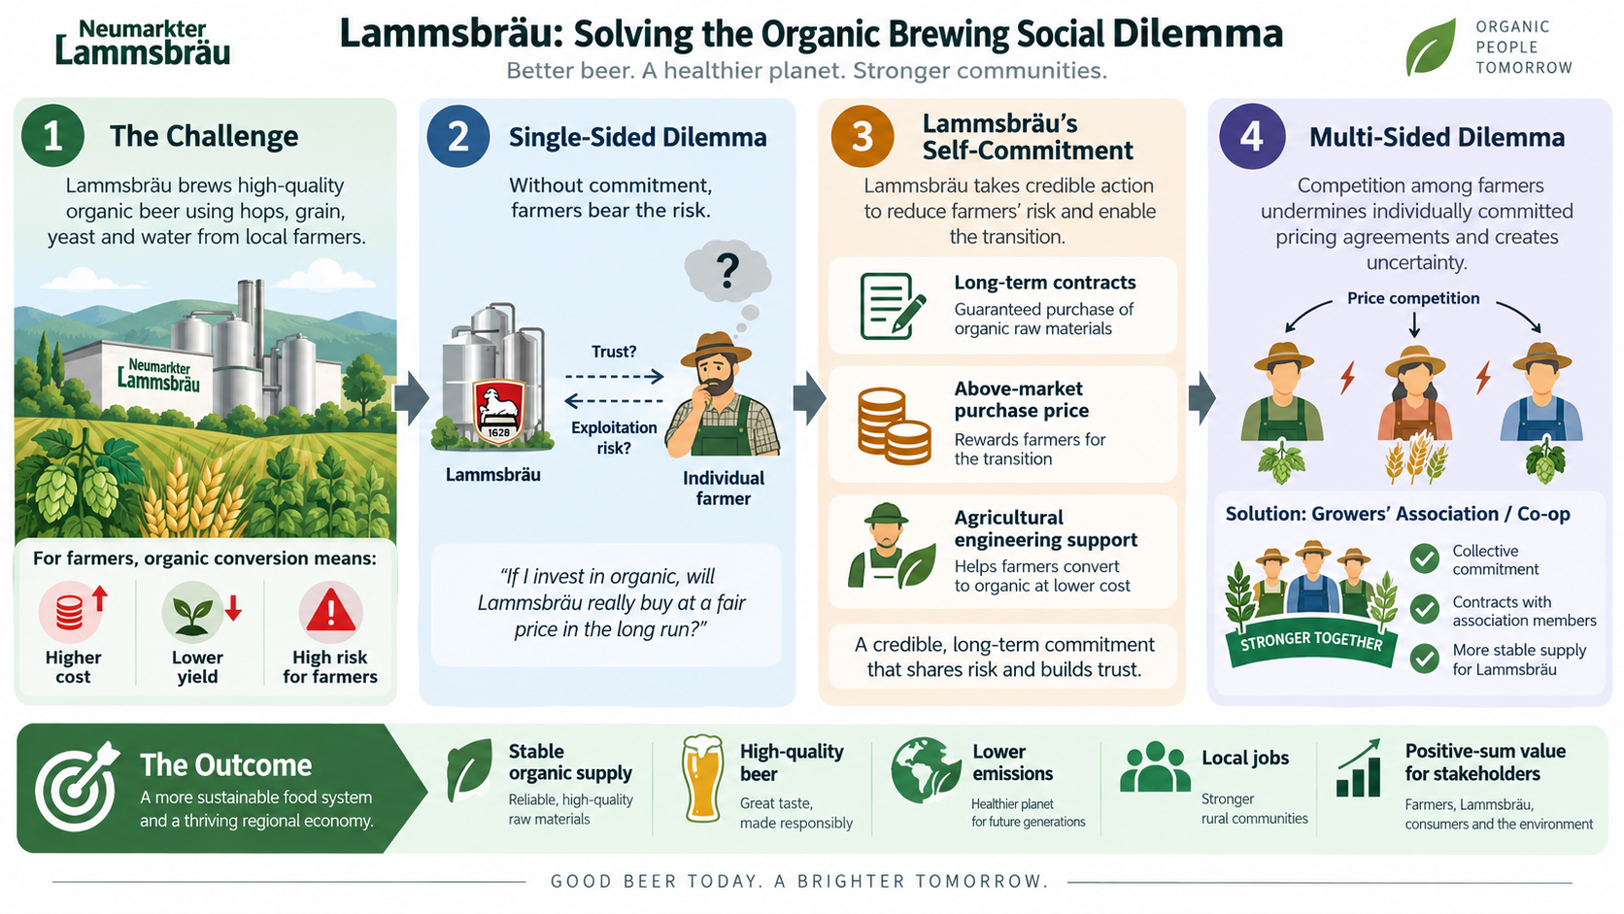

Slide 28
By thinking in Systems, Ehrensperger…
Identified mission, value, and vision of future
Identified and selected appropriate sustainability strategy
Identified a strategic goals
Operationalized goals
…and Lammsbräu shifted win-lose perceptions from sustainable vs. profit to profit AND sustainability.

Slide 29
The Muhammad Yunus Story
His observations in a Bangladesh village in 1974: Craftspeople were skilled but limited by credit availability
The opportunity he saw: Micro-loans, with no collateral and low interest, could improve their lives
The results: Very high loan repayment; Creation of the Grameen Bank; Nationwide adoption
The recognition: Professor Yunus won the 2006 Nobel Peace Prize; Grameen is a famous model of Social Entrepreneurship (social business)
https://www.youtube.com/watch?v=jk5LI_WcosQ
Notes:
UK patents will only give the holder rights in the UK and rights to stop others from importing the patented products into the UK.

Slide 30
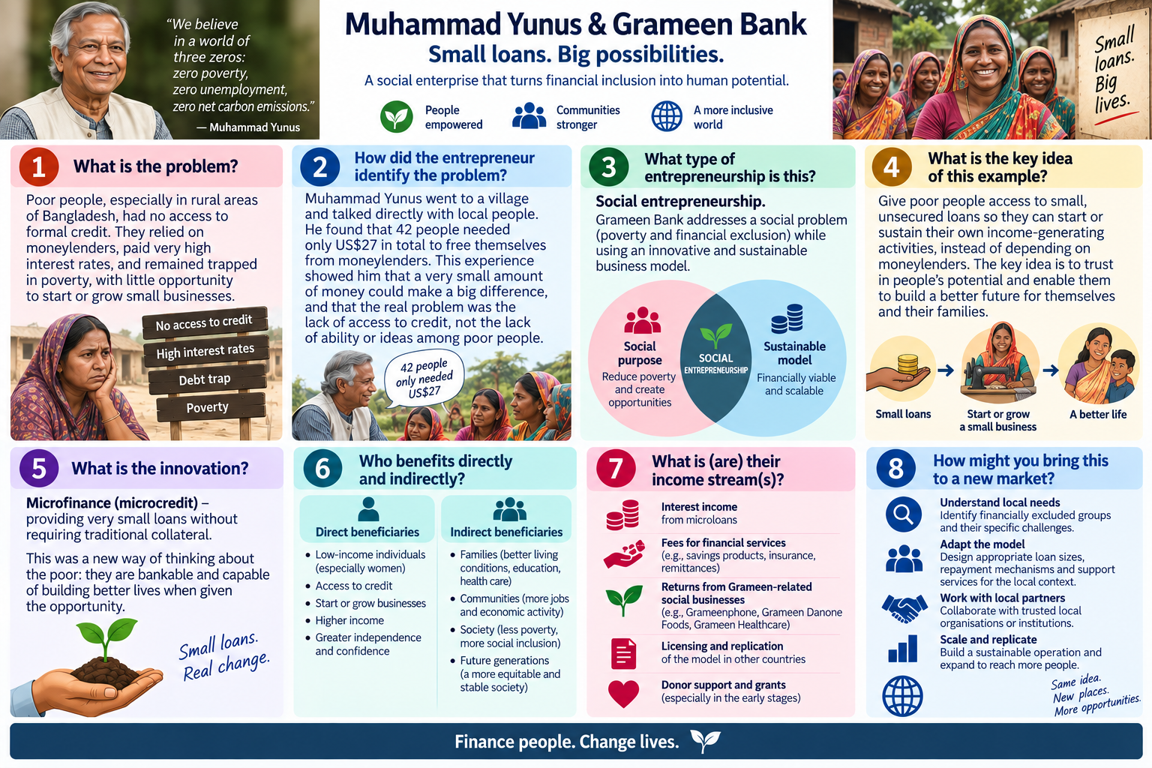

Slide 31
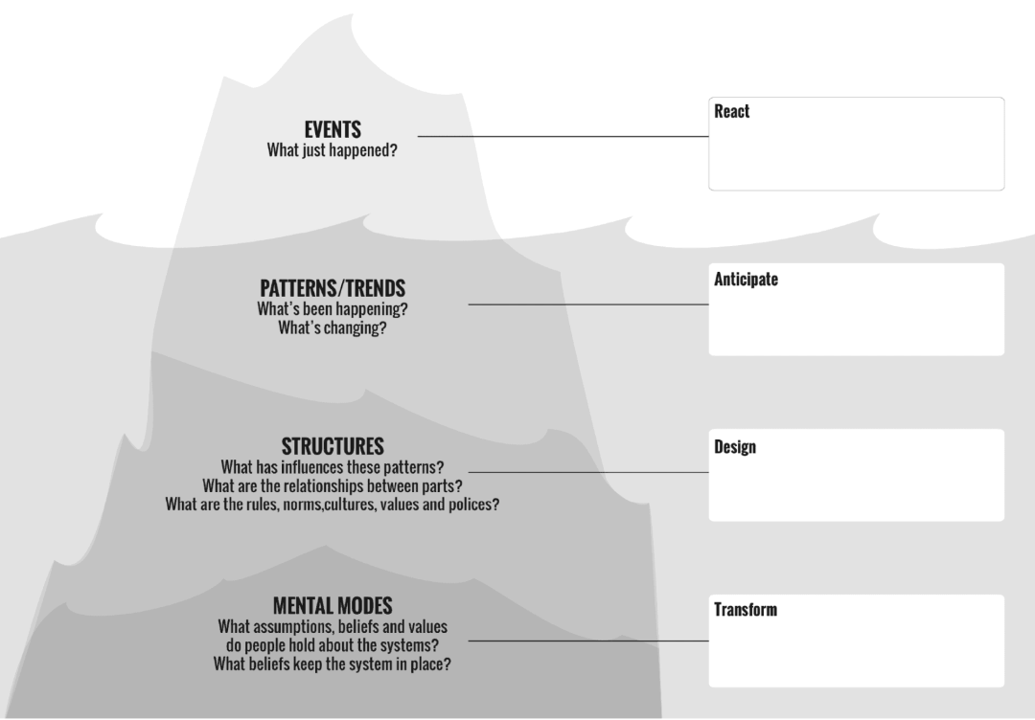
Capitalism requires repayment with interest and without collateral there is no guarantee or repayment.
Banking
Poverty Trap
The poor are denied for loans when they apply
Banks require collateral in order to take out loans ( collateral that the poor do not have)
Loans don’t work on trust

Slide 32
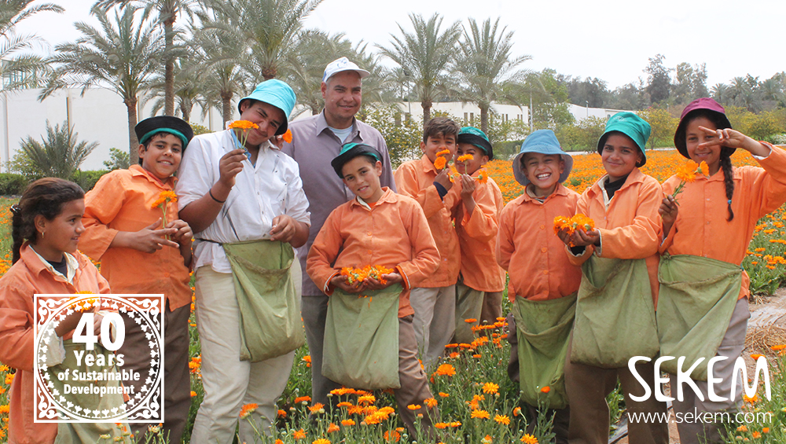


Innovation and navigating ambivalence
Dr. Ibrahim Abouleish

Slide 33
Navigating Ambivalence: A simple model of practical reasoning
1. what is it that we want
+ 2. what is that we can do
= 3. what is the we should do

Slide 34
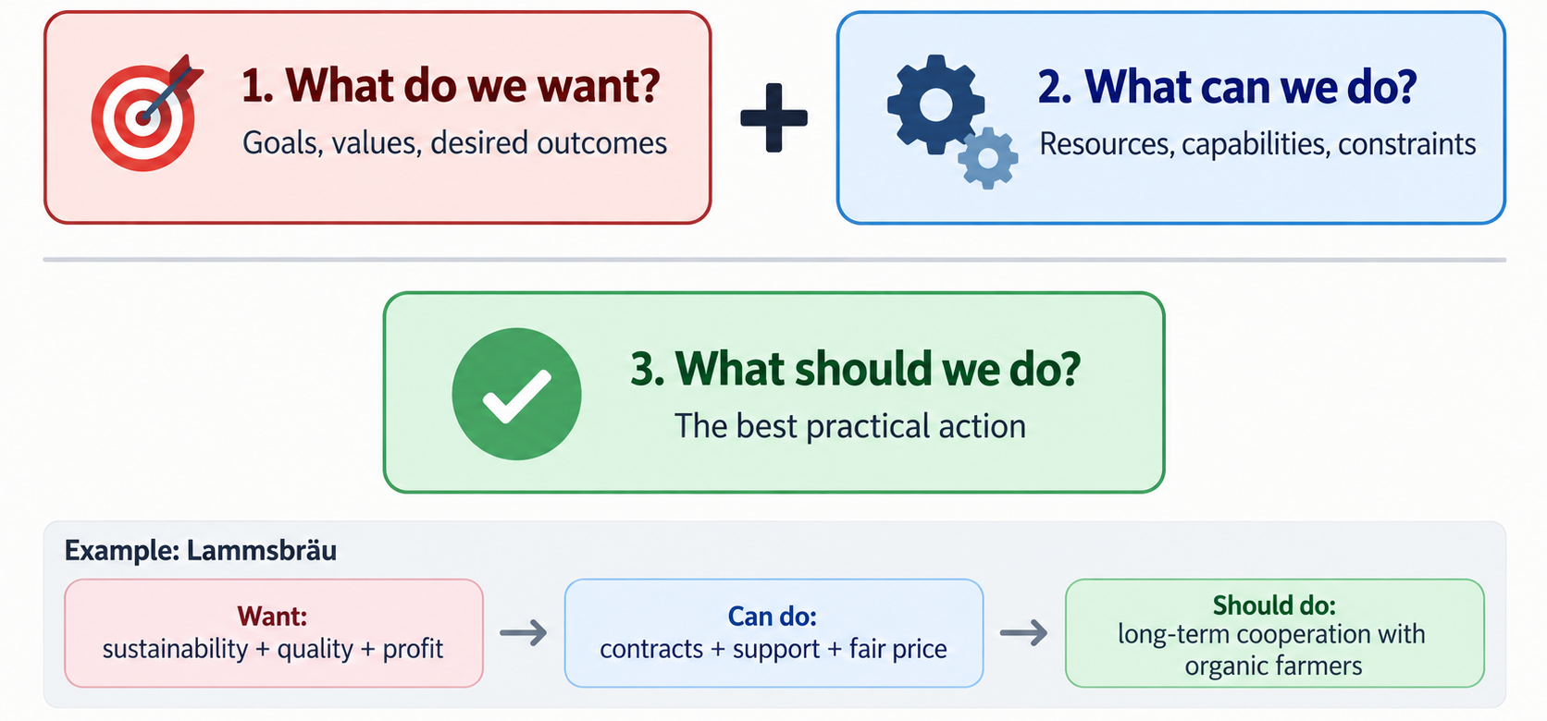
Navigating Ambivalence: A simple model of practical reasoning

Slide 35


The Extended Practical Syllogism
Categorical imperative
(no if… just do!)
1. normative assumption
+ 2. positive assumption
= 3. conclusion
Hypothetical imperatives
(if… then..)

Slide 36
Beware of fallacies!
Two common fallacies in handling the practical syllogism
Normativistic fallacy
1. normative assumption
+ 2. positive assumption
= 3. conclusion
Positivistic fallacy

Slide 37


International Entrepreneurship and Social Entrepreneurship
The analysis of approaches and models adopted by social enterprises to enter a foreign market with the aim of addressing a social need and being financially successful at the same time
Social Franchising
Hybrid Digital Business Models

Slide 38
Case Study: Dialogue Social Enterprises

Slide 39
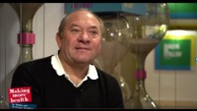
Case Study: Dialogue Social Enterprises

Slide 40



Complete an Iceberg on the following case
Andreas Heinecke
Dialogue Social Enterprises
What is the societal problem?
How did the social entrepreneur identify the problem?
Has this problem already been addressed by the state or the market?
What is the key idea of this example?
What is the social / environmental innovation?
Are there novel institutions or organizations?
Who benefits from their product/ service directly and how indirectly?
Are the stimuli for learning in the state or market?
Begin to work on a Theory of Change

Slide 41


Slide 42
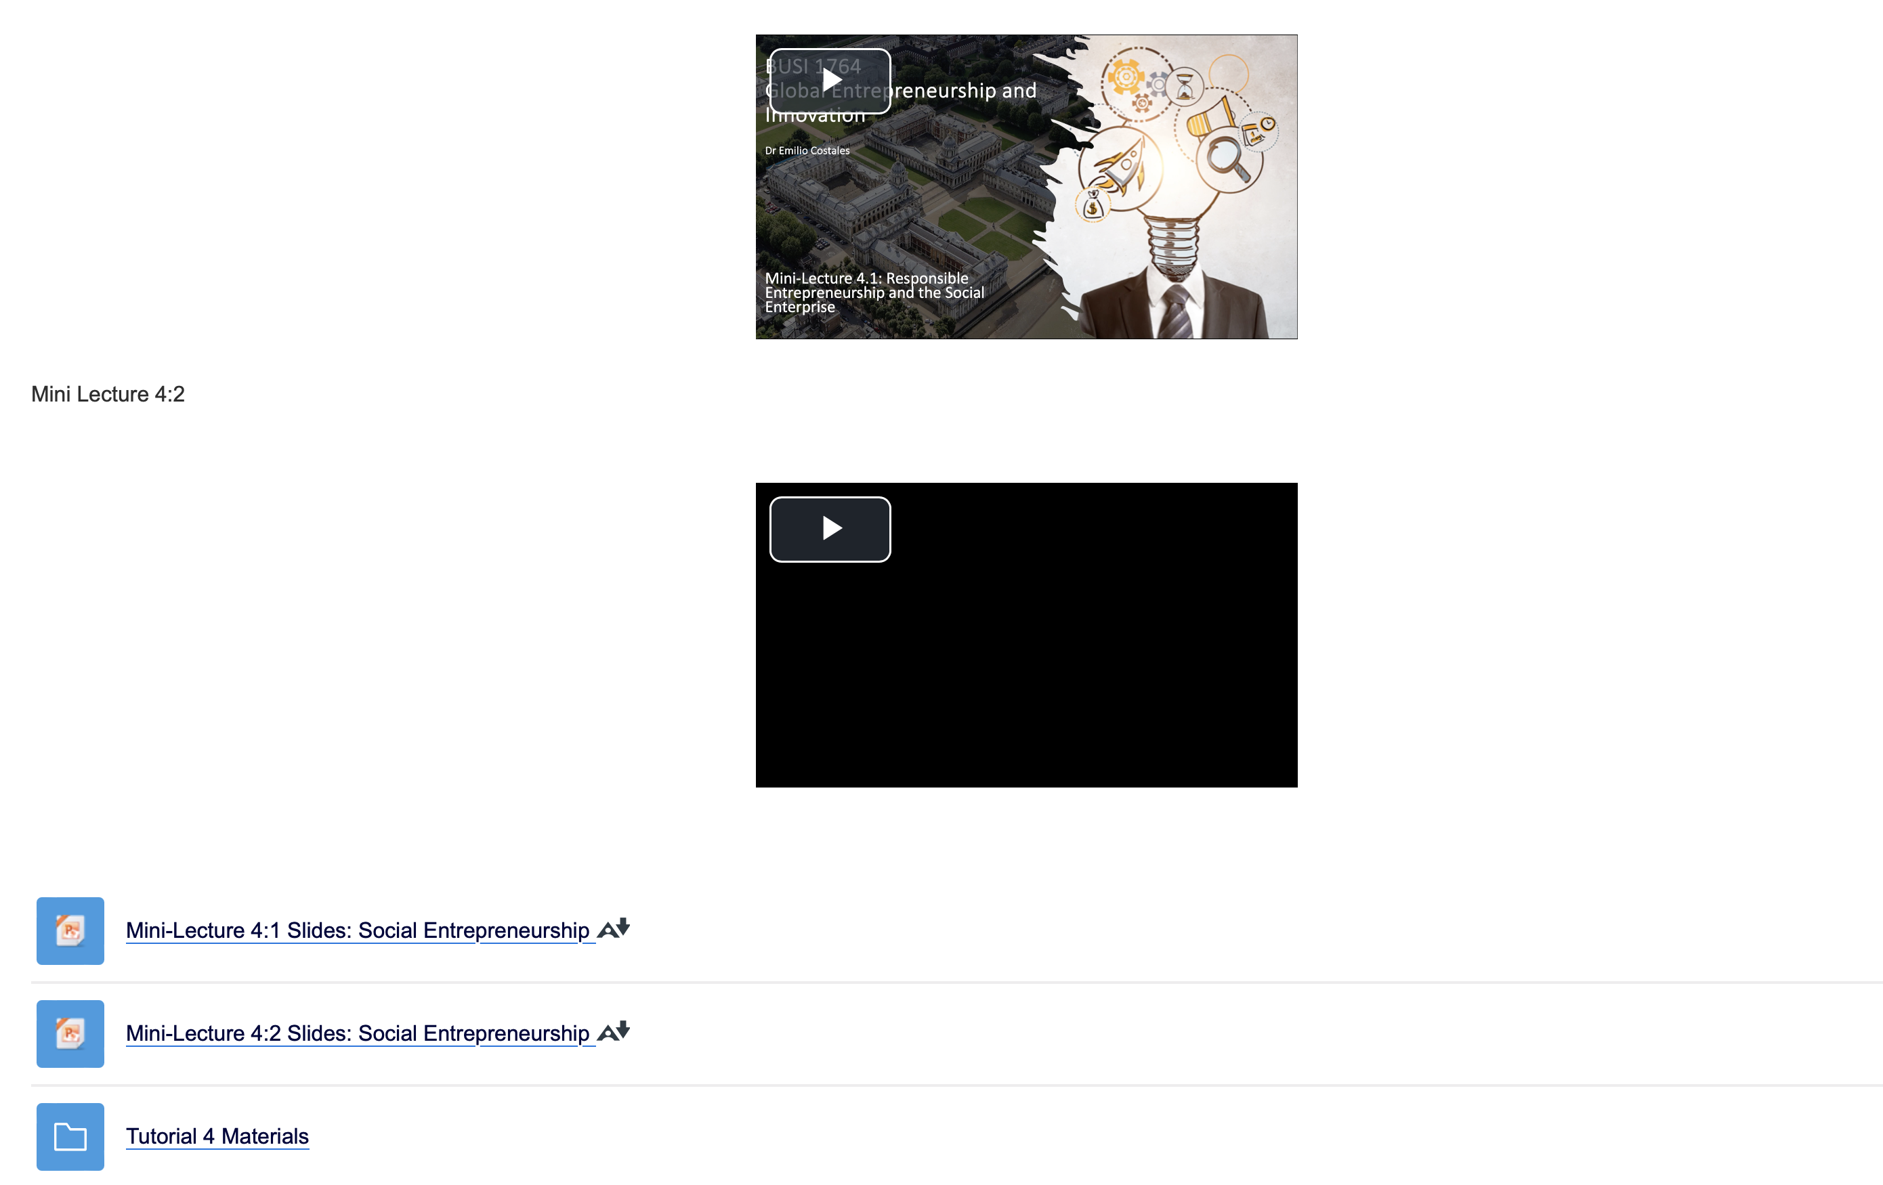
Open the Impact Ladder template

Slide 43
Assessment 1
Assessment 1 (30%) (12st Octorber, 2026)
  1,000 words
  Identify and reflect on the innovativeness of an existing venture

Slide 44
Choose a venture run by an Ashoka Fellow in a South American, African, or Asian country and explain why in your opinion the venture is innovative and how it can be internationalised. Support your answer by reflecting on your learning of the theories of entrepreneurship and innovation as well as some of the main theories of international business and the ways in which you strengthened these learnings during the tutorials. Key to this diary is to draw upon your experiences working through case studies in your tutorials and the ways in which you navigated these cases (e.g. think about how you put theories into practice during these sessions). You will find potential ventures here: www.ashoka.org (once you log onto the website, click on “our community > our fellows” tab. From there scroll to “Find Ashoka Fellows” at the bottom of the page, where you can search by country)
Provide a brief overview of the company or the venture. This should include the nature of the business, the products/service offered and the name of the entrepreneur. Explain clearly why in your opinion you think the venture is either social entrepreneurship, intrapreneurship, ecopreneurship or international entrepreneurship (your discussion should not only be restricted to why it is one of each. You are also to explain in detail why you think it is not one of the others.
Identify one innovative element of the venture and explain with reason if it is process innovation, business model innovation, service innovation or product innovation. Again, explain clearly why you think it is not one of the others. Here, you should draw on your experiences in your tutorials (how did you work with your groupmates to identify the innovative element of the case during the tutorial? How did you determine which element was most impactful?).
As an example: “During the tutorial my group and I worked through {XXX} case and we thought that {XXX} was innovative because of the way they did {YYY}, but we also discussed that {ZZZ} was quite innovative of them. We discussed that {YYY} was most impactful because of______. Thinking about {XXX theory} we came to the decision that {YYY} enables ____. In the case of {Ashoka Venture}…
Determine what level of innovation is at play? Incremental, radical, new to a region or new to the world, sustaining, or disruptive?
After identifying the innovativeness of the venture, reflect on your learning of the main theories of international business and discuss how this innovation can be transferred across borders (e.g. Will the same solution work in another part of the world? What will have to change? What market entry mode will be most appropriate to use and why?
· To help you get started, you might consider thinking about the following questions: what are the unique elements of the venture? How is the solution provided by the venture implemented? Who are their key partners? Who pays for the solution?
· You are required to use references from the venture, the context (e.g., statistics and so forth) as well as academic references and concepts. Use reliable sources only. This means you should have a reference list! Check the materials on how to reference properly (according to the Harvard format) https://www.ashoka.org/en-nrd/ashoka-fellows

Slide 45
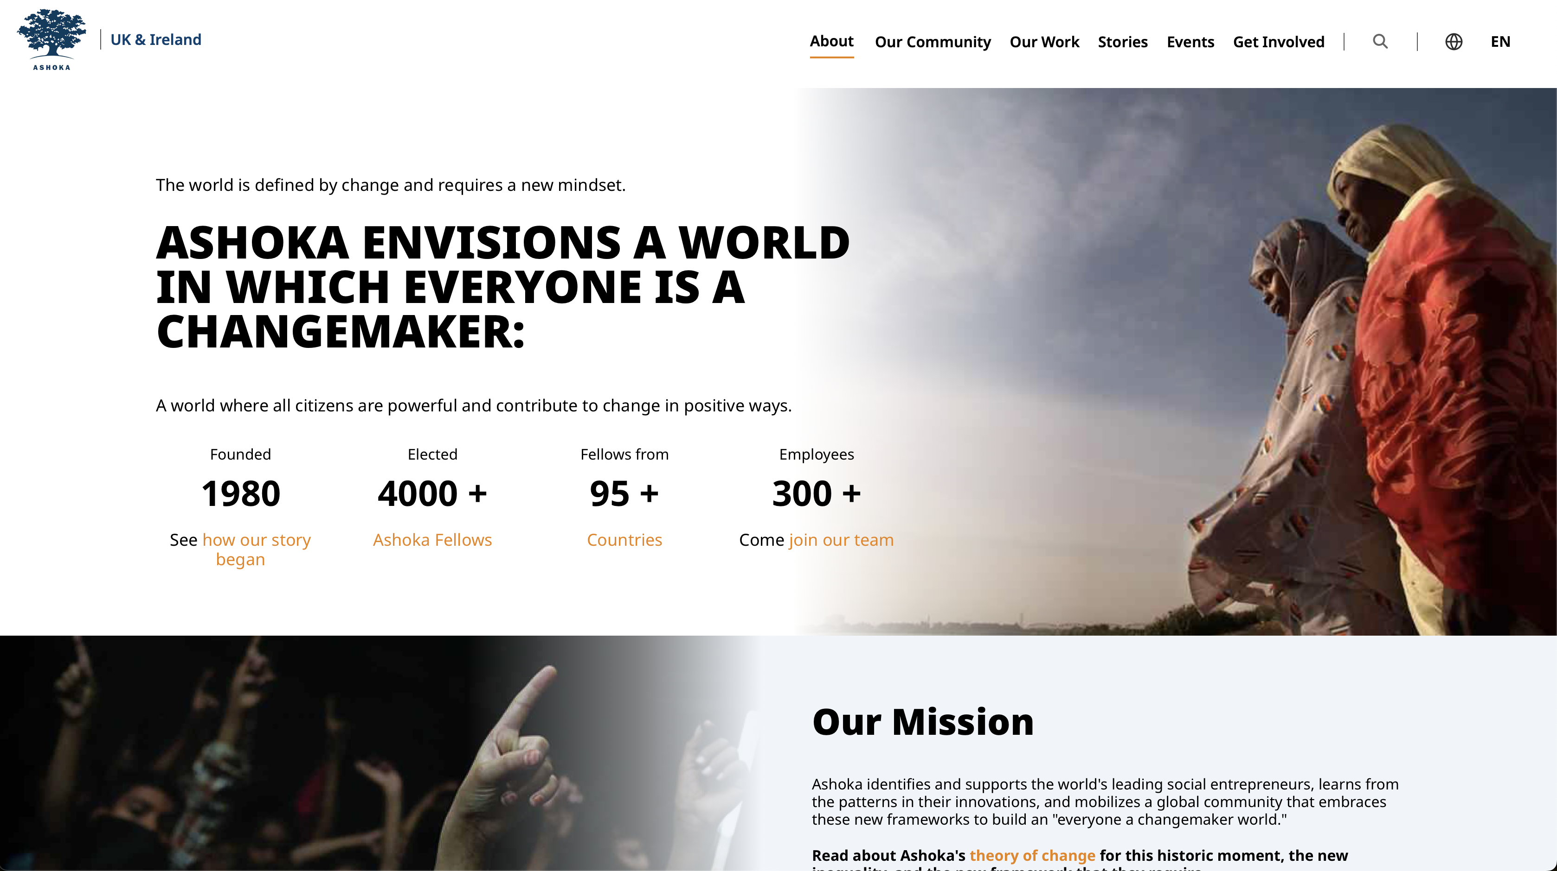
Ashoka

Slide 46

Ashoka

Slide 47
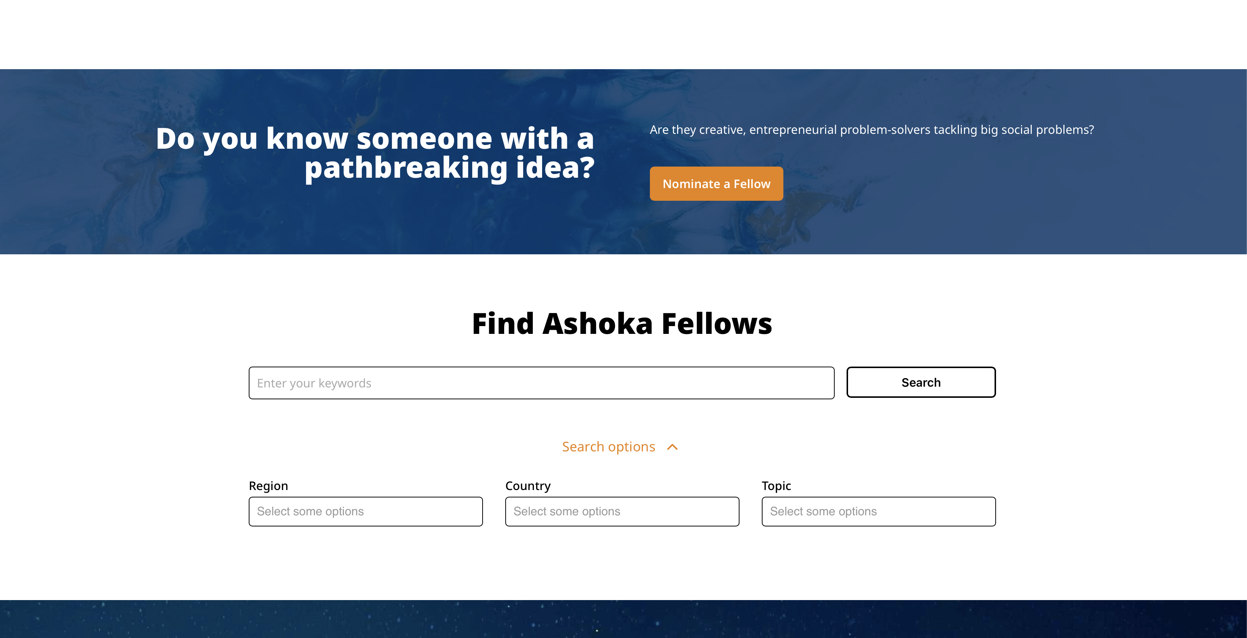
Ashoka

Slide 48
Thanks for Listening!
Any Questions:
  Module Leader- Emilio Costales
    E.Costales@Greenwich.ac.uk

