Slide 1


BUSI 1764
Global Entrepreneurship and Innovation
Dr Emilio Costales
Mini-Lecture 4.2: Social Entrepreneurship, Social Innovation, and Systems Change

Slide 2

Modern Society

Slide 3
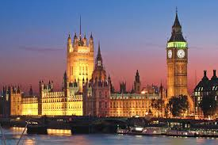

Our problem-solving mechanisms
The state
Our society has multiple mechanisms to solve problems and to fulfill essential tasks: our family, the solidarity of a (religious) community, neighborhoods, and similar structures. These are (still) important today.
The market

Slide 4

Market and State as two problem-solving structures
Both the state (government) and the market (economy) are able to systemically provide important functions to society
In this process institutions and organizations play a crucial role.
What are institutions? What are organisations?

Slide 5

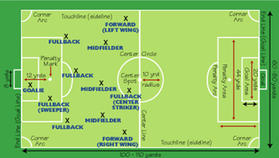
Institutions as society’s rules of the game
  “Institutions are the humanly devised constraints that structure political, economic, and social interactions. They consist of both informal constraints and formal rules” (North, 1990, 1992)
Game move
Distinction
Rules of the Game
Institutions!

Slide 6

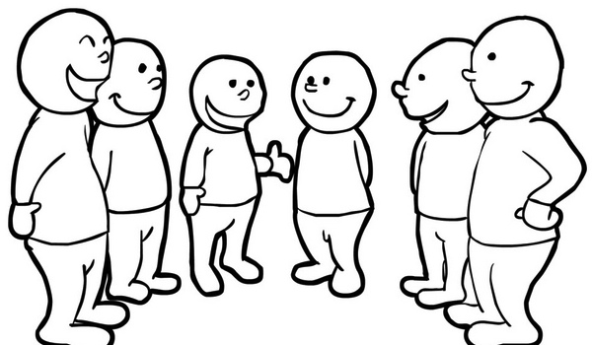
Organizations populate modern societies
  Modern society is a society of organizations. For instance, Parsons - a well-known organizational theorists – sees organisations as
  “the most important mechanism for a highly efficient society; a mechanism that ‘hold things together’ and achieves objectives that are greater than the capabilities of an individual would have allowed “ (Parsons, 1960, 2003, p. 17)
  Organisations are „collaborative“ or “collective“ actors that are capable of fulfilling tasks, having their own objectives, and beyond the individual.

Slide 7
The problem-solving abilities of market and state
As problems become more complex, society is in need of more sophisticated learning processes.
The competition to solve problems in market and state is often imperfect.
For many problems, we so far have no satisfying or satisficing solution.
State
Market
Societal problem
What happens to those problems for which the current market and the current state has not found a solution?

Slide 8
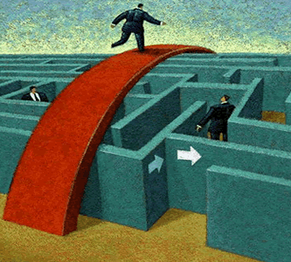
Who comes up with these innovations?
Entrepreneurs play an important role in societal innovations.
Entrepreneurs recognize potential for value creation that has so far been overlooked or not properly exploited.
As such they build bridges between existing and new systems.

Slide 9

Social Entrepreneurship

Slide 10
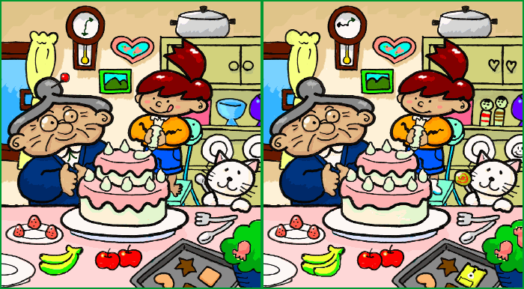
What‘s the difference?
Social activism
Responsible entrepreneurship
This Photo by Unknown Author is licensed under CC BY-SA

Slide 11
Same goal – different means
Social Service Provision
Social Entrepreneurship
Social Activism
Direct
Form of Action
Indirect
(Martin & Osberg, 2007)
Extant System
Maintained and Modified
New Equilibrium
Created and Sustained

Slide 12
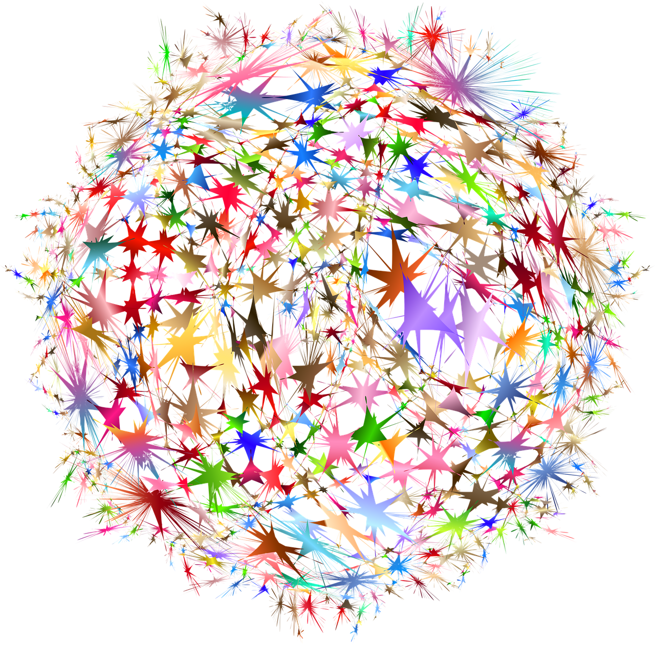
Systems

Slide 13
A set of interacting or interrelated entities that form a whole
Defined by their boundaries
Expressed by their functions

Slide 14




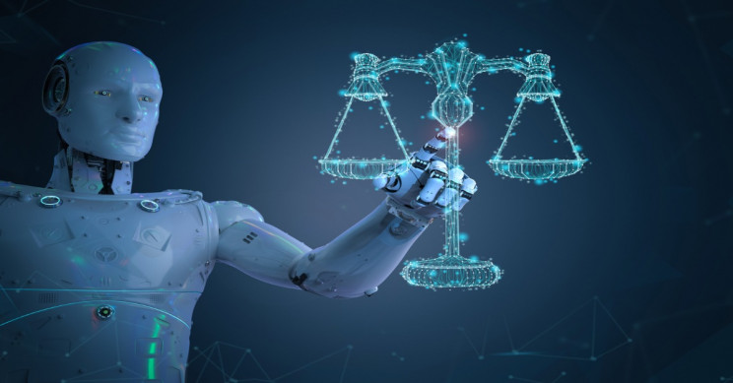

Slide 15
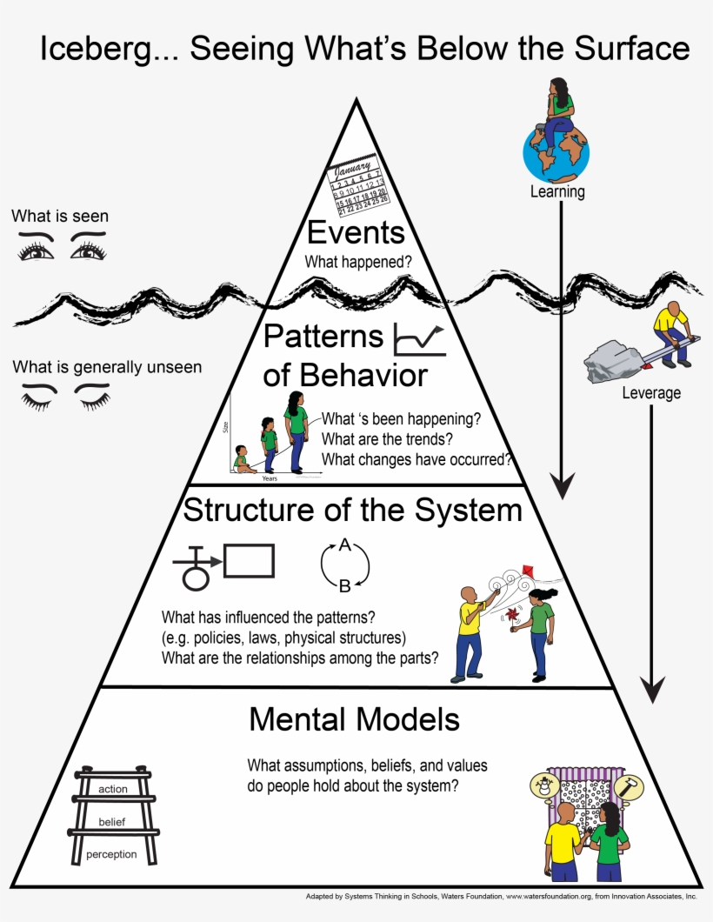

Slide 16


Slide 17
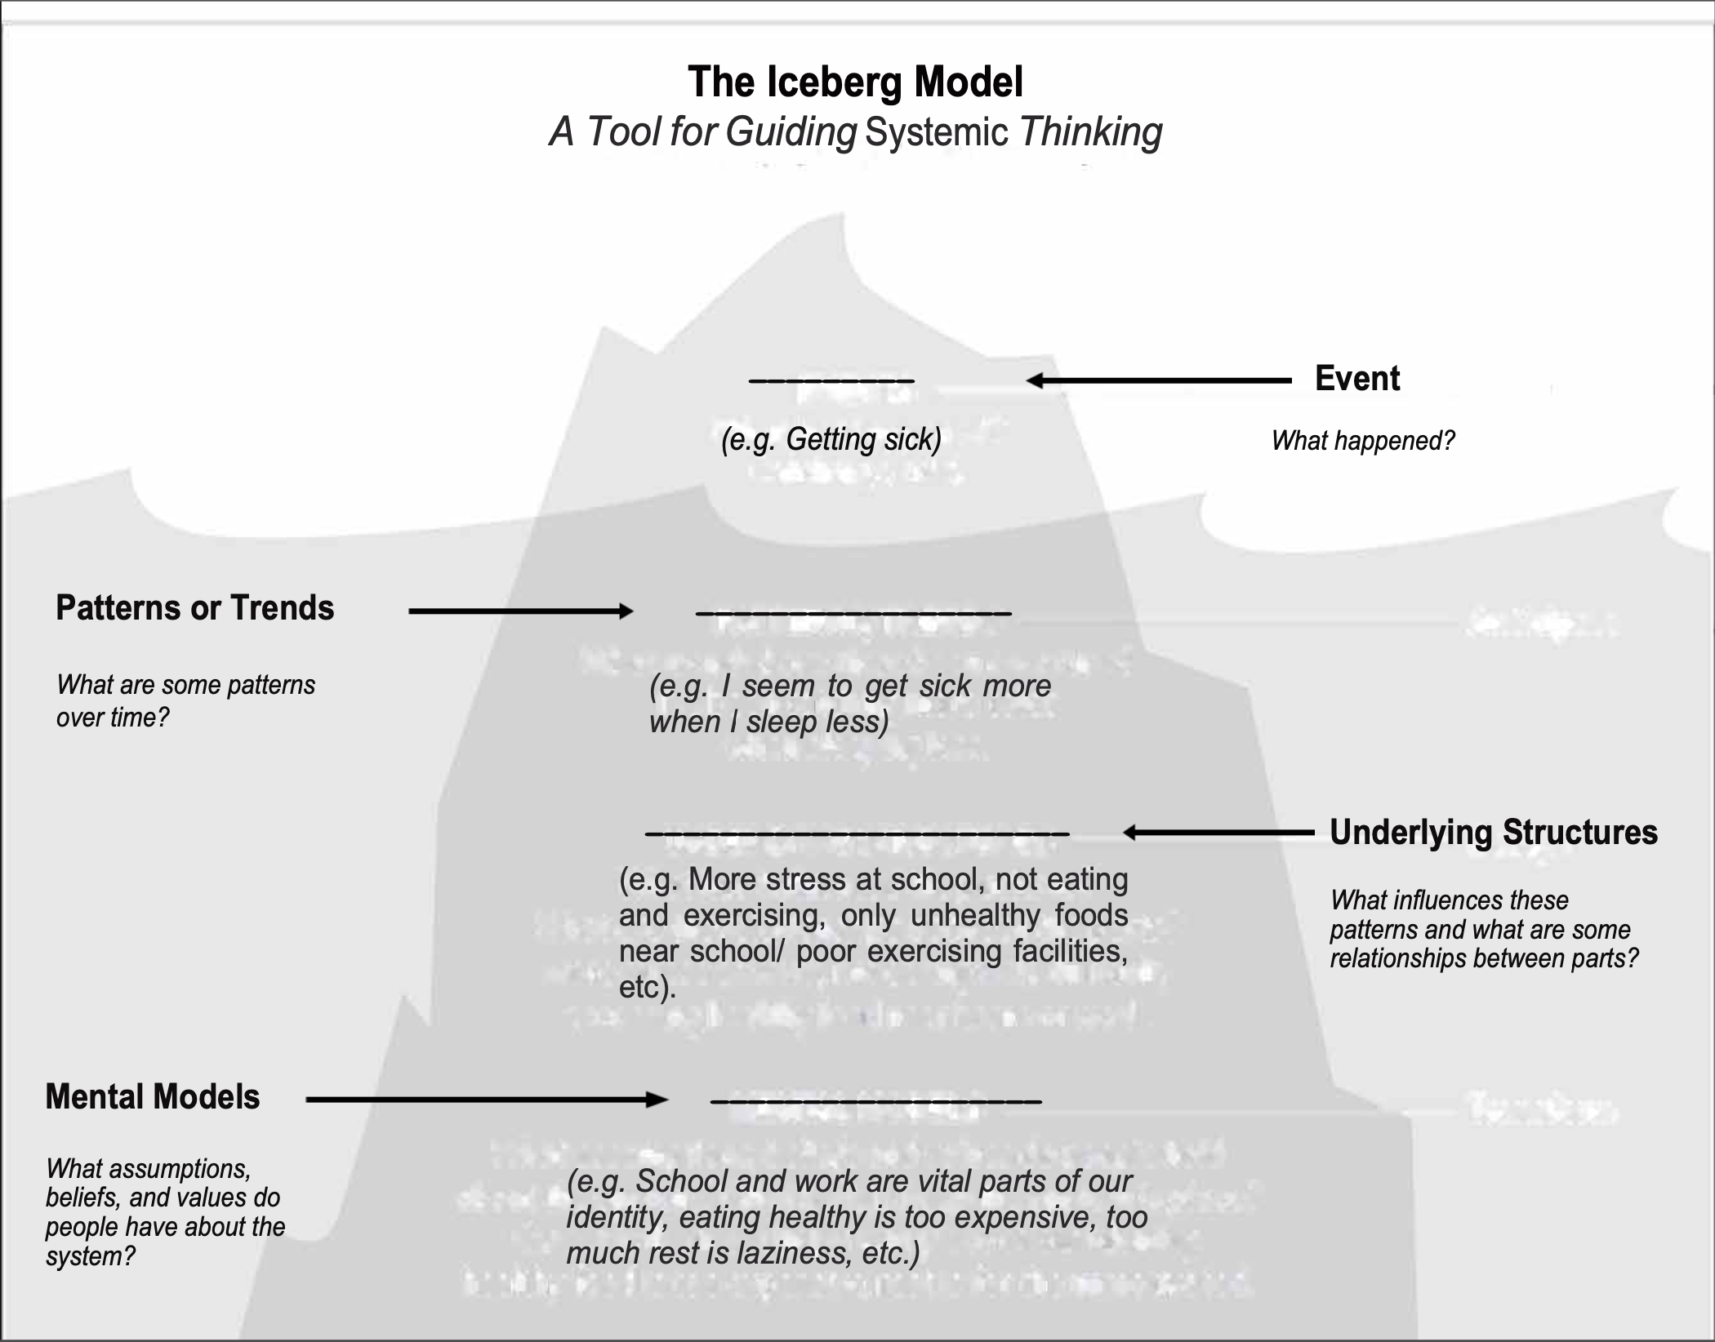
Source: Goodman, 2002)

Slide 18
Social Innovation
Social innovation has three fundamental elements which are vital to achieve social change:
addressing needs neglected by the market or state;
creating new institutional relations;
empowering people to transform existing structures (Moulaert et al., 2013).
Connected difference theory of social innovations:
they are usually new combinations or hybrids of existing elements, rather than being wholly new in themselves
Cutting across organisational, sectoral or disciplinary boundaries
Developing new social relationships between previously separate individuals and groups which contribute to the diffusion and embedding of the innovation, and fuel a cumulative dynamic whereby each innovation opens up the possibility of further innovations (Mulgan, 2007)
Notes:
Moulaert, F., MacCallum, D., & Hillier, J. (2013). Social innovation: Intuition, precept,
concept. In The International Handbook on Social Innovation: Collective action, social
learning and transdisciplinary research (p. 13).
Mulgan, G. (2007). Social innovation: What it is, why it matters and how it can be
accelerated.

Slide 19

Systems thinking expands the range of choices available for solving a problem by broadening our thinking and helping us articulate problems in new and different ways

Slide 20


Slide 21
Event
Pattern
Surface-level Solution

Slide 22
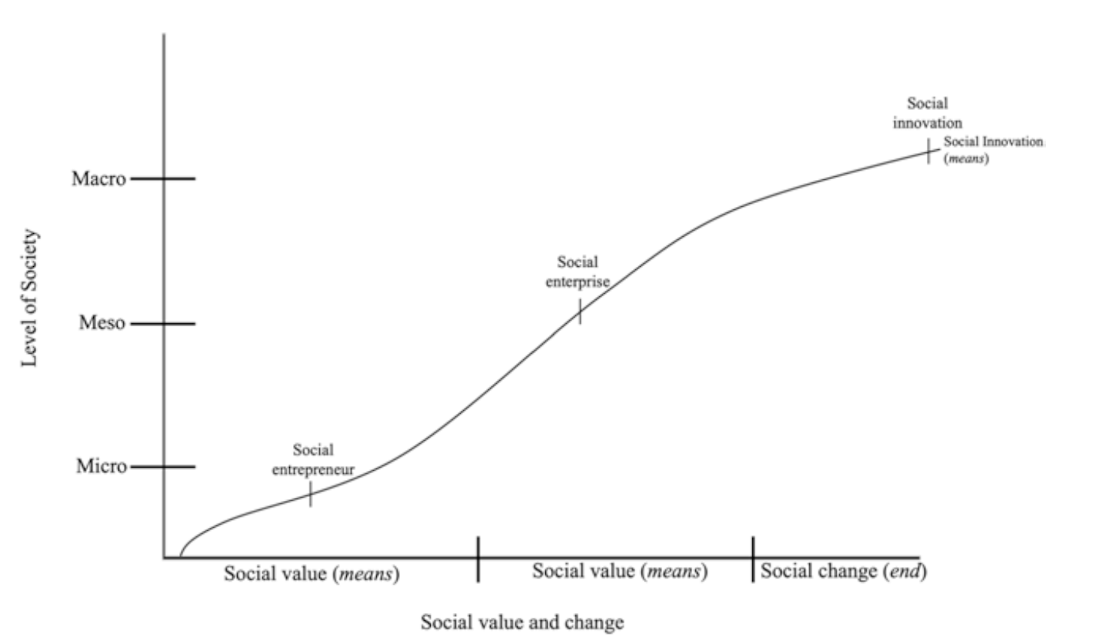
Social Innovation and Systems Change
Source: Costales and Zeyen, 2023

Slide 23

Thanks for Listening

