Slide 1


BUSI 1764
Global Entrepreneurship and Innovation
Dr Emilio Costales
Mini-Lecture 4.1: Responsible Entrepreneurship and the Social Enterprise

Slide 2

What is Responsible Entrepreneurship?

Slide 3


Entrepreneurship – What is it?
Entrepreneurship is about
Doing something yourself (not let other people do it)
Innovation
Notes:
ilUFHL WEIUFHLQWEIUFHDIUWQELFHQLIWEUFH

Slide 4





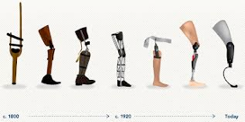




Entrepreneurship – what is innovation?
Innovation is the re-combination of existing elements i.e. Resources, processes, knowledge, products, services, methods and so forth (Schumpeter, 1911)
There are various types of innovation ranging from incremental (small changes) to radical (large changes).

Slide 5
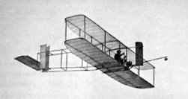
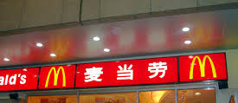



Entrepreneurship – types of innovation
We can differentiate various levels of innovation
Incremental to
Level of innovation
radical
New to a firm / region
Level of innovation
New to the world
Sustaining to
Level of innovation
Disruptive (game change)

Slide 6
Make things happen - the entrepreneurial process
Emotional support
Expert knowledge
Networks
Ideas & Feedback
Funding
The entrepreneur’s views
The entrepreneur’s resources
Idea Generation
Opportunity Evaluation
Planning
Organization formation
Growth / scaling

Slide 7
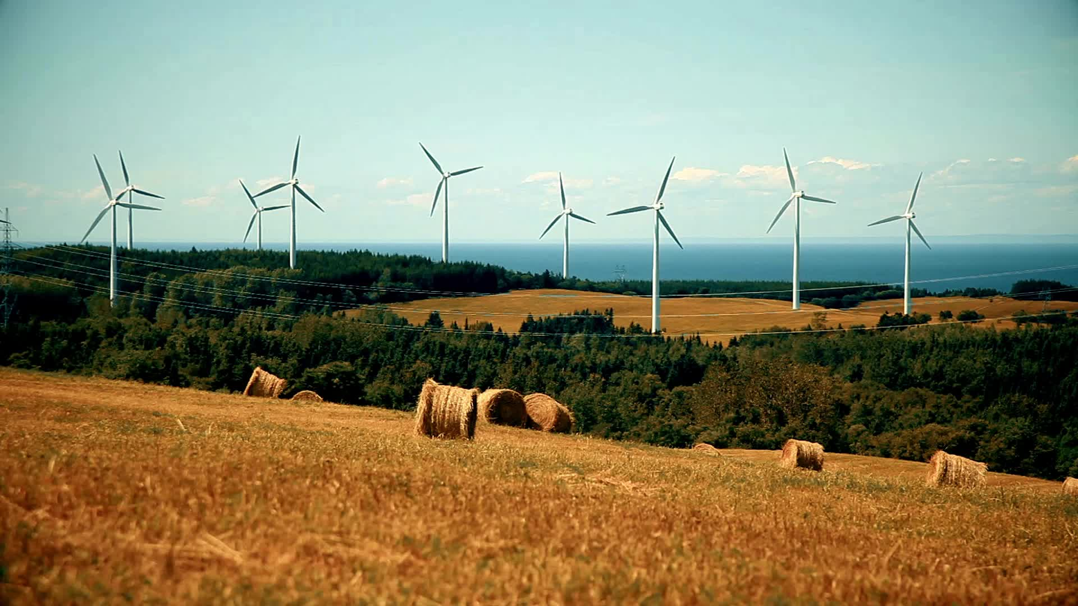
Responsibility and Sustainability

Slide 8
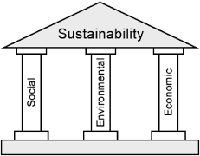
Sustainability
„Sustainable development meets the needs of the present
without compromising the ability of future generations
to meet their own needs.“ (Brundtland, 1987)
Notes:
Wkeuhdliwequdhli hliqeuwdhiluw

Slide 9

Sustainable Development Goals
Notes:
Skfhwe;cuhwjoifjw;ofiqw;iefj;weqjfeqw

Slide 10
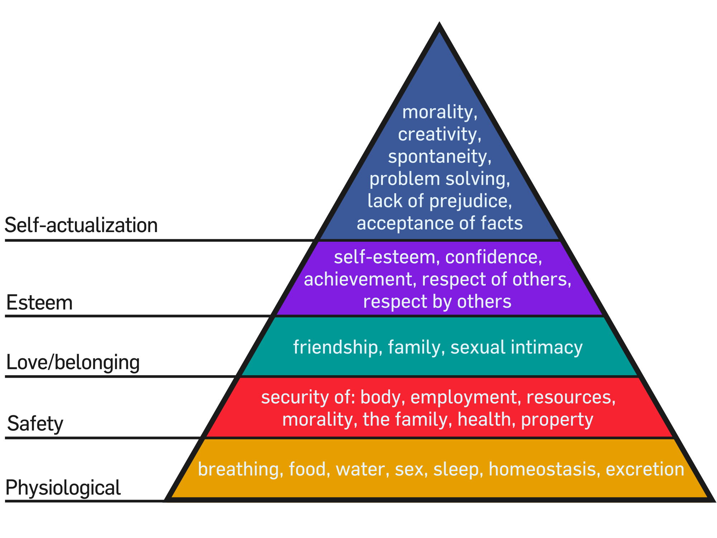
How we look at needs
(Maslow, 1970)

Slide 11

Why do we need to know about needs?
Entrepreneurship is about recognizing (finding) or creating opportunities. You can only do so if you understand the needs of people.
For responsible entrepreneurs, understanding needs is even more essential.
“Embracing human-centered design means believing that all problems, even the seemingly intractable ones like poverty, gender equality, and clean water, are solvable. Moreover, it means believing that the people who face those problems every day are the ones who hold the key to their answer.” (IDEO.org, 2015, page 9)

Slide 12

So why do we need entrepreneurship?
To understand why we need (responsible) entrepreneurship, we need to first understand what role entrepreneurship plays in our societal make-up.

Slide 13
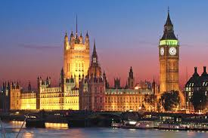
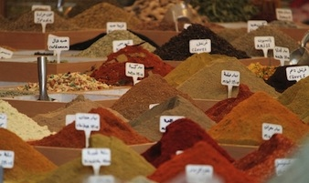
Our problem-solving mechanisms
Our society has multiple mechanisms to solve problems and to fulfill essential tasks: our family, the solidarity of a (religious) community, neighborhoods, and similar structures. These are (still) important today.
The state
The market

Slide 14
Market and State as sources of innovation
State
Market
Democratic and bureaucratic competition for solutions
Market-based competition for viable solutions
  ‘political entrepreneurs’
  ‘commercial entrepreneur’
Entrepreneurs solve problems in order to achieve their own objectives.
Notes:
qwelfiuhgcweoichlulweiuhiewu

Slide 15
The problem-solving abilities of market and state
As problems become more complex, society is in need of more sophisticated learning processes.
The competition to solve problems in market and state is often imperfect.
For many problems, we so far have no satisfying or satisficing solution.
State
Market
Societal problem
What happens to those problems for which the current market and the current state has not found a solution?

Slide 16
Responsible entrepreneurs as drives of societal innovation
State
Market
Societal Problems
Responsible Entrepreneurship
Responsible entrepreneurship cannot substitute either the market or
the government but is a valuable stimuli for innovation. In other words,
it can be societies “R&D“ department.

Slide 17

Social Entrepreneurship

Slide 18
Social Entrepreneurship
”innovative and effective activities that focus strategically on resolving social market failures and creating new opportunities to add social value systematically by using a range of resources and organizational formats to maximize social impact and bring about change” (Nicholls, 2006)
The pursuit of social improvement over profit a distinguishing characteristic of social entrepreneurship (Dees, 1998)
Notes:
Dees, J. G. (1998). The meaning of social entrepreneurship. Fuqua School of Business
Dukes University, 1–6.
Nicholls, A. (Ed.). (2006). Social entrepreneurship: New models of sustainable social change.
OUP Oxford.

Slide 19
What is social entrepreneurship?
Social Entrepreneurship
Social Enterprise School
Social Innovation School

Slide 20

Social Enterprise School
The Social Enterprise School focusses on market income of non-profit organizations. This is called ‘earned income strategy’.

Slide 21
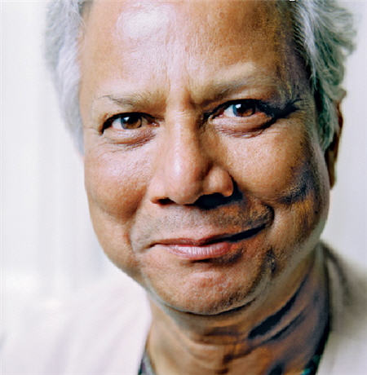
Social Business – the ‘extreme’ social enterprise
Seven Principles of Grameen Social Business
1. Business Objective - will be to overcome poverty or one or more problems (such as education, health, technology access, environment, etc) which threaten people and society, not profit maximization
2. Financial and economic sustainability
3. Investors get back the investment amount only. No divident is given beyond the investment money.
4. When investment amount is paid back, company profit stays with the company for expansion and improvement
5. Environmentally conscious
6. Workerforce get market wage with better working conditions
7. Do it with JOY
Social Business
=
+ social purpose
+ no loss
+ no dividend
The 7 Principles
Focus on
Source of funding
Organizational form
(Yunus, 2007; Yunus & Weber, 2010)

Slide 22

Social Innovation School
They "establish new and better ways to address social problems“ (Dees & Anderson, 2006)
Non Profit Organisation
Hybrid
Social Business
Focus on:
Innovation
Societal change
no restrictions on legal form
(Dees & Anderson, 2006; Defourney & Nyssens, 2010)

Slide 23

Ecopreneurship- preserving natural capital

Slide 24
Ecopreneurship
“entrepreneurship through an environmental lens… entrepreneurial activities that are oriented less towards management systems or technical procedures and focused more on the personal initiative and skills of the entrepreneurial person or team to realise market success with environmental innovations”(Shaltegger, 2002)
  Entrepreneurship based on the principles of sustainability (Kirkwood and Walton, 2010)
Notes:
Kirkwood, J., & Walton, S. (2010). What motivates ecopreneurs to start businesses?. International Journal of Entrepreneurial Behavior & Research, 16(3), 204-228
Schaltegger, S. (2002). A framework for ecopreneurship: Leading bioneers and environmental managers to ecopreneurship. Greener management international, (38), 45-58.

Slide 25
Ecopreneurship and its distinctiveness
Environmental performance core to the business
Alternative Actors
Bioneers
Ecopreneurs
Environmental goals supplementary to core business
Environmental management
Environmental Admin
Environmental action is seen as trustee duty
(Schaltegger, 2002)
Alternative
Niche Market
Mass market

Slide 26

Thanks for Listening

