Slide 1
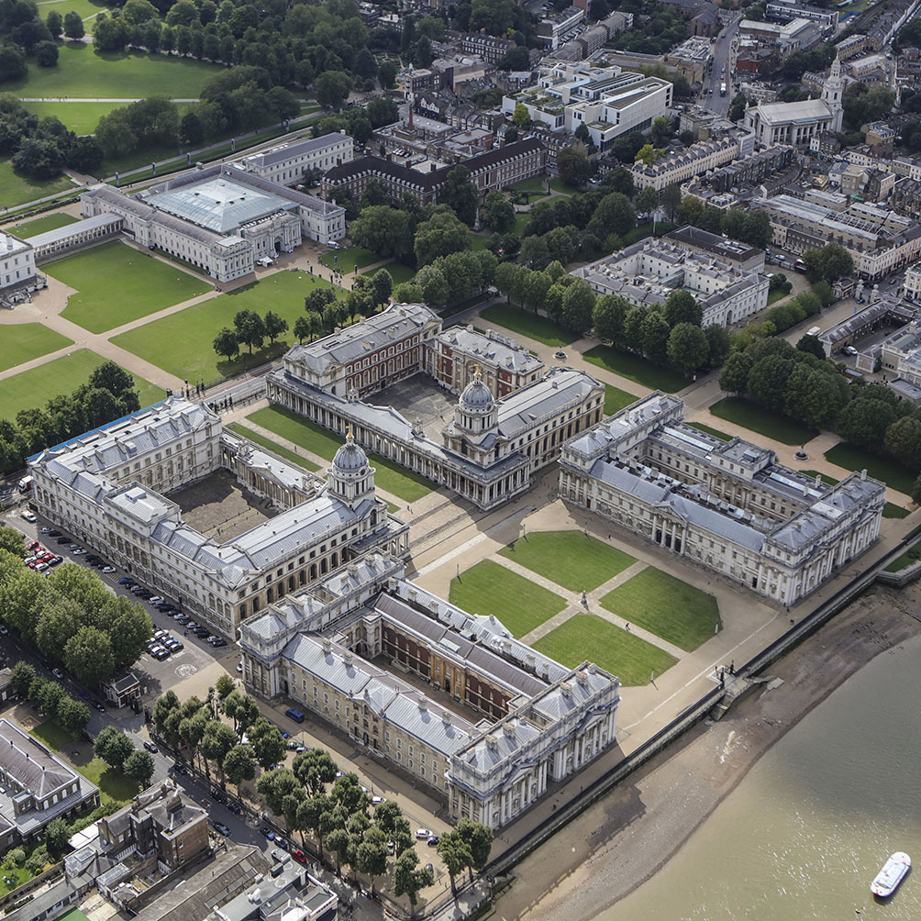
Family Firms
BUSI 1764- Global Entrepreneurship and Innovation
Week 3 Tutorial Slides
170223

Slide 2
Session Outline
Brief Lecture Recap
Discuss Case Studies

Slide 3
LEARNING OUTCOMES
To understand the nature and specific features of family firms
To identify and recognise some of the core values of family firms
To distinguish between family firms and non-family firms
To understand the theoretical perspectives of family firms
To understand the internationalisation pathways of family firms

Slide 4
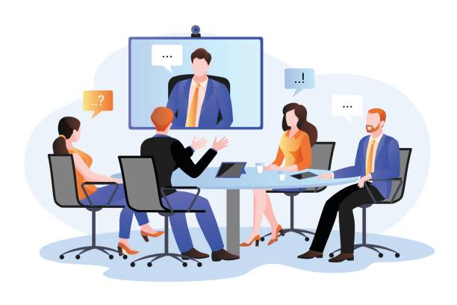
INTRODUCTION
Family firms are business organisations in which decision making is influenced by multiple generations of a family who are related by blood, marriage or adoption.

Slide 5
NATURE OF FAMILY FIRMS
Family businesses are the oldest and most common economic organization.
In some countries, many of the largest publicly listed firms are family-owned.
A firm is said to be family-owned if a person is the controlling shareholder and has the highest percentage of voting rights as compared to other shareholders
Passed from generation to generation
Bound by family norms and values
There is the intertwining of family and business objectives when family members are involved in ownership and management of the business. Unlike most non-family firms that are performance based, family firms are relationship based.
Existence of bifurcation bias - Unbalanced treatment of family and non-family members in a family firm (Verbeke & Kano, 2012).

Slide 6

FAMILY FIRMS CORE VALUES
Family Unity
Long-Term Perspective
Legacy and Tradition
Stewardship
Respect for Employees
Innovation
Open Communication

Slide 7
THEORETICAL PERSPECTIVES OF FAMILY FIRMS
(TO SHOW HOW THEY DIFFER FROM OTHER FIMS)
Agency Theory (Kara et al 2006)
The Concept of Stewardship (Lebreton-Miller & Miller 2009)
Resource Based View (Chrisman et al 2005)
Socio-emotional Wealth
Bifurcation Bias
170223

Slide 8
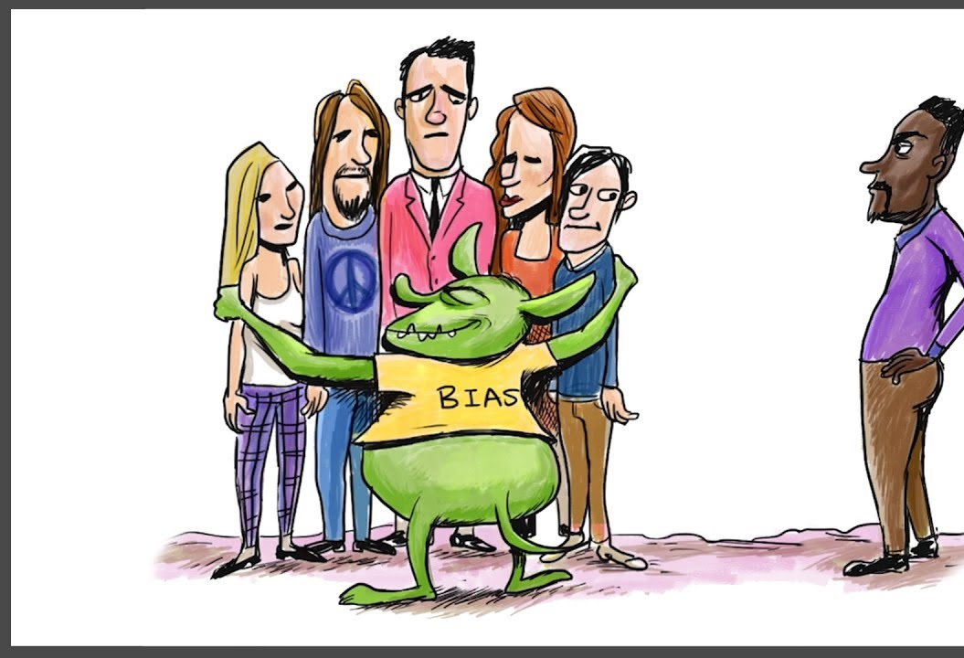
BIFURCATION BIAS IN FAMILY FIRMS
170223

Slide 9
INTERNATIONALISATION PATHWAYS OF FAMILY FIRMS
Follow the Uppsala Model
Some follow the Born Global Parthway
Internationalisation tends to be limited in the first instance to countries with low psychic distance

Slide 10
Case Study Task 1
Read the article on Family Firms (pay attention to Fig 1 on page 3)
Read the case studies on page 5 of the article on Family Firms
What are the reasons for the success and longevity of the 3 Family Firms?
Link your answers to the 25 principles of success of Family Firms?

Slide 11
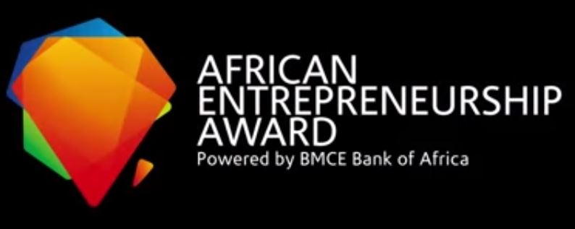
TASK 2
CLASS DISCUSSION
WAS I RIGHT
OR WRONG?

Slide 12
CLASS DISCUSSION
In 2012, I established a manufacturing company that converts used wastepaper into the parent roll that is used for manufacturing toilet rolls, paper napkin (serviettes) and kitchen paper. The whole idea behind setting up the company was so that I could hand it over to my kids when they come of age. The company was also named after my kids. In 2018, I decided to participate in a Business Plan Competition called the African Entrepreneurial Award. The prize money was USD 1 Million. Now, out of the 5400 businesses across Africa that participated in the competition, 40 companies including my company was shortlisted for the finals in Casablanca, Morocco. This was following a rigorous 4-stage screening rounds. We were to make a pitch before a team of high-profile international investors from around the world.
Whilst I was confident of winning, I was also worried that when these investors hear about my business, they may want to be part of it but to be honest, I did not want to share. Following my pitch, I was selected as one of the winners and received a prize money of USD 100,000 as there were 12 winners. Shortly after the award ceremony, I was approached by some of these investors. They said they liked my pitch and that they liked my business model and would like to invest a substantial sum of money in the business in return for equity. I said no that I was not willing to part with any equity in the business. They were shocked and asked if I was sure of my decision and I said yes. I took my prize money of USD100,000 and left.
When I returned home, I told some of my friends what had happened in Casablanca. Although they were happy that I won the USD 100,000 prize money, they said I was wrong for not accepting the offer from the investors. One fellow even said “Sylvester, don’t you know that it is better to have 10 percent of a billion-dollar company than to have 100 percent of a million-dollar company? I still stand by my decision even today.
The question is, was I right or was I wrong? In view of all that we have discussed so far on family firms, provide your thoughts on this matter as aspiring entrepreneurs.

Slide 13
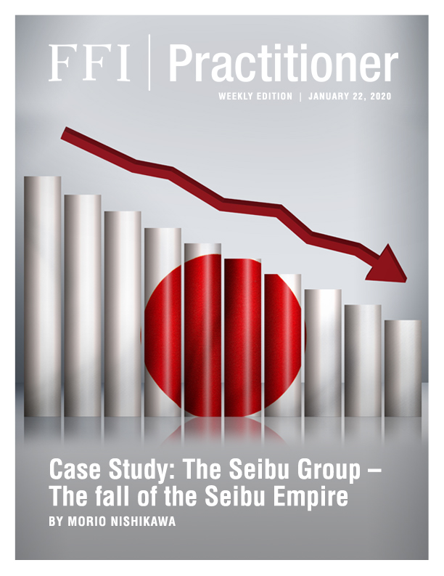
SUCCESSION CASE STUDY
THE SEIBU GROUP: FALL OF THE SEIBU EMPIRE
In 1993, Yoshiaki Tsutsumi, the former owner of Seibu Railway Group, was named the wealthiest man in the world by Forbes, an American business magazine, placing him ahead of Bill Gates, who had topped the previous year’s list. Tsutsumi’s total assets were reportedly worth three trillion yen (US$30 billion at 100 JPY/USD).
WHAT WENT WRONG?

Slide 14
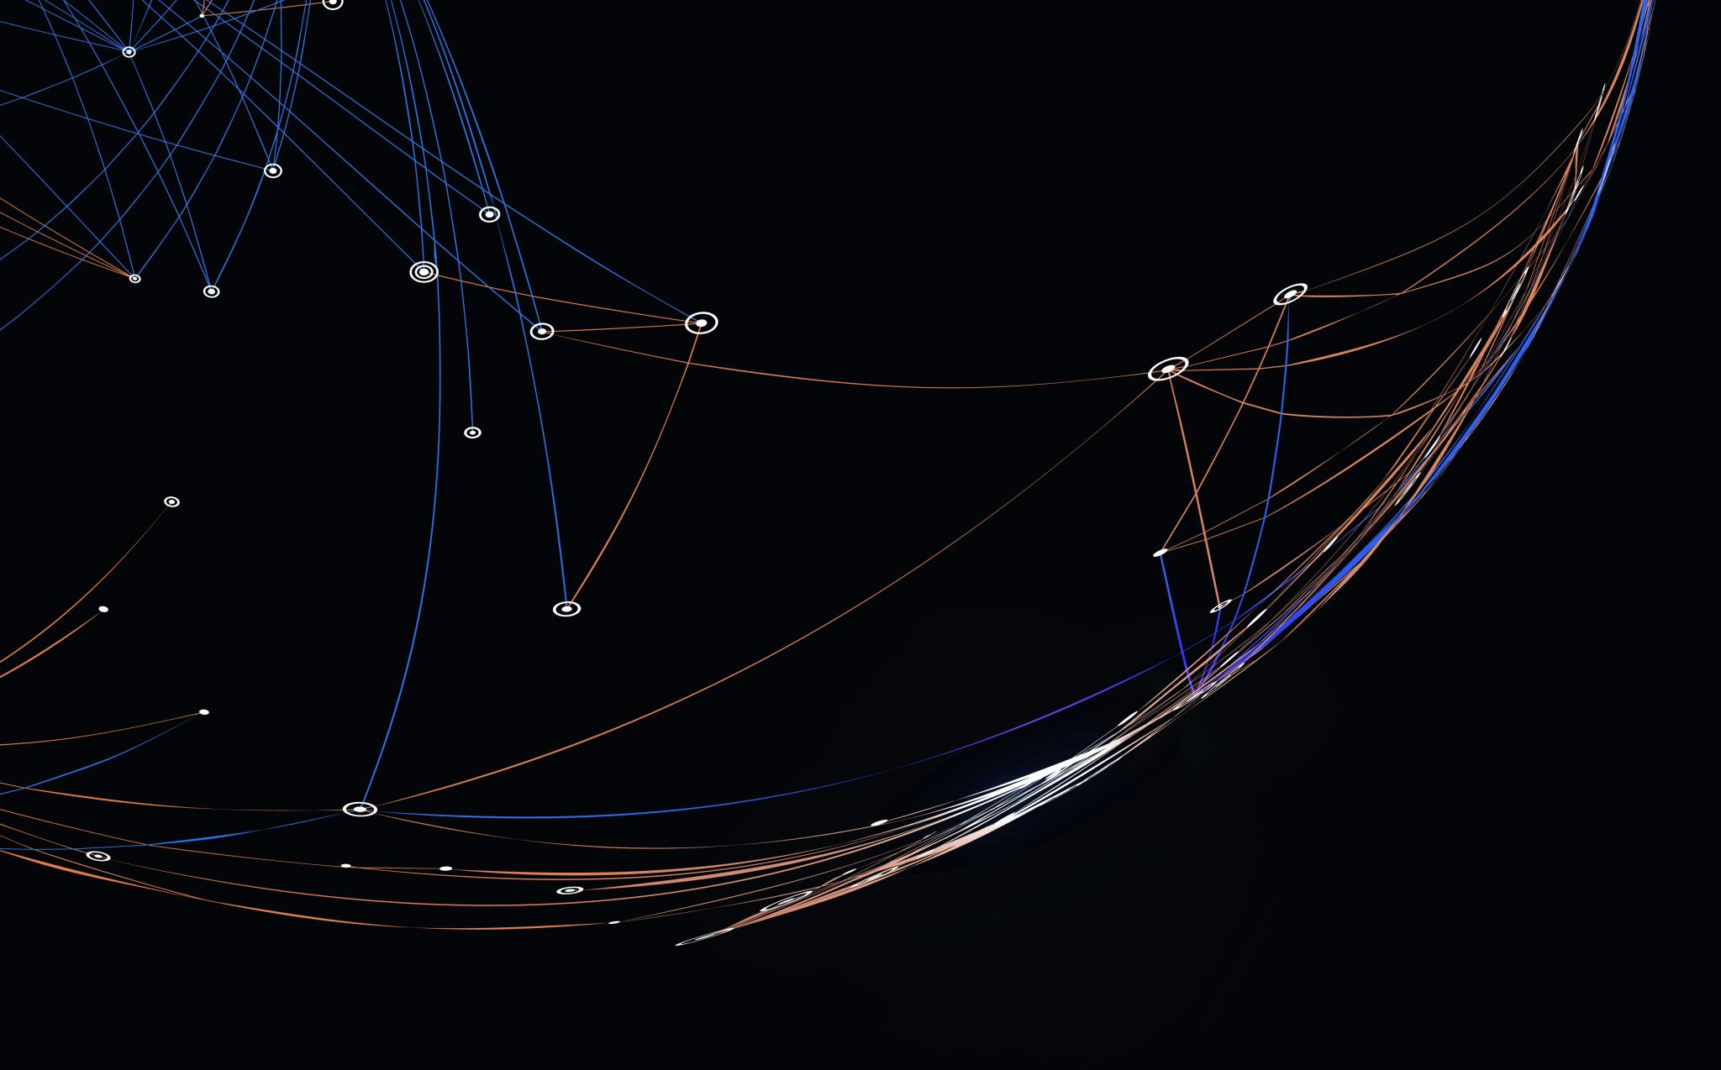
Thank you

Slide 15
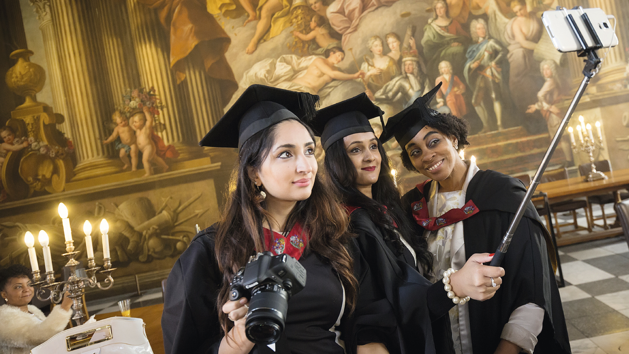

Be inspired

