Slide 1
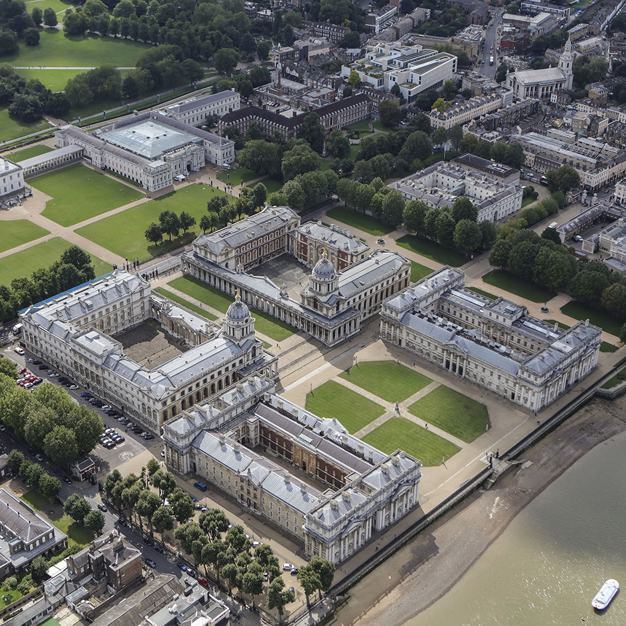
Family Firms
BUSI 1764
Global Entrepreneurship and Innovation
Department: Executive Business Centre
170223

Slide 2
FAMILY FIRMS
PART 3
170223

Slide 3

WAS I RIGHT
OR WRONG?

Slide 4
INTERNATIONALISATION PATHWAYS OF FAMILY FIRMS
Family firms tend to follow the Uppsala Model in their internationalisation
Internationalisation tends to be limited in the first instance to countries with low psychic distance
Some follow the Born Global Partway
Reliance on Networks ties
Internationalisation is with customers & suppliers
- Usually based on high level of trust

Slide 5
FACTORS RESTRICTING INTERNATIONALISATION OF FAMILY FIRMS
They sometimes refuse to accept help from externals
Not very receptive to recruiting externals
Founding family may restrict internationalisation ideas from later generation to preserve socio-economic wealth

Slide 6
CONCLUSION
170223

Slide 7
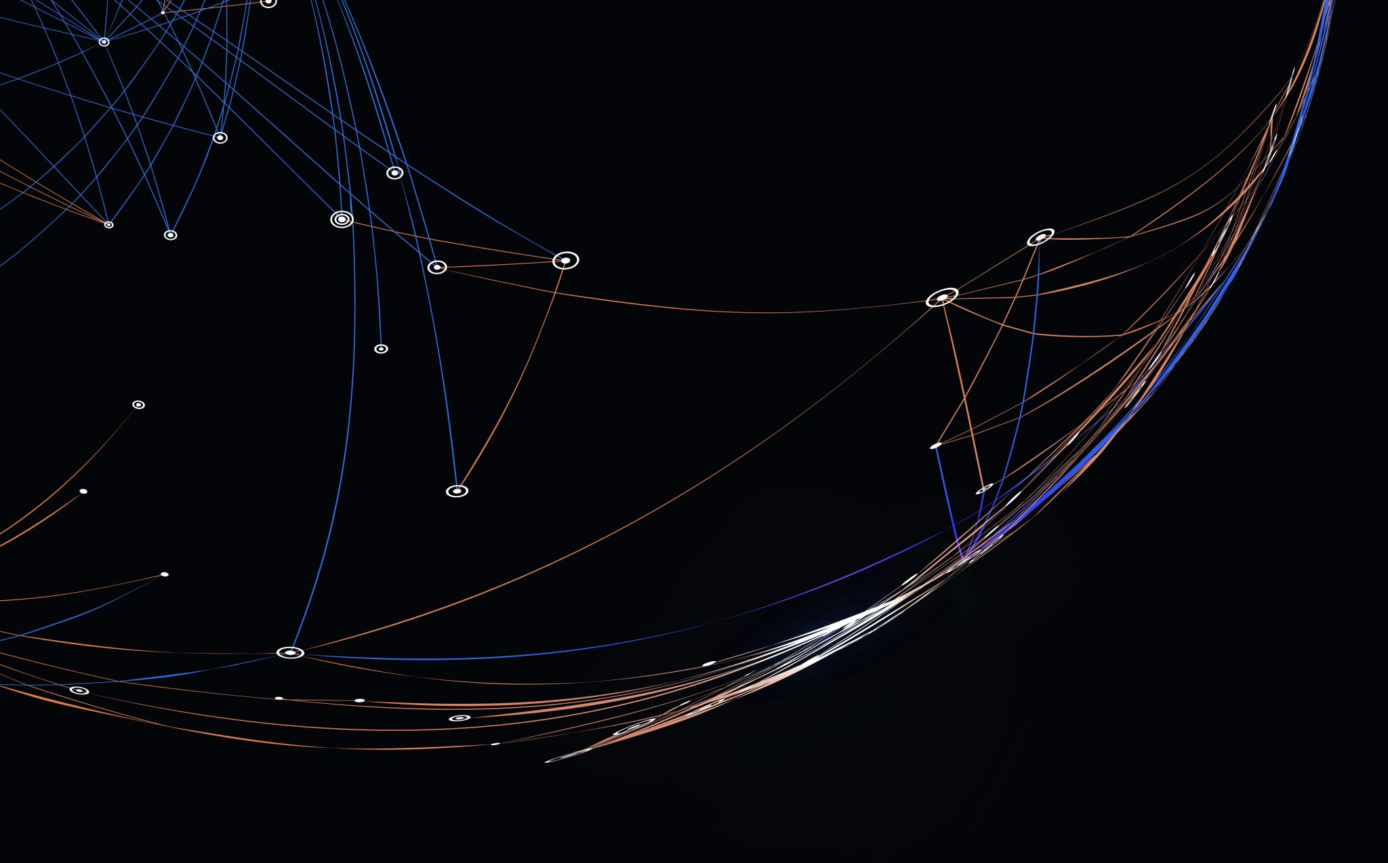
Thank you

Slide 8


Be inspired

