Slide 1

Family Firms
BUSI 1764
Global Entrepreneurship and Innovation
Department: Executive Business Centre
170223

Slide 2
Family Firms
PART 2
170223

Slide 3
THEORETICAL PERSPECTIVES OF FAMILY FIRMS
(TO SHOW HOW THEY DIFFER FROM OTHER FIMS)
Agency Theory (Kara et al 2006)
The Concept of Stewardship (Lebreton-Miller & Miller 2009)
Resource Based View (Chrisman et al 2005)
Socio-emotional Wealth
Bifurcation Bias
170223

Slide 4

AGENCY PROBLEMS IN FAMILY FIRMS
Also known as the principal-agent paradigm,
Agency theory emphasises the contractual problem between a firm’s principal, generally known as the owner, and a firm’s agents who is the employed executives that control the use of resources.
170223

Slide 5

STEWARDSHIP IN FAMILY FIRMS
Owner managers of family firms see themselves as stewards over the family business assets and its continuity.
These family managers would always seek to protect the assets of the family firm rather than pursue interests that maximise their own personal gain.
170223

Slide 6

THE RESOURCE-BASED VIEW IN FAMILY FIRMS
The Resource-Based View (RBV) theory is a strategic management framework that emphasizes the importance of a firm’s internal resources in achieving sustainable competitive advantage and superior performance (Penrose 1959)
This relates to the kind of resources that the family firms use in order to be successful

Slide 7
THE SOCIO-EMOTIONAL WEALTH IN FAMILY FIRMS
Socioemotional Wealth (SEW) is defined as the ‘non-financial aspects of the firm that meet the family's affective needs’ (Gómez-Mejía, Haynes, Núñez-Nickel, Jacobson, & Moyano-Fuentes, 2007)

Slide 8
EXAMPLES OF HOW FAMILY FIRM OWNERS PRESERVE SOCIO-EMOTIONAL WEALTH
Family-owners derive socioemotional wealth from several sources, including
Having the family name associated with their firms,
Emotional attachment to the firm, and the satisfaction of family members working for the company (Gómez-Mejía et al., 2011).
Decisions that seem unprofessional to outside observers, such as appointing an unexperienced family member as the CEO of the firm, might be logical to family-owners because they provide nonfinancial benefits.
Family’s owners desire to preserve socioemotional wealth affects family firms’ long-term performance both positively and negatively.
170223

Slide 9
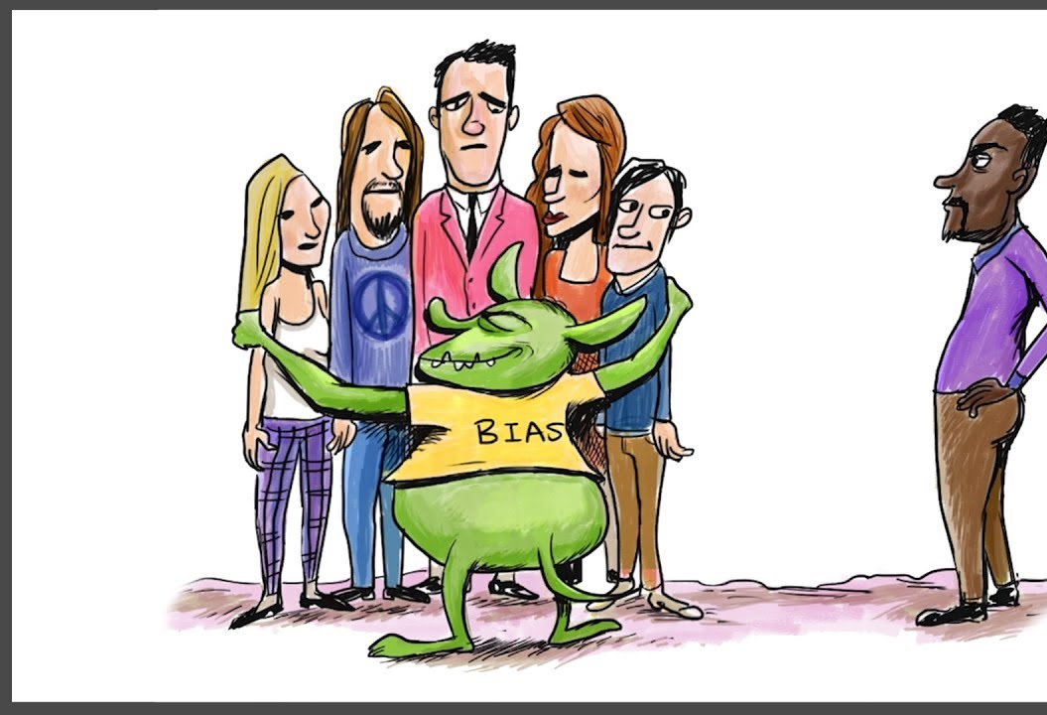
BIFURCATION BIAS IN FAMILY FIRMS
170223

Slide 10
CONCLUSION
170223

Slide 11

Thank you

Slide 12


Be inspired

