Slide 1



BUSI 1764
Global Entrepreneurship and Innovation
Dr Emilio Costales
Week 2: 2 October, 2024
Tutorial 2: Innovation and Global Competitiveness

Slide 2
Session Objectives
Develop your ability to identify innovation as a tool for enhancing Global Competition
Analyze innovation as a basis of differentiation
Practice navigating the business environment

Slide 3
Agenda
Recapping the Mini Lectures
Tools for Innovation: the Business Model Canvas and AirBnB
Case Study: Toyota

Slide 4

Recapping the Mini Lectures
Join at Menti.com
Use code: 8104 0333

Slide 5

What is opportunity?

Slide 6
Are opportunities discovered or created?
Discovery can be seen as ‘’filling gaps’’
Creation can be seen as ‘creating gaps’
Gaps can follow creation opportunities – GrabTaxi following Uber to fill gaps in Asia, Hailo (UK); CitizenM following AirBnB to fill gaps for mobile customers
Also, creation opportunities can follow gaps filled - Netflix vs Blockbuster (filled the gap of avoiding late return fees to creating opportunity from renting to delivering its movies by broadband)
Source: Zucchella, Hagen and Serapio (2018)

Slide 7


Example of discovered opportunities
Intuitive Surgical – young US start-up 1995, in 2000 launched the Da Vinci Surgical System
Factors that created the opportunity
- advancement in robotic & telemedicine technologies
- shortage of surgeons in the US/competition among hospitals in the use of high-tech equipment
-Change in regulatory environment. FDA becoming more supportive of robotic surgical systems
tremor-filtration technology
Source: Zucchella, Hagen and Serapio (2018)
Notes:
Other case studies may include TESLA

Slide 8



Examples of created opportunities
Steve Jobs and the iPad went against what the market wanted and what technology ‘allowed’
AirBnB
Netflix vs Blockbuster
A cheaper notebook instead of a tablet (failure of the tablet was predicted by many analysts)
created a completely different business model in the lodging industry “booking unique homes and experiencing a city like a local resident”
Reed Hastings originally said company emerged due to late fees
Source: Zucchella, Hagen and Serapio (2018)

Slide 9
Dynamic capabilities
Companies with strong dynamic capabilities are entrepreneurial (Teece, 2007). They have strong capacities in three key areas:
Sensing: identification and assessment of opportunities at home and abroad
Seizing: mobilizing of resources globally to address opportunities
Transforming: continued renewal, innovativeness e.t.c
Source: Zucchella, Hagen and Serapio (2018)

Slide 10
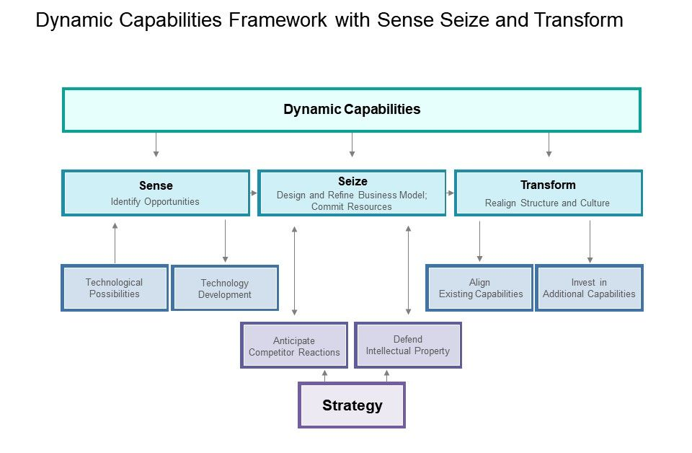
Dynamic capabilities framework
Source: https://www.slideteam.net/

Slide 11
Internationalizing
Mistakes can play a huge role in influencing the transformation process in dynamic capabilities. They can inform development of rules to deal with future opportunities.
The transformation process play an important part in an organization’s market selection and entry for its products
Product/service features can be altered to suit the customer preference of foreign customers
Source: Zucchella, Hagen and Serapio (2018)

Slide 12

Where does Innovation come in?
Incremental Innovation: Small, gradual improvements to existing products, services, or processes. Typically enhance efficiency, functionality, or quality without fundamentally altering the core offering.
Radical Innovation: Significant, transformative changes that introduce entirely new products, services, or ways of doing business. Often involve breakthrough technologies or novel approaches that create new markets or dramatically reshape existing ones.
Sustaining Innovation: Improvements that enhance the performance of established products or services along dimensions historically valued by mainstream customers. Can include both incremental and more significant advancements.
Disruptive Innovation: Innovations that initially serve a niche market with a product or service that may be simpler, cheaper, or more convenient than existing offerings. Over time, these innovations improve and move upmarket, eventually displacing established competitors.
Process Innovation: Improving or redesigning how a company creates or delivers its products or services. Focuses on enhancing efficiency, reducing costs, or improving quality in internal operations.
Product Innovation: Developing new products or significantly improving existing ones to meet market needs or create new markets. This can involve changes in functionality, design, or features.
Business Model Innovation (revenue model innovation): Fundamentally changing how a company creates, delivers, and captures value. Involves altering revenue streams, customer relationships, or key activities.

Slide 13



Anywhere in our Business Model
Business Model
Value Proposition
Value Architecture
Revenue Model

Slide 14
Process Innovation
Product Innovation
Business Model Innovation

Slide 15
BMC- The alternative view

Slide 16

How does this lead to competitiveness and survivability?

Slide 17
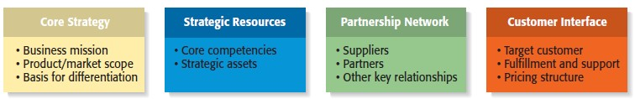
Building and managing a new entrepreneurial firm – 4 framework strategies - for longer sustainability in the market
A new firm must have a framework that helps build and manage operations to sustain itself in different markets for a longer period:
how a firm
competes
how a firm acquires and uses its resources
how a firm structures and nurtures its partnerships
how a firm interfaces with its customers

Slide 18
1. Core Strategy – How a firm competes
Core Strategy
The first component of the framework is the core strategy, which describes how a firm competes relative to its competitors.
Primary Elements of Core Strategy
  Mission statement.
  A firm’s mission, or mission statement, describes why it exists and what its framework is supposed to accomplish.
  B. Product/market scope.
  Offerings to the customers, product lines/extensions, and B2B or B2C international markets.
  C. Basis for differentiation.
  It is important that a new venture differentiate itself from its competitors in some way that is important to its customers. If a new firm’s products or services aren’t different from those of its competitors, why should anyone try them?
  Cost leadership strategy (Price)
  Differentiation strategy (Product and services)

Slide 19
2. Strategic resources - how a firm acquires and uses its resources
  A. A firm’s core competencies. (A core competency is a resource or capability that serves as a source of a firm’s competitive advantage over rivals). A firm’s core competencies determine where a firm is able to create the most value.
In the short term, it is a company’s core competencies that allow it to differentiate itself from its competitors and create unique value.
In the long term, it is important to have core competencies to grow and establish strong positions in complementary/new markets.
Strategic Resources
  A firm is not able to implement a strategy without resources, so the resources a firm has affects its framework substantially.
  New ventures ultimately try to combine their core competencies and strategic assets to create a sustainable competitive advantage.
B. Strategic assets. are anything rare and valuable that a firm owns. They include plant and equipment, location, brands, patents, customer data, a highly qualified staff, and distinctive partnerships etc.

Slide 20
3. Partnership network - how a firm structures and nurtures its partnerships (outsourcing/insourcing)
An example: Dell sought to differentiate itself from competitors through its expertise in assembling computers but buys chips from others, primarily Intel. Dell could manufacture its own chips, but it didn’t have a core competency in this area. Similarly, Dell relies on UPS and FedEx to deliver its products because it would be silly for Dell to build a nationwide system to deliver its computers.
  A firm’s partnership network includes:
    Suppliers. (To insource products)
    Partners. (To outsource products)
    Other key relationships. (Logistics companies)
Partnership Network
- New ventures, in particular, typically do not have the resources to perform key roles.
In most cases, a business does not want to do everything itself because the majority of tasks needed to build a product or deliver a service are not core to a company’s competitive advantage.

Slide 21
4. Customer interface - how a firm interfaces with its customers
  A. Target/Niche customer. New firm can focus its marketing and promotional campaigns, and it can develop deep core competencies pertaining to its specific marketplace.
  - Niche customers – Niche selective marketing campaigns.
Customer Interface (traditional/digital)
The way a firm interacts with its customer before, during and after sales.
The type of customer interaction depends on how it chooses to compete.
An example: Amazon and ebay.com sells products over the Internet and Ryman stationaries sells through its traditional bookstores and online.
B. Fulfilment and support. Fulfilment and support describes the way a firm’s product or service reaches it customers. It also refers to the channels a company uses and what level of customer support it provides.
  - Customer service can include delivery and installation, financing arrangements, customer training, warranties and guarantees, repairs, convenient hours of operation, convenient parking, and information through toll-free numbers and Web sites.
C. Pricing model. Pricing models vary, depending on a firm’s target market and its pricing philosophy. The practice of letting customers explicitly set prices they are willing to pay for products and services. Such as,
  - Monthly instalments, Minimum deposit and remining on finance/credit. IFC (Interest Free Credit).
- A company must also choose whether to charge its customers directly or indirectly through a service provider.

Slide 22

Navigating Complexity: Using the Business Model Canvas

Slide 23
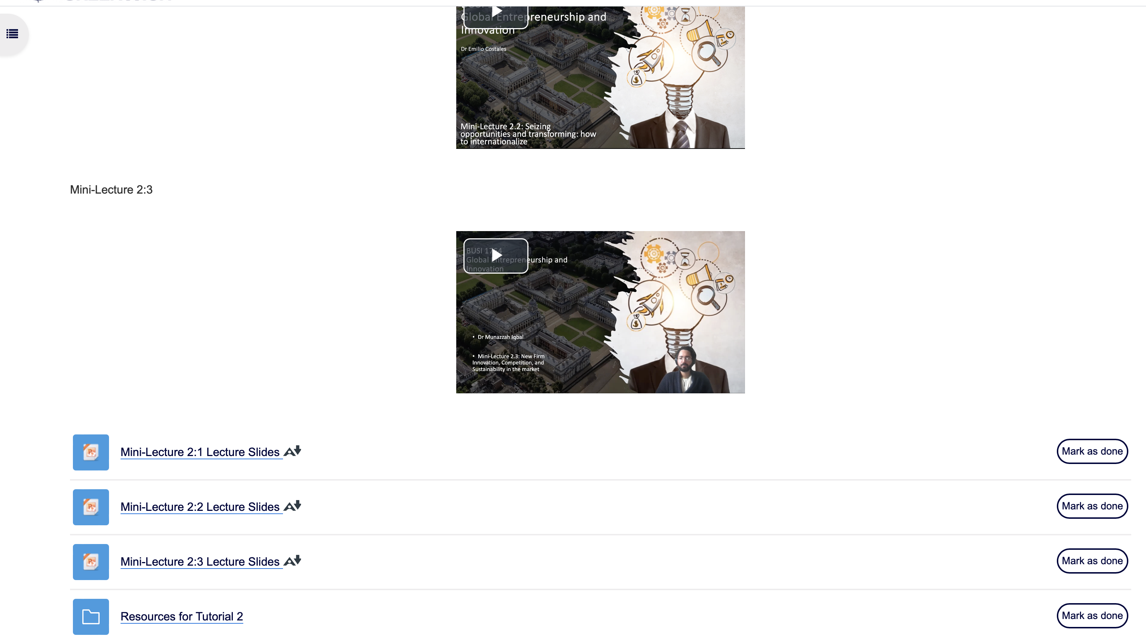
Open the Airbnb case study

Slide 24

Airbnb
1. What is AirBnb’s core business model? Describe its revenue streams, value proposition, key resources, and customer segments.
Business Model
Value Proposition
Value Architecture
Revenue Model

Slide 25
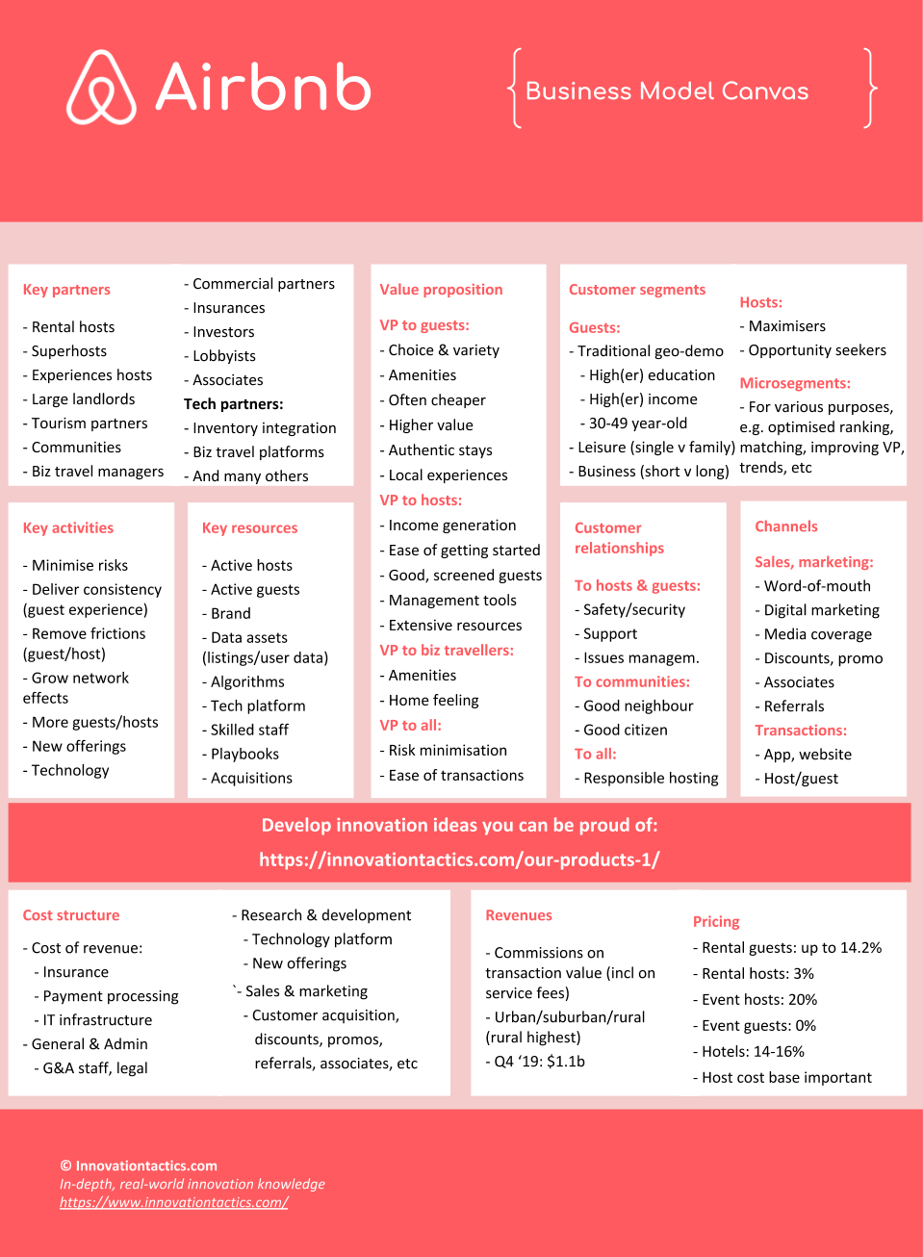
Business Model Canvas- AirBnB

Slide 26
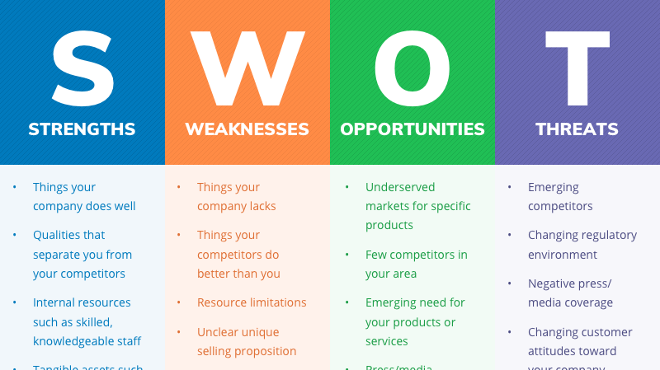
Airbnb- using lean canvas tools

Slide 27
Airbnb- SWOT
Using the SWOT analysis:
2. What are the key drivers of success for this business model? What factors contribute most significantly to the company's competitive advantage and profitability?
3. Can you identify any potential opportunities for the company to further optimize or innovate its business model? Are there untapped markets, new technologies, or emerging trends that the company could leverage?
4. Identify potential threats, (remember thePESTEL framework), how might you respond to these potential challenges?
5. Choose and Identify AirBnB’s: Core Strategy; Strategic Resources; Partnership Network; or Customer Interface

Slide 28
Case Study: Toyota

Slide 29
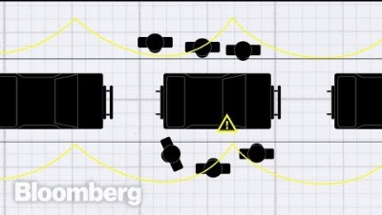
Your Turn: Toyota
Notes:
https://youtu.be/F5vtCRFRAK0?si=MBoy1rVxdBePjZA0

Slide 30
Toyota – where does innovation lead to competitiveness?
To attract and attain customers with high-valued products and services and the most satisfying ownership experience.
Automotive products for B2B and B2C customers of different segmentations.
Quality, reliable and cost-effective products.
Hybrid & Electric vehicles, good suspension system and great price, reliable products.
Almost everywhere in the world, good centers/locations of dealers and sales and spare parts.
Over 800+ suppliers based on an open-door policy relationship.
The majority of SME suppliers help to manufacture different products.
Logistic partners – operate a milk-run service, picking up parts from multiple supplier locations delivering just-in-time to support our production and B2B and B2C customers.
B2B, B2C, B2G (Demographic, Geographic & Behavioural customers).
After-sales service, customer support centers, product delivery services and installation of electric vehicle chargers.
Personal and business finance.

Slide 31
Thanks for Listening!

