Slide 1


BUSI 1764
Global Entrepreneurship and Innovation
Dr Emilio Costales
Mini-Lecture 2.1: Opportunity theories and Innovation

Slide 2

What is opportunity?

Slide 3
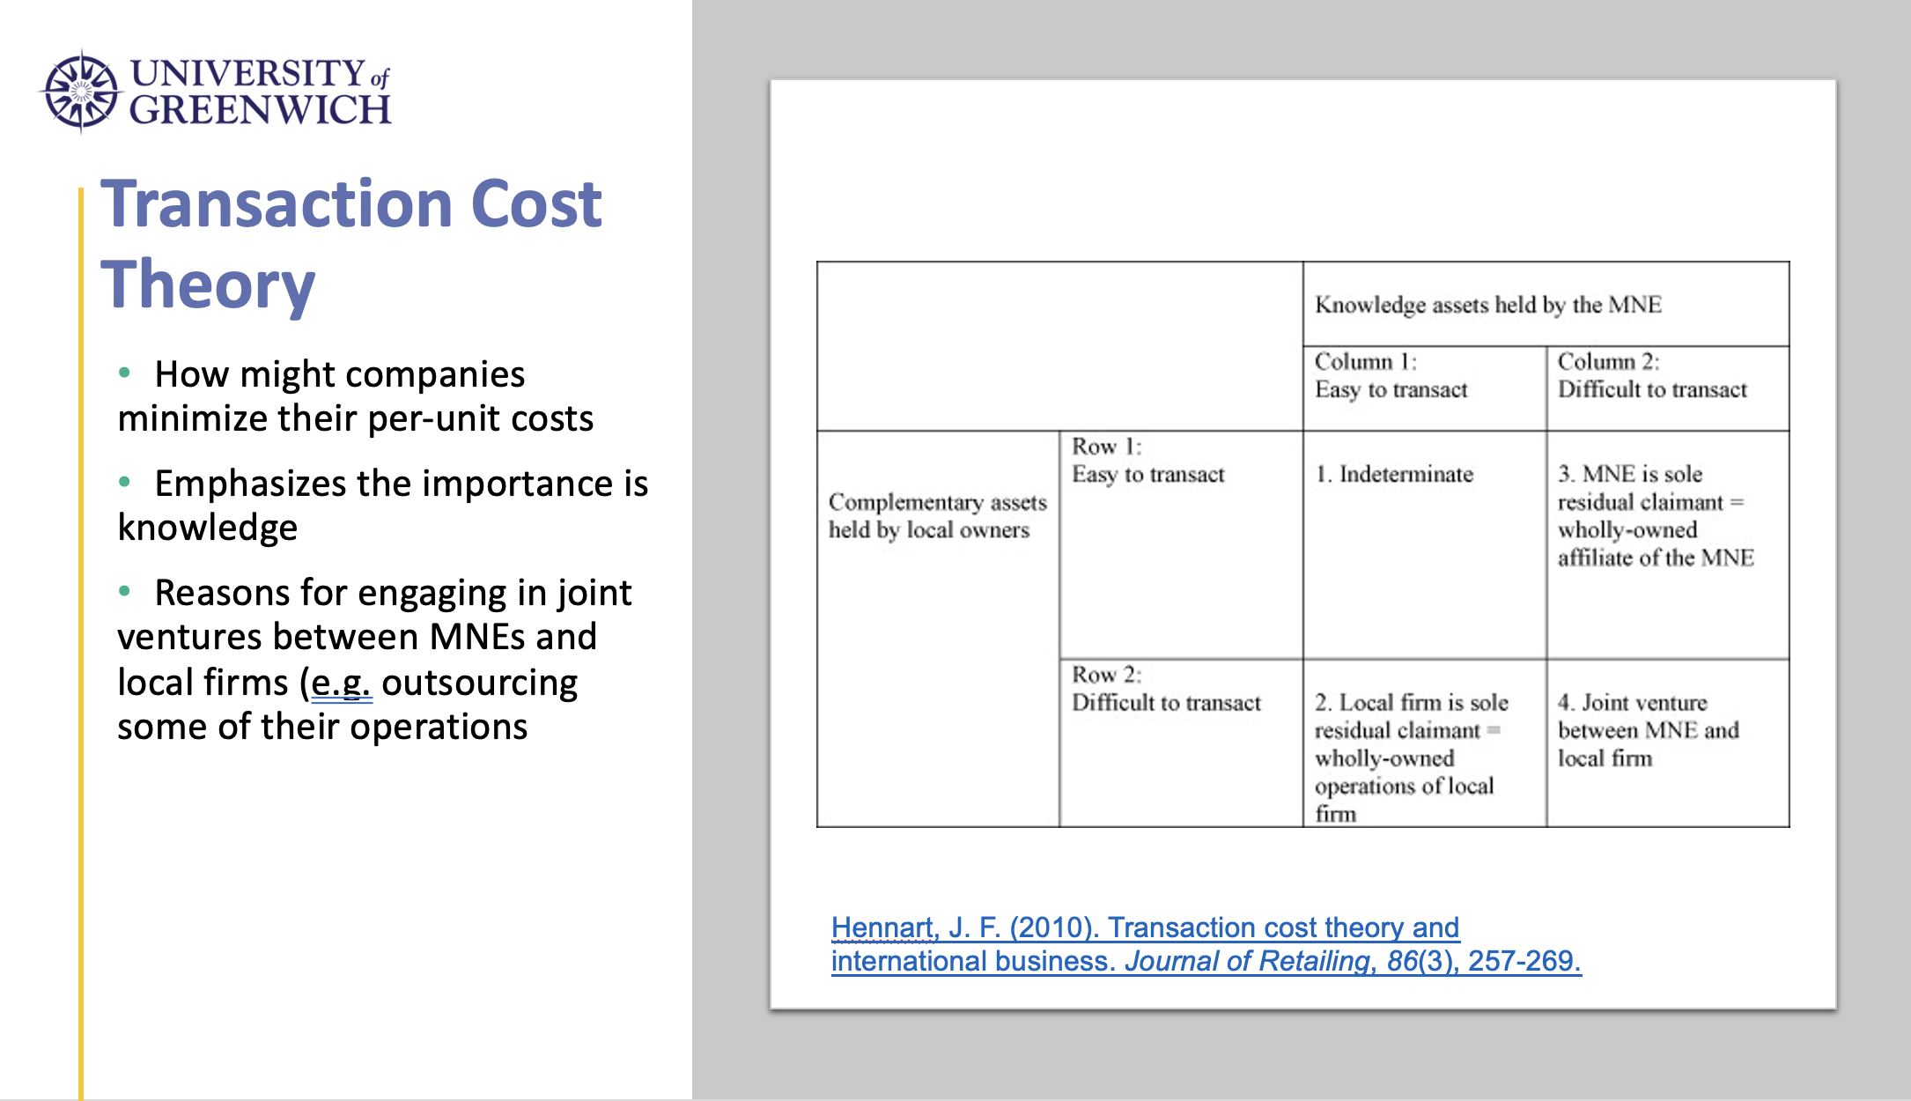

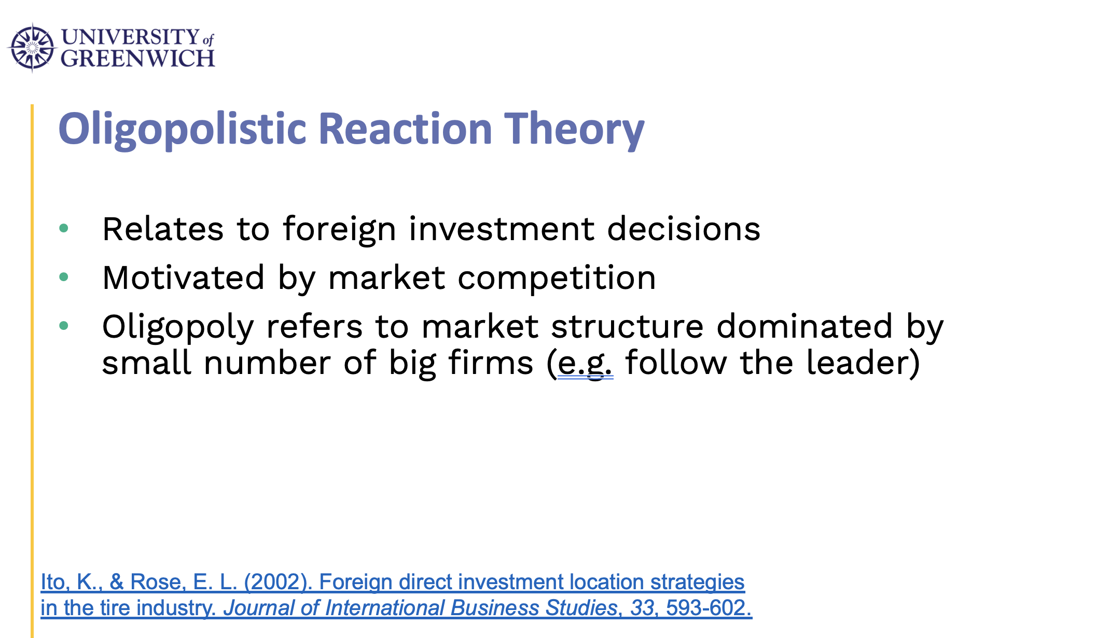
Market imperfection
Refers to a situation where a perfect market does not exist
Typical in international trade

Slide 4
Assumptions of a perfect market
Assumptions of a perfect market:
Buyers and sellers are both price takers
Sellers sell homogeneous products – same goods, same price
Buyers and sellers have perfect information about prices charged by others, production capability of others, and immediate access to resources used by other sellers.
There are no barriers to entry or exit for sellers

Slide 5
How can we define opportunity?
Economic agents attenuate to imperfections in the market
Entrepreneurs have the capabilities to capitalize and take advantage of these imperfections
The key goal of entrepreneurship is the pursuit of economic profit…the potential of realizing economic profit defines an opportunity
Source: Zucchella, Hagen and Serapio (2018)

Slide 6
Nature of opportunities: theoretical perspectives
Opportunities
Discovery theory
Creation theory
Source: Zucchella, Hagen and Serapio (2018)

Slide 7
Nature of opportunities: theoretical perspectives
Both perspectives agree opportunities result from market/product imperfections
However, both differ on
-nature/origin of these imperfections
-the nature and role of entrepreneurs
-nature of decision-making context
Source: Zucchella, Hagen and Serapio (2018)

Slide 8
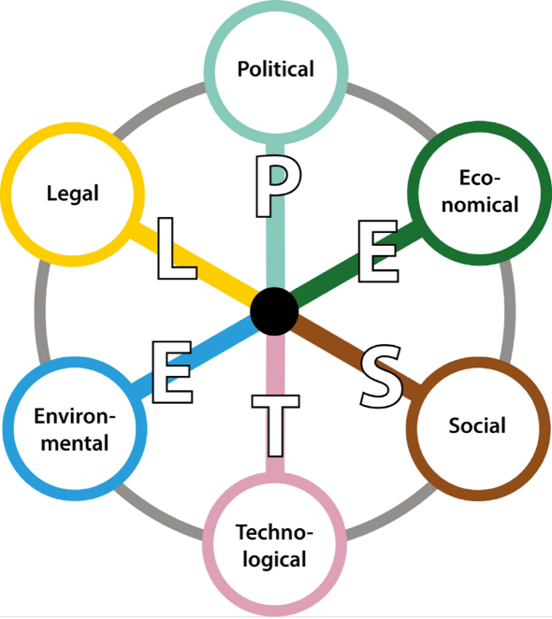
Nature of opportunities: theoretical perspectives
Nature of opportunities
Discovered opportunities:
-Exist as objective phenomena
-Independent of action of the entrepreneur
-Entrepreneurs search and discover opportunities
-Outcome probabilities are known
Created opportunities:
-Do not exist by themselves, dependent on action of the entrepreneur
-Entrepreneurs form and shape opportunities
-Outcome probabilities are not known
Source: Zucchella, Hagen and Serapio (2018)

Slide 9
Discovered versus created opportunities
 | Discovered opportunities | Created opportunities
Nature of opportunities | Opportunities exist as objective phenomena and independent of entrepreneurs. | Opportunities do not exist by themselves; they are dependent on the actions of entrepreneurs.
Nature and Role of Entrepreneurs | Ex ante differences between entrepreneurs and non-entrepreneurs. Entrepreneurs search and discover opportunities. | Ex post differences between entrepreneurs and non-entrepreneurs. Entrepreneurs shape and form opportunities.
Nature of Decision Making context | Risky: outcome probabilities are known. | Uncertain: outcome probabilities are not known.
Source: Zucchella, Hagen and Serapio (2018)
Notes:
Discovered – opportunities are objective phenomena ( they are caused by exogenous factors such as shifts in tech changes, changes to consumer preference, political changes, regulatory changes, e.t.c; opportunity exist waiting to be discovered). key difference between entrepreneurs and non-entrepreneurs is ex ante, actions taken prior/before an opportunity is discovered. ‘Alertness’ to identify and exploit opportunities. Decisions are made under conditions of risk, but entrepreneurs are able to evaluate the risk-reward profiles and outcome probabilities are known- some entrepreneurs are better equipped resource and information wise and to undertake this risk evaluation than others; hence they do better and faster.
Created opportunities: opportunities created by actions endogenous to entrepreneurs through their actions and reactions to produce new products/services that don’t exist…in creation theory, entrepreneurs don’t wait for exogenous events to form opportunities, they act and their action lead to creation of opportunities.
In creation theory difference between entrepreneurs and non entrepreneurs is also ex ante, but is more pronounced ex post of previous experiences. Jobs had experiences creating before launch of iPad, created iPhone, iPod, Mac computer.

Slide 10
Mitigating Risk
Uncertainty
Risk?

Slide 11
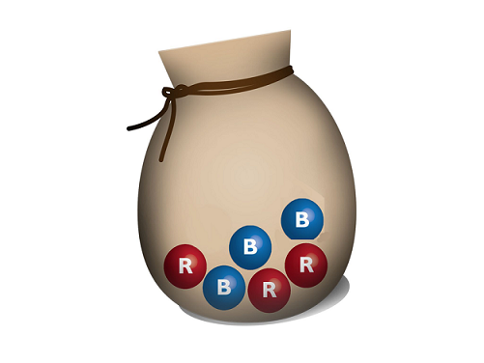

Risk
Uncertainty

Slide 12
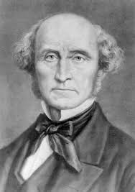
Entrepreneurship and Risk-Taking
“...interest, is all that a person is enabled to get by merely abstaining from the immediate consumption of his capital, and allowing it to be used for productive purposes by others. The remuneration which is obtained in any country for mere abstinence, is measured by the current rate of interest on the best security: such security as precludes any appreciable chance of losing the principal. What a person expects to gain, who superintends the employment of his own capital, is always more, and generally much more, than this. The rate of profit greatly exceeds the rate of interest. The surplus is partly compensation for risk. By lending his capital, on unexceptionable security, he runs little or no risk. But if he embarks in business on his own account, he always exposes his capital to some, and in many cases to very great, danger of partial or total loss. For this danger he must be compensated, otherwise he will not incur it.”
John Stuart Mill (1848)
Principles of Political Economy
Notes:
Mill, John Stuart. Principles of Political Economy with some of their Applications to Social Philosophy. William J. Ashley, ed. 1909. Library of Economics and Liberty. Retrieved April 23, 2015 from the World Wide Web: http://www.econlib.org/library/Mill/mlP.html

Slide 13

Thanks for Listening

