Slide 1

Main Theories of International Business and International Entrepreneurship
BUSI 1764
(Global Entrepreneurship and Innovation)
Week 1 Tutorial Slides
Dr Sylvester Mujakperuo
Module Leader
170223

Slide 2
Session Outline
Develop your ability to identify various elements of innovation​
Analyze the ways in which innovation enhances competitive advantage​
Practice internationalizing based on innovation​

Slide 3

Agenda
Introductory Round
Assessment
Brief Recap
Case Study

Slide 4

Introductory Round

Slide 5

The Big Welcome- Seven Week Framework
Welcome | University of Greenwich
The Big Welcome - Getting Started | Events | University of Greenwich
Week | Date | Theme
0 | 5-9 January | Getting Started
1 | 12-16 January | Well-Being & Support
2 | 19- 23 January | Succeeding in your studies
3 | 26 - 30 January | Making Connections
4 | 2 – 6 February | Managing Your Money
5 | 9 – 13 February | Careers & Next Steps
6 | 16 – 20 February | Assignment Support

Slide 6
Housekeeping
Be sure to attend your tutorials
Please prepare: watch mini-lectures
Communicate and engage
Be critical
Be creative
Get Inspired

Slide 7
Teaching Structure
One-hour Pre-recorded lecture
Two hours in-class tutorial
Must watch pre-recorded lectures before tutorials
Must engage in group activities

Slide 8
Summary of Assessment
Assessment Title | Weight | Length | Due Date
Learning dairy | 30% | 1,000 | 09/03/2026
Individual report | 70% | 2,000 | 30/03/2026
Notes:
Presentation will start wc 14/03/2022: 10 minutes + 5 min Q&A 20% (schedule of group presentations will be made available closer to time)
Group report 20%
Individual report 60%

Slide 9

How can you prepare?
Read the Assessment Guidelines carefully that are available on Moodle
Listen and learn from your group work during these tutorials
Read the examples available on Moodle
Refer Back to Recorded Lectures
Ask Questions!

Slide 10

Recapping the Mini-Lectures

Slide 11

Types of Innovation
Incremental Innovation: Small, gradual improvements to existing products, services, or processes. Typically enhance efficiency, functionality, or quality without fundamentally altering the core offering.
Radical Innovation: Significant, transformative changes that introduce entirely new products, services, or ways of doing business. Often involve breakthrough technologies or novel approaches that create new markets or dramatically reshape existing ones.
Sustaining Innovation: Improvements that enhance the performance of established products or services along dimensions historically valued by mainstream customers. Can include both incremental and more significant advancements.
Disruptive Innovation: Innovations that initially serve a niche market with a product or service that may be simpler, cheaper, or more convenient than existing offerings. Over time, these innovations improve and move upmarket, eventually displacing established competitors.
Process Innovation: Improving or redesigning how a company creates or delivers its products or services. Focuses on enhancing efficiency, reducing costs, or improving quality in internal operations.
Product Innovation: Developing new products or significantly improving existing ones to meet market needs or create new markets. This can involve changes in functionality, design, or features.
Business Model Innovation (revenue model innovation): Fundamentally changing how a company creates, delivers, and captures value. Involves altering revenue streams, customer relationships, or key activities.

Slide 12
Transaction Cost Theory
TRANSACTION COST
The transaction cost approach to the theory of the firm was first discussed by Coase (1937). The author described transaction costs as the cost of providing for some goods and services through the market rather than having them produced within the firm.
Basically, the author grouped transaction cost into 3 categories.
These are the search and information costs
bargaining and decision costs
policing and enforcement costs.
Hennart, J. F. (2010). Transaction cost theory and international business. Journal of Retailing, 86(3), 257-269.

Slide 13
International Product Life Cycle (Vernon’s)
Representation of the relation between profit margin, sales volume, and lifecycle of a product
Introduction (Development) Stage- Characterized by the risk of fit between market need & product/service
Growth Stage- Potential competition become involved
Maturity Stage- Market becomes relatively saturated
Decline- Characterized by Industry transformation and consumer disconnect
Harvard Business Review

Slide 14
Monopolistic Advantage Theory
Stephen Hymer's monopolistic advantage theory suggests that firms with monopolies establish foreign direct investment, FDI, by relocating production to the unfamiliar and sometimes hostile environments of new countries because the ultimate market power advantages make it worth their while.
Presumes that an internationalizing firm or other (FDI) has some sort of market capturing advantage (e.g. technology, social capital, human capital, economies of scale, economies of agglomeration, etc)
Hymer, S. H. (1960). The international operations of national firms, a study of direct foreign investment (Doctoral dissertation, Massachusetts Institute of Technology).

Slide 15
Oligopolistic Reaction Theory
Relates to foreign investment decisions
Motivated by market competition
Oligopoly refers to market structure dominated by small number of big firms (e.g. follow the leader)
The oligopolistic reaction is defined as: the decision of one firm to invest overseas raises competing firms' incentives to invest in the same country (Head, Mayer, Ries, 2002) .
Ito, K., & Rose, E. L. (2002). Foreign direct investment location strategies in the tire industry. Journal of International Business Studies, 33, 593-602.

Slide 16
OLI Model (Eclectic Paradigm)
The eclectic paradigm or the ownership, location and internalisation (OLI) model as often called, is a framework used by firms to ascertain whether or not to embark on Foreign Direct Investment (FDI) in a particular market (Eden and Dai 2010).
The model which was developed by Dunning (1977, 1980, 1993, 2000 and 2001), holds that a company must satisfy three main conditions prior to engaging in FDI.
Firstly, the company must have ownership advantage in terms of requisite skills and other resources including technical, scientific and other physical assets relative to foreign rivals.
The second precondition which companies must satisfy according to the author, is the location advantage. This involves assessing whether there are compelling advantages in undertaking FDI in the host country.
Dunning, J. H., & Lundan, S. M. (2008). Multinational enterprises and the global economy. Edward Elgar Publishing.

Slide 17
OLI Model (Eclectic Paradigm)
The internalisation advantage represents the third precondition a company must satisfy to justify undertaking FDI. The key issues to consider under the internalisation advantage according to Dunning (1988), is establishing whether it remains beneficial or cost effective to perform value chain activities in the home country or to outsource or perform them abroad.
Dunning, J. H., & Lundan, S. M. (2008). Multinational enterprises and the global economy. Edward Elgar Publishing.

Slide 18
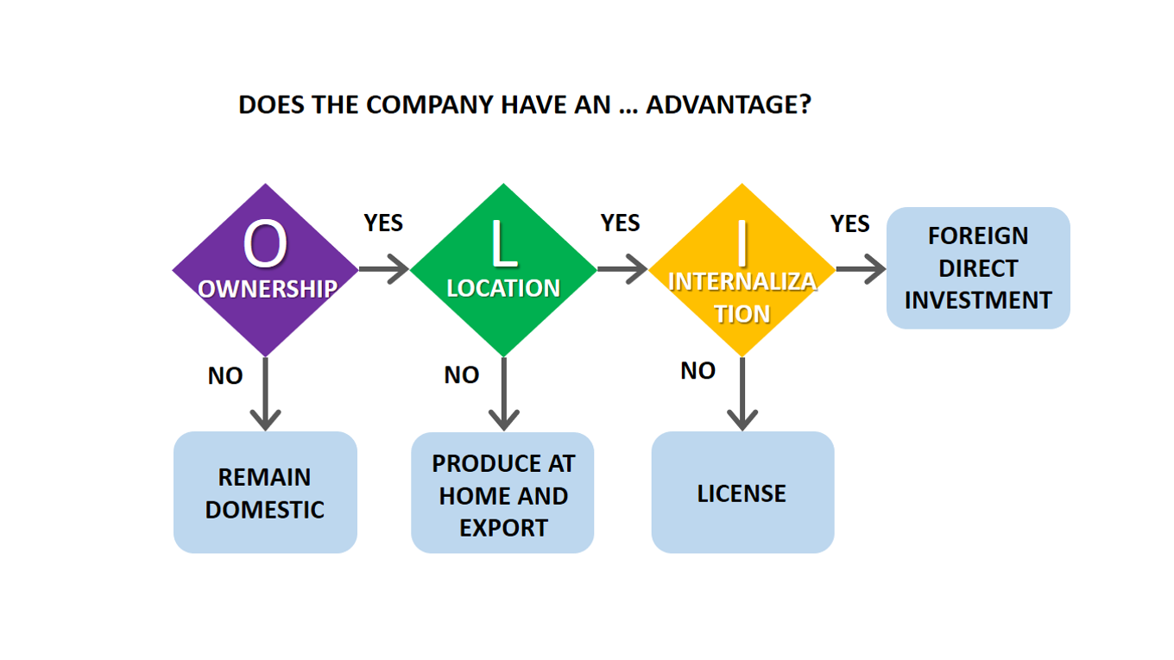
OLI Model (Eclectic Paradigm) (continued)
Tool developed by John Dunning for conceptualizing and understanding how companies might internationalize (I)
Breaks down choice of optimal locations (L) for conducting activities of competitive advantages (O)
Differentiates externally and internally induced organizational change

Slide 19
Uppsala Model
Swedish model: internationalization is evolutionary and temporal process
Knowledge iteratively accumulated
Emphasizes notion of psychic distance
Vahlne, J. E., & Johanson, J. (2017). From internationalization to evolution: The Uppsala model at 40 years. Journal of International Business Studies, 48, 1087-1102.

Slide 20
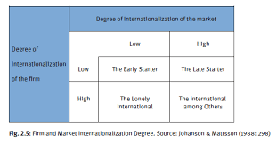
The Network Theory of Internationalisation
The network theory of internationalisation emphasizes the importance of establishing and developing long-term relationships with participants in foreign markets.
It involves cultivating business relationships with customers, suppliers, distributors and governments of the foreign environment.
This implies that companies considering international expansion into foreign markets must make effort to develop their business networks (Johanson and Mattsson 1988).
A company’s position in a network and the nature of relationship it enjoys within the network is a prerequisite for success in its internationalisation process.
.

Slide 21
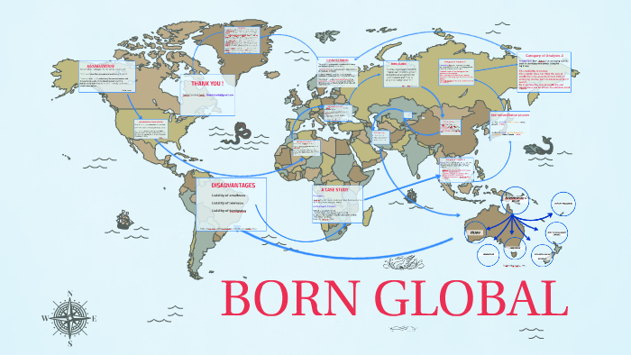
The Born Global Theory
Born Global Firm are firms that from inception, seek to derive competitive advantage through the use of their resources and the sale of their outputs in multiple countries (Oviatt and McDougall 1994).
Other names by which they are called includes:
Global start-ups (Oviatt and McDougall 1994).
International new ventures (McDougall et al 1994)
Instant international (Preece et al 1999)
.

Slide 22
Case Study: Analyzing the External Environment using the PESTEL Framework

Slide 23



Discuss and analyse the following case example
1
Andreas Heinecke
Dialogue Social Enterprises
What is the problem?
How did the entrepreneur identify the problem?
What type of entrepreneurship is this?
What is the key idea of this example?
What is the innovation?
Who benefits from their product/ service directly and how indirectly?
What is (are) their income stream(s)?
How might you bring this to a new market?

Slide 24


Discuss and analyse the following case example
2
Kristian Tapaninaho & Darina Garland
Ooni
What is the problem?
How did the entrepreneur identify the problem?
What type of entrepreneurship is this?
What is the key idea of this example?
What is the innovation?
Who benefits from their product/ service directly and how indirectly?
What is (are) their income stream(s)?
How might you bring this to a new market?

Slide 25


Discuss and analyse the following case example
3
Monisha Narke
RUR Greenlife
What is the problem?
How did the entrepreneur identify the problem?
What type of entrepreneurship is this?
What is the key idea of this example?
What is the innovation?
Who benefits from their product/ service directly and how indirectly?
What is (are) their income stream(s)?
How might you bring this to a new market?

Slide 26


Discuss and analyse the following case example
4
Tope Awotona
Calendly
What is the problem?
How did the entrepreneur identify the problem?
What type of entrepreneurship is this?
What is the key idea of this example?
What is the innovation?
Who benefits from their product/ service directly and how indirectly?
What is (are) their income stream(s)?
How might you bring this to a new market?

Slide 27
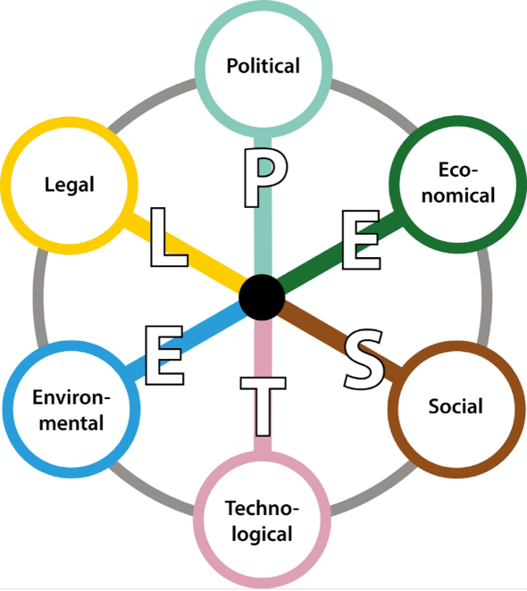
Use the PESTEL Framework to identify the external environment of a new market and use the previously discussed international business tools to examine how you would internationalize this venture
Notes:
UK patents will only give the holder rights in the UK and rights to stop others from importing the patented products into the UK.

Slide 28
Thanks for Listening!
Any Questions:
  Module Leader- Dr Sylvester Mujakperuo
    S.O.Mujakperuo@greenwich.ac.uk

Slide 29


Be inspired

