Slide 1


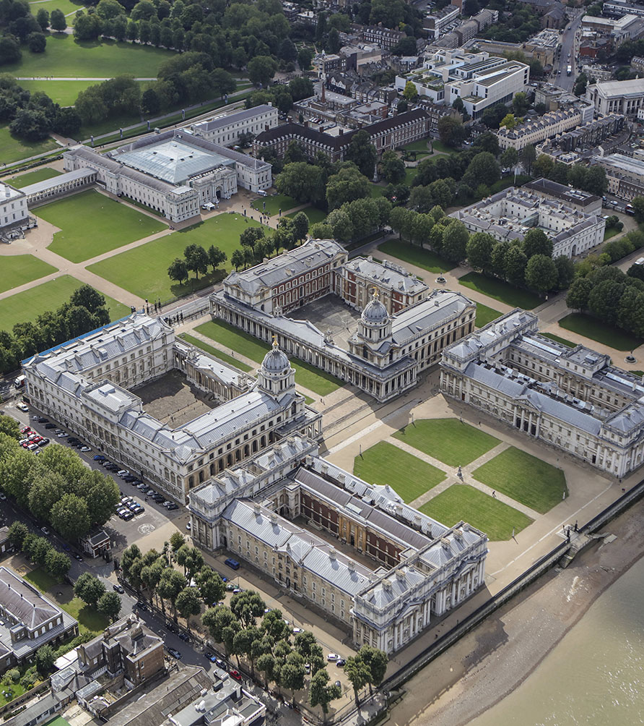
BUSI 1764
Global Entrepreneurship and Innovation
Dr Emilio Costales
Mini Lecture 1.3
Identifying Innovation: Analyzing the External Environment using the PESTEL Framework

Slide 2
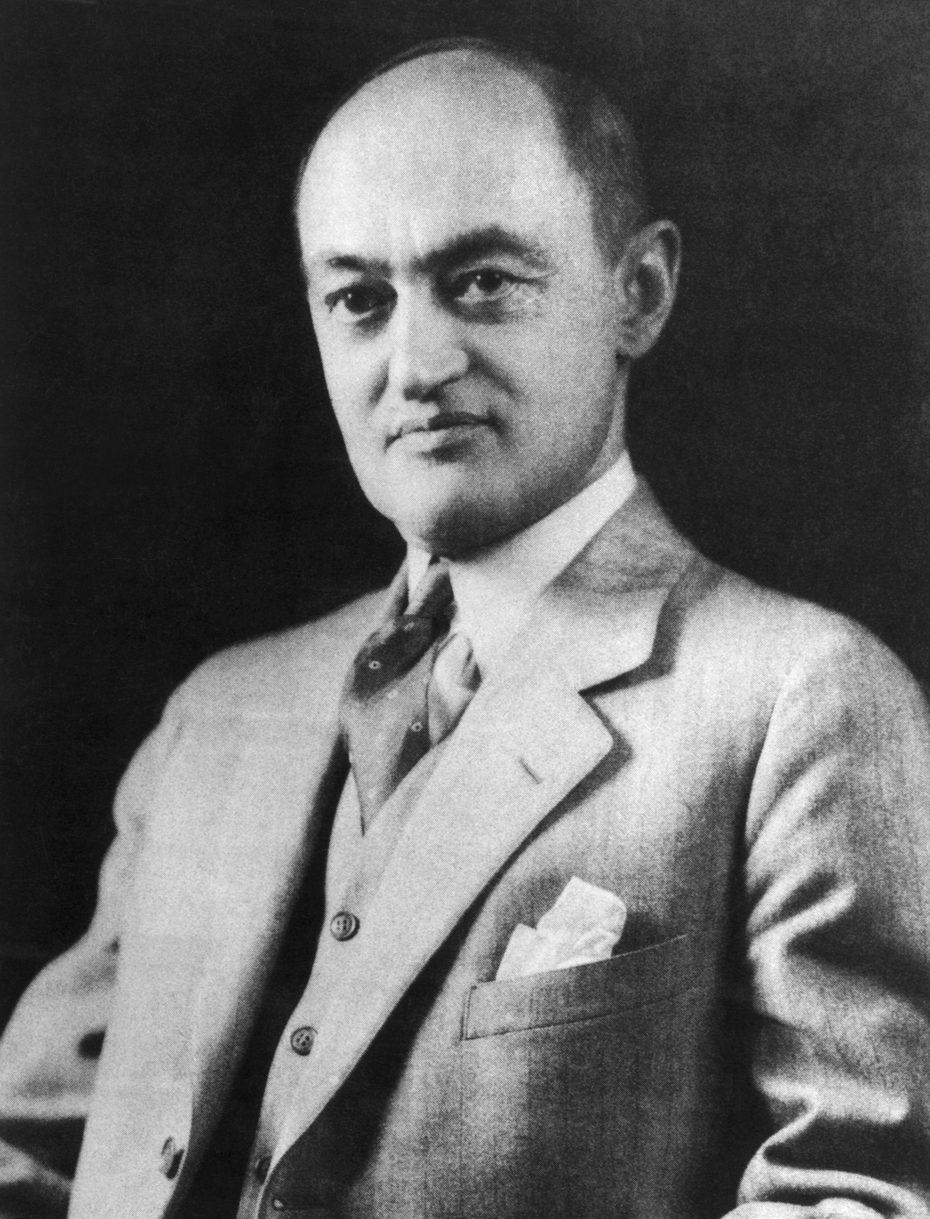
Innovation Theory of Entrepreneurship
“the entrepreneur and his function are not difficult to conceptualize: the defining characteristic is simply the doing of things that are already being done in a new way (innovation). It is but natural, and in fact it is an advantage, that such a definition does not draw any sharp line between what is and what is not ‘enterprise’” (Schumpeter, 1947, p. 151).
Creative Destruction

Slide 3
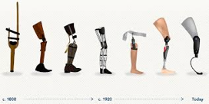
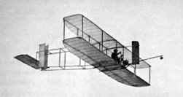
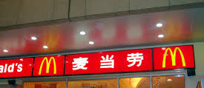



Entrepreneurship – types of innovation
We can differentiate various levels of innovation
Incremental to
Level of innovation
radical
New to a firm / region
Level of innovation
New to the world
Sustaining to
Level of innovation
Disruptive (game change)

Slide 4
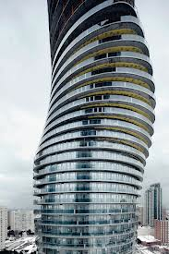


The elements of a business model
Business Model
Value Proposition
Value Architecture
Revenue Model

Slide 5
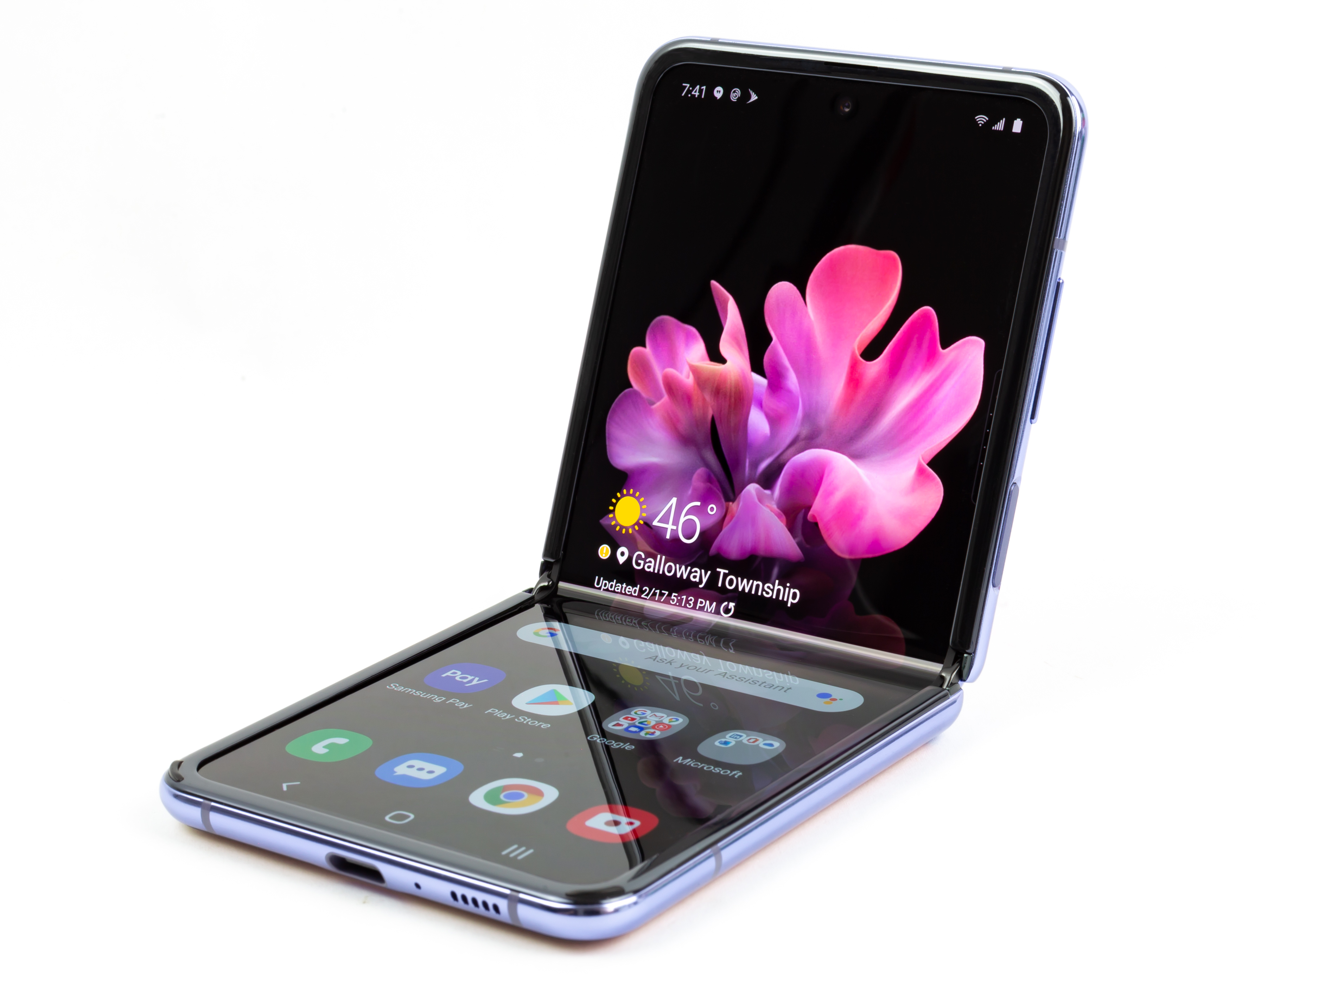
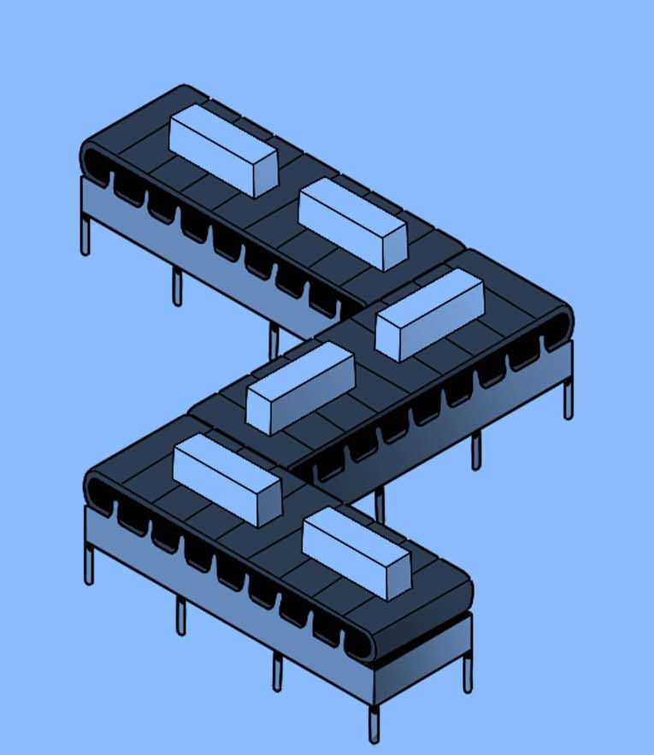


Slide 6
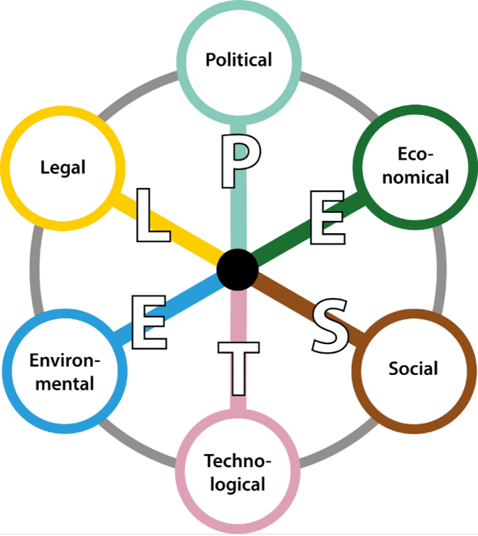
e.g. global supply-chain blockages
e.g. steep climb in energy costs
Strategy
If we consider innovation as a strategic means of providing solutions to new problems we have to look outwards to consider where new market opportunities (and threats) may be emerging. Which ones demand our attention and where can innovation capture opportunities (or alleviate threats)
External trends are commonly analysed using the PESTEL framework.
e.g. more working from home
e.g. Net Zero targets 2030 / 2050
e.g. reduce single-use plastics
e.g. swing towards online retail
e.g. Mobile payments
Notes:
Potential discussion points:
Net zero targets are a good example (Environmental and Political dimensions of PESTEL and linking into SDGs)
The UK is making policy commitments to move our economy onto the path to net zero by 2050, with an interim target to reduce the UK's emissions by at least 68% by 2030
In B-to-C markets in particular, Socially and Environmentally responsible values are increasingly sought by customers.
This also impacts your attractiveness as an employer – ability to attract top talent - as younger employees increasingly seek meaningful employment opportunities.
Social Responsibility example, footwear brand Toms have a giveback programme where, with each sale in western markets, they donate footwear in the developing world. See their Grass Roots Good programme here: https://www.toms.com/uk/impact-report-emea.html
Presenters may wish to share a worked example of a PESTEL as an additional slide at this point, or discuss how this can be a useful team-based exercise to carry out within the business (involving a wide range of people to identify the macro-scale trends)

Slide 7
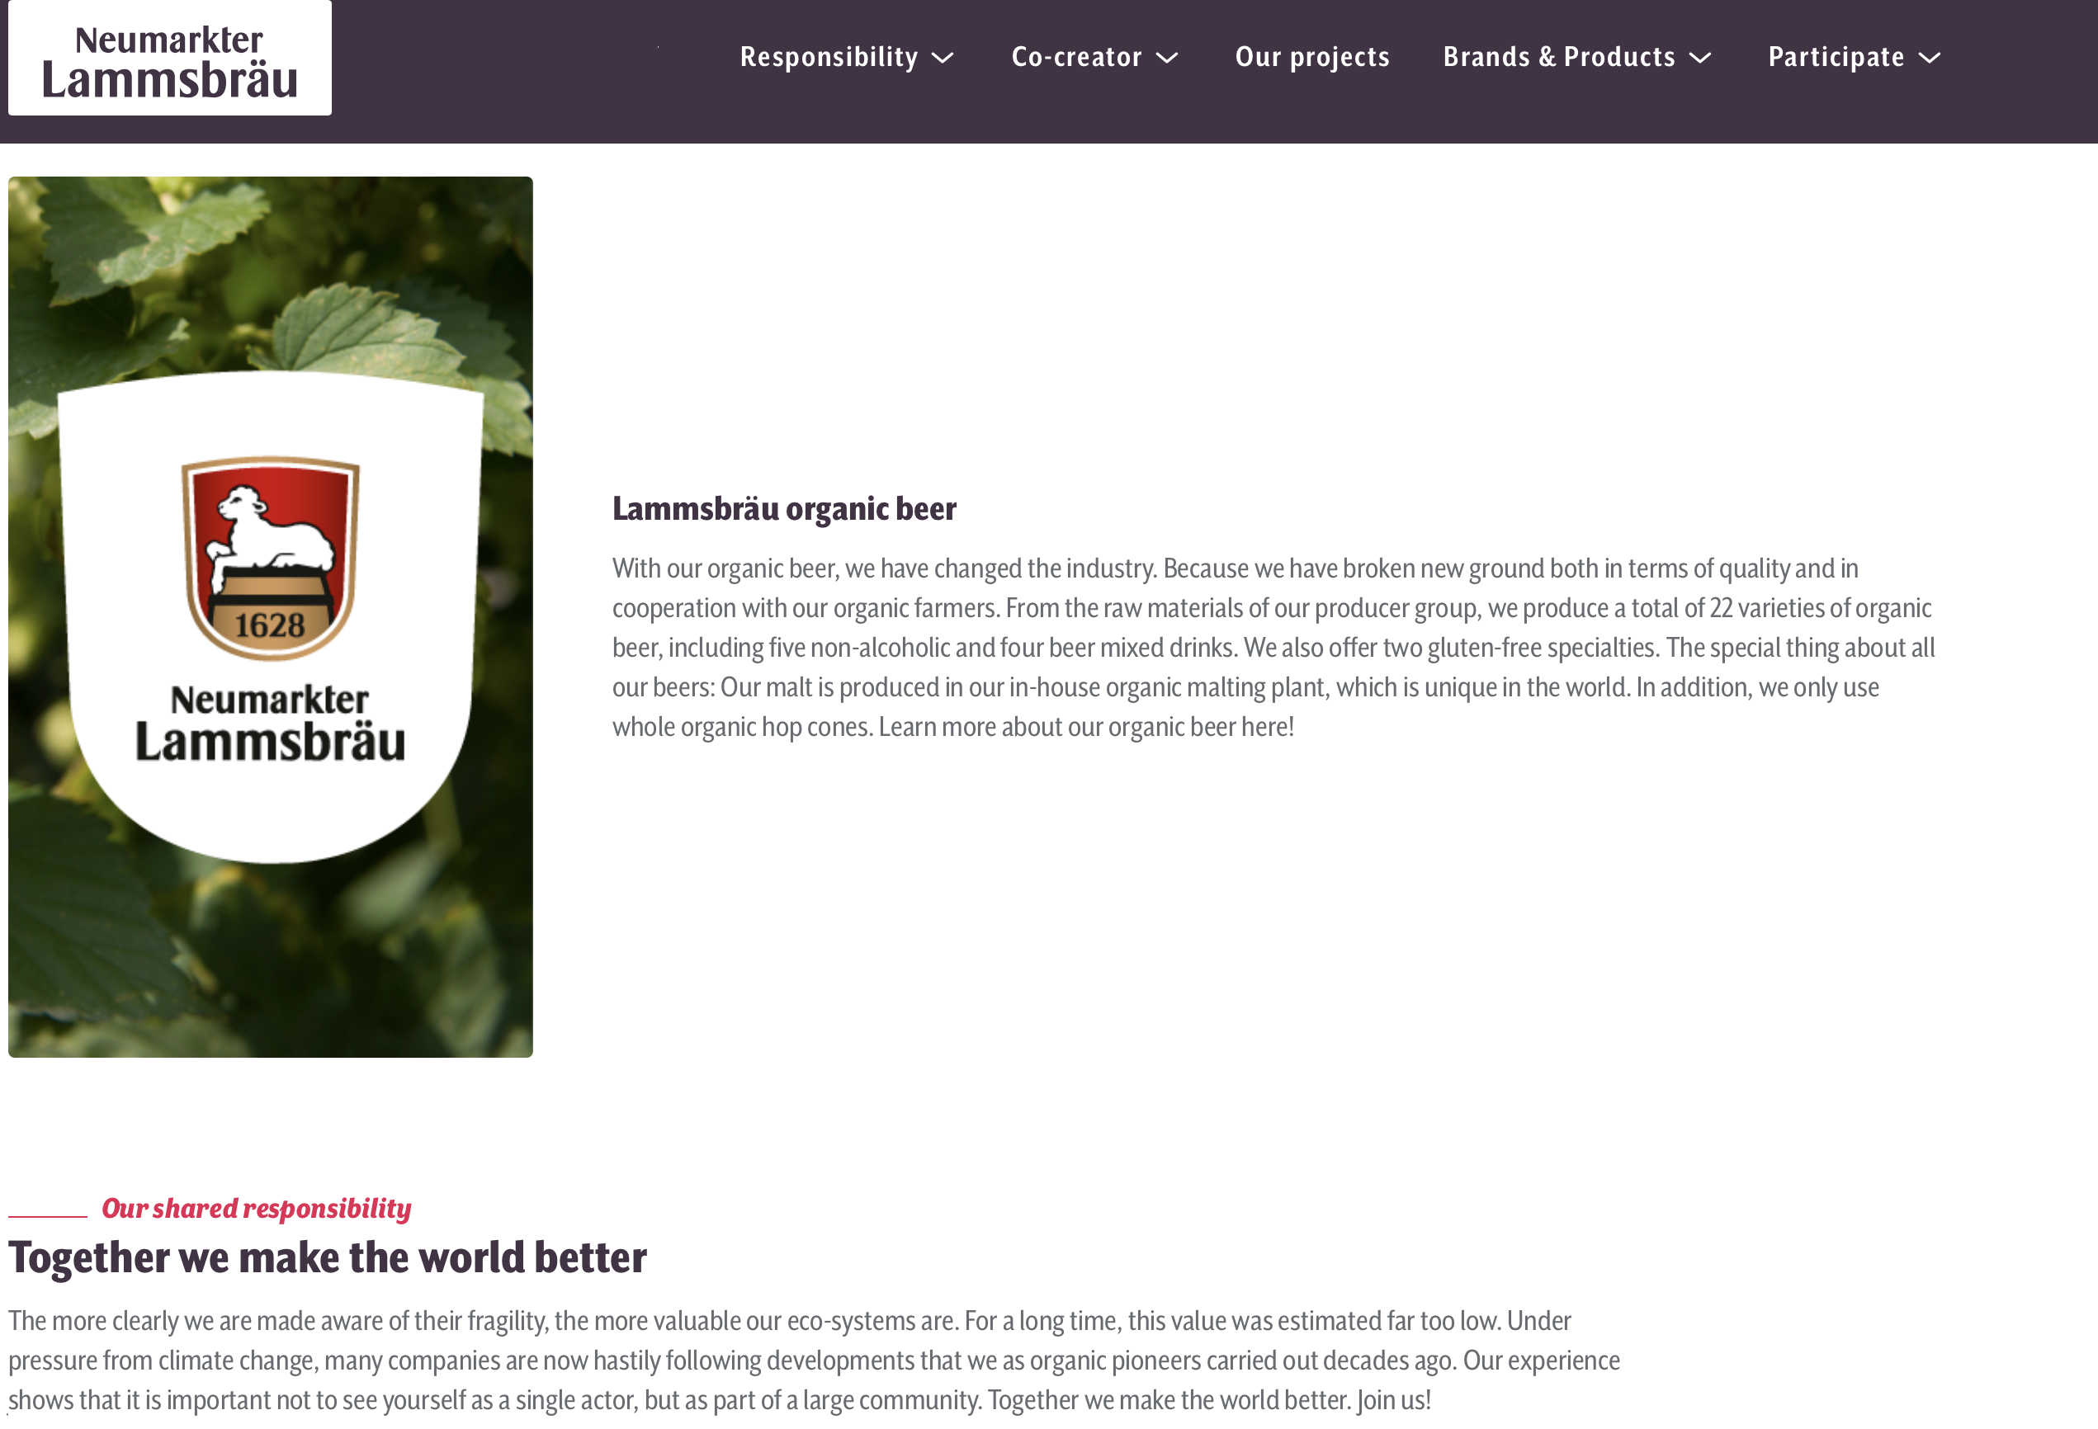
Source: www.lammsbraeu.de
Dr. Franz Ehrensperger: “Ecology is long-term economy“
The Goal? → create high quality beer, reduce emissions, secure local jobs, and source organic raw material
His idea? → create a positive-sum situation for all Lammsbräu stakeholders

Slide 8

Single Sided Social Dilemma
Lammsbräu
F
L
-2, 4
Organic hops, grain, yeast and water (in the 80s) runs the risk of higher cost and lower yield– very high risk for farmers
exploit
Go organic
Don’t exploit
2, 2
Not go organic
Farmers
0, 0
Solution to this Dilemma?
Lammsbräu self-commits
Lammsbräu initiates a long-term contract guaranteeing the purchase of organic brewing material at above market rate
Lammsbräu contracts an agricultural engineer to help farmers transform production to lower cost to farmers
Source: Beckmann, 2009

Slide 9
Multi-Sided Social Dilemma
Farmer B
Not cooperate
cooperate
Traditional competition between farmers undermines individually committed pricing agreements, creates uncertainty, and continues eroding Lammsbräu’s ecological goal
IV
I
2, 5
4, 4
cooperate
Farmer A
Not cooperate
2, 2
5, 2
III
II
Solution to this Dilemma?
Lammsbräu encourages cooperation for collective commitment among farmers
Lammsbräu initiates the “Growers Association for Organic Brewing Raw Materials”
Lammsbräu initiates the “Association of Organic Food Producers” and will only engage in contracts with members of this co-op

Slide 10
Our frames of reference are not immutable
Zero-sum perceptions come from particular frames of understanding– often socially constructed
But socially constructed frames of reference can be changed to create positive-sum perceptions

Slide 11
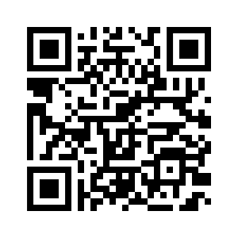
Thanks for Listening!
Emilio Costales
Senior Lecturer in Social Entrepreneurship and Innovation
Contact information
Email: e.costales@Greenwich.ac.uk
Office: QM 161
Office hours: book via calendly: https://calendly.com/ecostales_ebc/greenwich

