Slide 1


BUSI 1764
Global Entrepreneurship and Innovation
Dr Emilio Costales
Mini-Lecture 1.2: International Entrepreneurship and the International New Venture

Slide 2


What is Entrepreneurship?
Entrepreneurs are agents of change who do things themselves (not let other people do it) and do them in Innovative ways

Slide 3
What is Entrepreneurship
The practice of identifying, capturing, and exploiting the opportunities that change creates through innovative activity (Drucker, 1985; Schumpeter, 1947)
Notes:
Drucker, P. (1985). Innovation and entrepreneurship: Practice and principles. Harper & Row.
Schumpeter, J. A. (1947). The creative response in economic history. The Journal of Economic History, 7(2), 149–159.

Slide 4
Entrepreneurial Variation
Social Entrepreneurship- “innovative and effective activities that focus strategically on resolving social market failures and creating new opportunities to add social value systematically by using a range of resources and organizational formats to maximize social impact and bring about change” (Nicholls, 2006 p. 43)
  The pursuit of social improvement over profit a distinguishing characteristic of social entrepreneurship (Dees, 1998)
Ecopreneurship- “entrepreneurship through an environmental lens… entrepreneurial activities that are oriented less towards management systems or technical procedures and focused more on the personal initiative and skills of the entrepreneurial person or team to realise market success with environmental innovations”(Shaltegger, 2002)
  Entrepreneurship based on the principles of sustainability (Kirkwood and Walton, 2010)
Intrapreneurship- “Entrepreneurship within an existing organization” (Antoncic & Hisrich, 2003)
  An individual employee's agentic and anticipatory behaviors aimed at creating new businesses for the organization (i.e., venture behavior) and enhancing an organization's ability to react to internal and external advancements (i.e., strategic renewal behavior) (Gawke et al., 2017)
International Entrepreneurship- “the discovery, enactment, evaluation, and exploitation of opportunities—across national borders—to create future goods and services.” (Oviatt & McDougall, 2005)
International Entrepreneurship- “the discovery, enactment, evaluation, and exploitation of opportunities—across national borders—to create future goods and services.” (Oviatt & McDougall, 2005)
Notes:
Oviatt, B. M., & McDougall, P. P. (2005). Defining international entrepreneurship and modeling the speed of internationalization. Entrepreneurship theory and practice, 29(5), 537-553.

Slide 5

The role of Globalization
“Globalization as a concept refers both to the compression of the world and the intensification of consciousness of the world as a whole . . . both concrete global interdependence and consciousness of the global whole.” (Robertson, 1992)
“Globalisation can . . . be defined as the intensification of world- wide social relations which link distant localities in such a way that local happenings are shaped by events occurring many miles away and vice versa. This is a dialectical process because such local happenings may move in an obverse direction from the very distanciated relations that shape them. Local transformation is as much a part of globalisation as the lateral extension of social connections across time and space.” (Giddens, 1990)
“A social process in which the constraints of geography on economic, political, social and cultural arrangements recede, in which people become increasingly aware that they are receding and in which people act accordingly.” (Waters, 2013)
Notes:
Giddens, A. (1990) The Consequences of Modernity, Cambridge: Polity.
Robertson, R. (1992) Globalization, London: Sage.
Waters, M. (2013). Globalization. routledge.

Slide 6
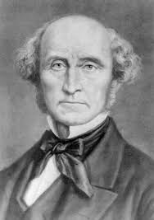
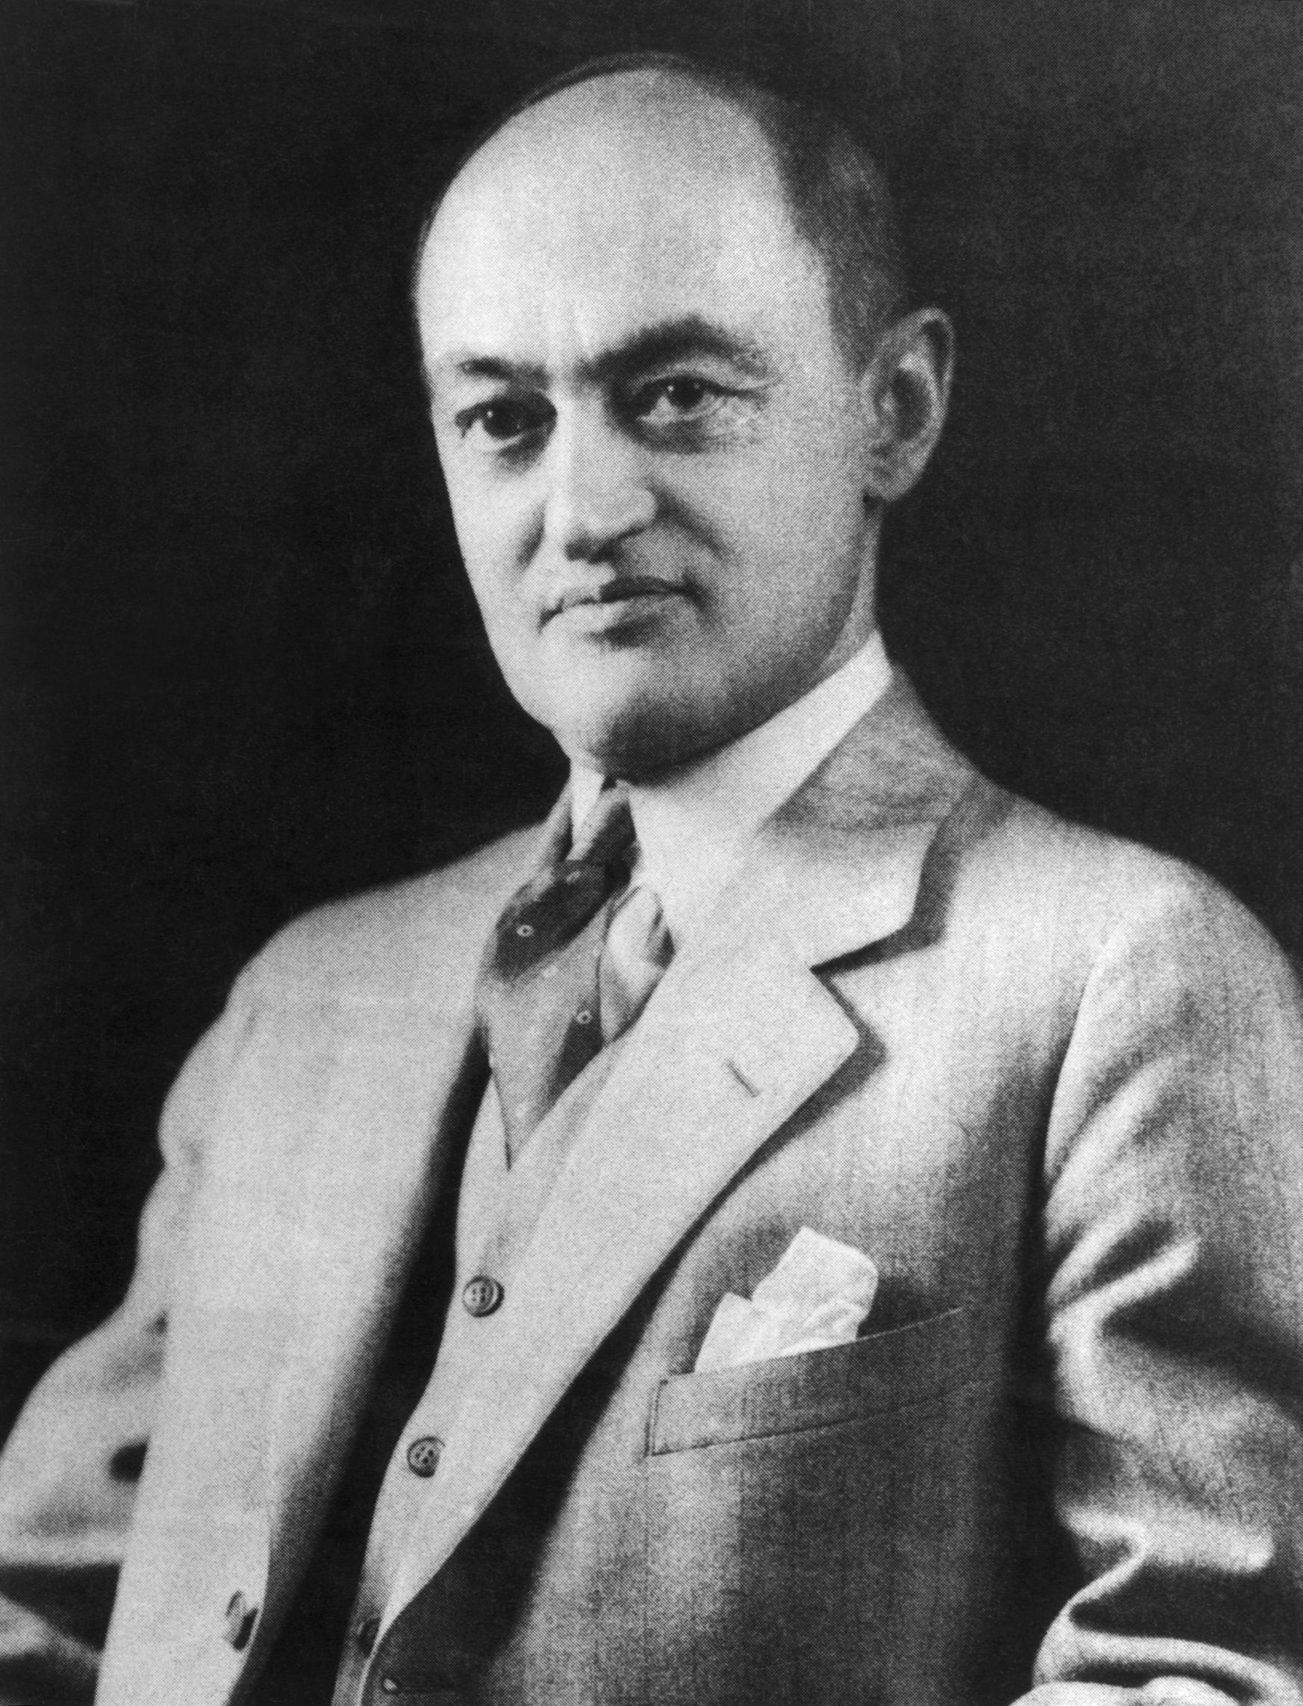
Drivers of the Economy
An entrepreneur is the prime mover in the private enterprise. The entrepreneur is the fourth factor of production.
John Stuart Mill (1848)
The entrepreneur is an innovator. The economy moves forward because of their innovations. This process is called ‘Creative Destruction’
Joseph A. Schumpeter (1911)
Notes:
Mill, J. S. (1848). Principles of political economy: With some of their applications to social philosophy (Vol. 1).
Schumpeter, J. A. (1939). Business cycles (Vol. 1, pp. 161–174). McGraw-Hill.

Slide 7
Introducing the International New Venture (INV)
Oviatt and McDougall (1994) defined INVs as firms that from their inception seek to gain significant competitive advantage by using their resources effectively and the sale of outputs in multiple countries.
INVs are firms that within six years from their inception internationalise and 25% to 30% of their total revenue comes from foreign operations.

Slide 8

Elements of the International New Venture (INV)
There are 4 key elements for a sustainable INV (Oviatt & McDougall (2018):
The first element is related to firm’s internalisation of transactions and the use of hierarchical authority as the mechanism of governance.
The second element is related to alternative governance structures and prioritises scarcity of resources that pushes INVs to consider and use alternative approaches and planning for managing crucial assets.
The third element is related to foreign location advantage and underlines the ability of INVs to develop their competitive advantage by synthesising resources across national borders.
The fourth element is related to unique resources, the importance of proprietary knowledge is stressed especially in INVs that are knowledge based.
Notes:
Oviatt, B. M., & McDougall, P. P. (2018). Toward a theory of international new ventures. International Entrepreneurship: The Pursuit of Opportunities across National Borders, 31-57.

Slide 9
The International New Venture (INV)
INVs are strongly associated with their founders. Founders are able to identify and exploit international opportunities and they have personal contacts in foreign markets (McDougall et al., 1994).
INVs also develop international relationships during their studies abroad and from their previous international work experience (e.g. Reuber and Fischer, 1997; Crick and Jones, 2000).
Coviello and Munro (1995) Research with international firms found that networks facilitate internationalisation (Costales & Zeyen, 2022; Coviello & Munro, 1995; Oviatt & McDougall, 2018)
Notes:
Costales, E., & Zeyen, A. (2022). Social capital and the morphogenesis of actors: lessons from international social entrepreneurs. The International Dimension of Entrepreneurial Decision-Making: Cultures, Contexts, and Behaviours, 193-222.
Oviatt, B. M., & McDougall, P. P. (2018). Toward a theory of international new ventures. International Entrepreneurship: The Pursuit of Opportunities across National Borders, 31-57.

Slide 10
Transaction Cost Theory
How might companies minimize their per-unit costs
Emphasizes the importance is knowledge
Reasons for engaging in joint ventures between MNEs and local firms (e.g. outsourcing some of their operations
Hennart, J. F. (2010). Transaction cost theory and international business. Journal of Retailing, 86(3), 257-269.

Slide 11
International Product Life Cycle (Vernon’s)
Representation of the relation between profit margin, sales volume, and lifecycle of a product
Introduction (Development) Stage- Characterized by the risk of fit between market need & product/service
Growth Stage- Potential competition become involved
Maturity Stage- Market becomes relatively saturated
Decline- Characterized by Industry transformation and consumer disconnect
Harvard Business Review

Slide 12
Monopolistic Advantage Theory
Stephen Hymer’s 1960 Dissertation
Presumes that an internationalizing firm or other (FDI) has some sort of market capturing advantage (e.g. technology, social capital, human capital, economies of scale, economies of agglomeration, etc)
Hymer, S. H. (1960). The international operations of national firms, a study of direct foreign investment (Doctoral dissertation, Massachusetts Institute of Technology).

Slide 13
Oligopolistic Reaction Theory
Relates to foreign investment decisions
Motivated by market competition
Oligopoly refers to market structure dominated by small number of big firms (e.g. follow the leader)
Ito, K., & Rose, E. L. (2002). Foreign direct investment location strategies in the tire industry. Journal of International Business Studies, 33, 593-602.

Slide 14
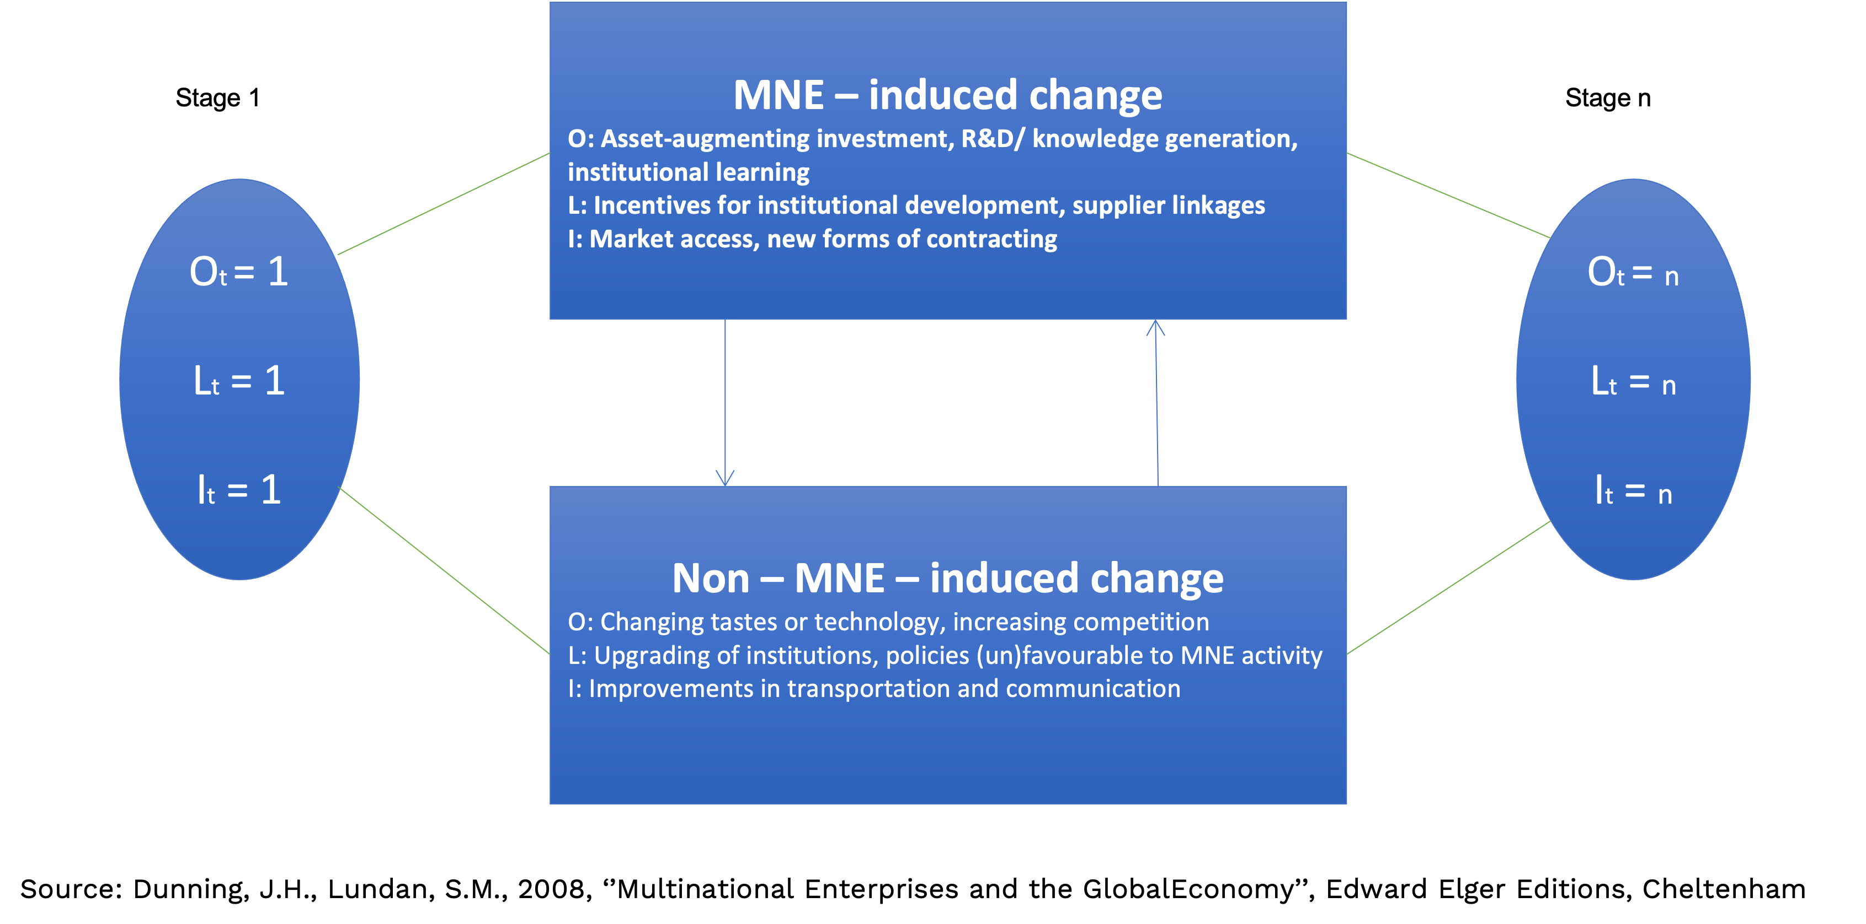
OLI Paradigm
Tool developed by John Dunning for conceptualizing and understanding how companies might internationalize
Differentiates externally and internally induced organizational change
Dunning, J. H., & Lundan, S. M. (2008). Multinational enterprises and the global economy. Edward Elgar Publishing.

Slide 15
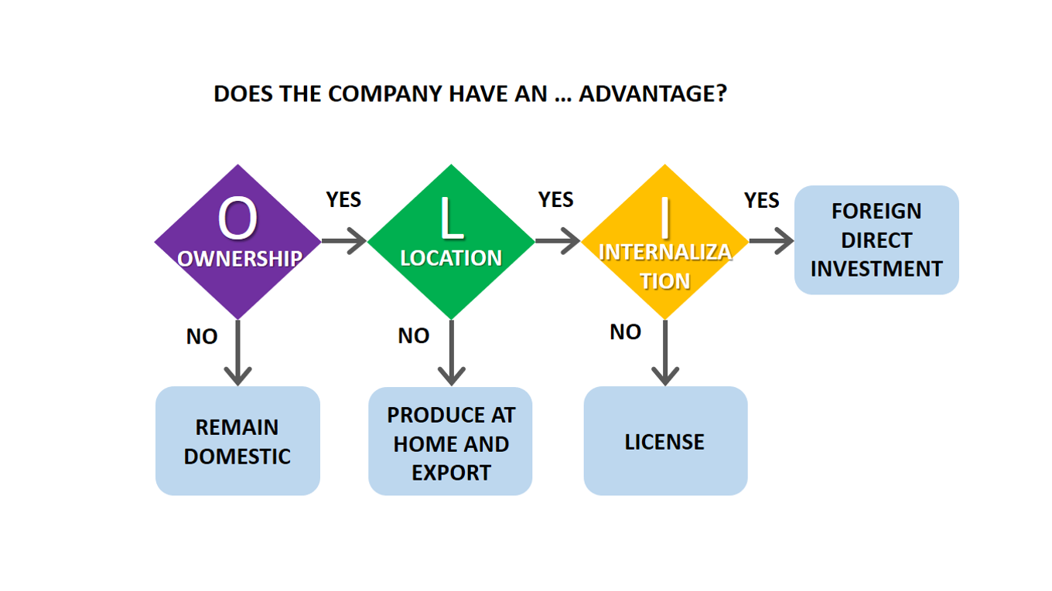
OLI Paradigm (cont)
Tool developed by John Dunning for conceptualizing and understanding how companies might internationalize (I)
Breaks down choice of optimal locations (L) for conducting activities of competitive advantages (O)
Differentiates externally and internally induced organizational change

Slide 16
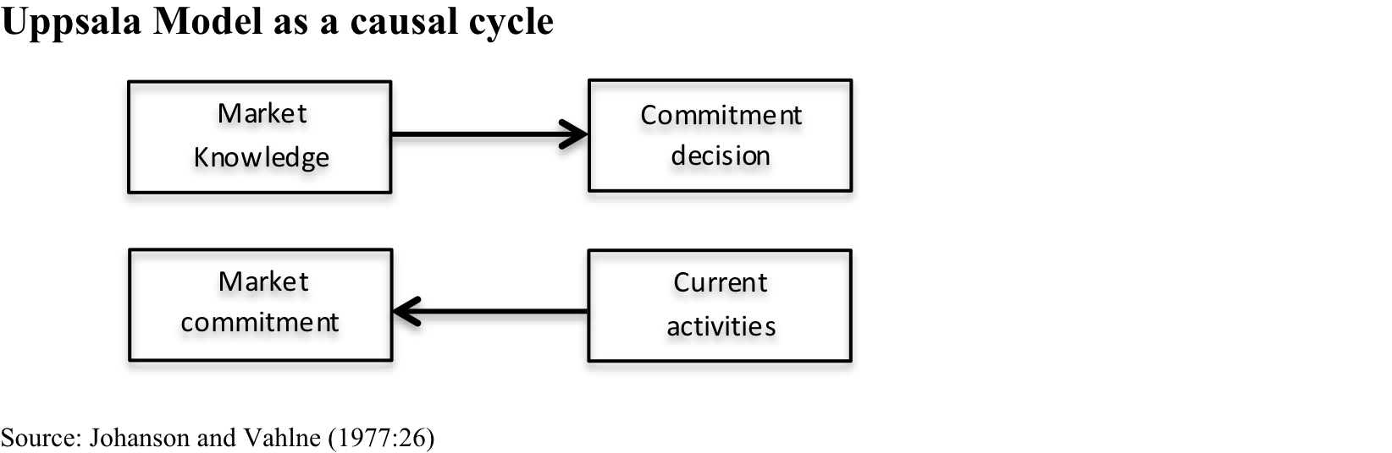
Uppsala Model
Swedish model: internationalization is evolutionary and temporal process
Knowledge iteratively accumulated
Emphasizes notion of psychic distance
Vahlne, J. E., & Johanson, J. (2017). From internationalization to evolution: The Uppsala model at 40 years. Journal of International Business Studies, 48, 1087-1102.

Slide 17


Thanks for Listening

