Slide 1


BUSI 1764
Global Entrepreneurship and Innovation
Dr Emilio Costales
Mini-Lecture 1.1: Entrepreneurship and Innovation

Slide 2


Course Outline and Housekeeping
https://youtube.com/@IntEntrepreneurship_UoG

Slide 3
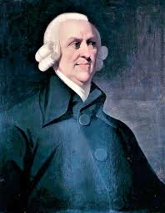

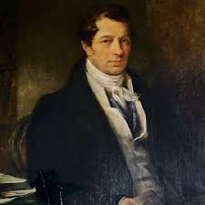
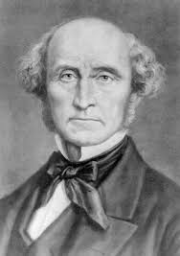
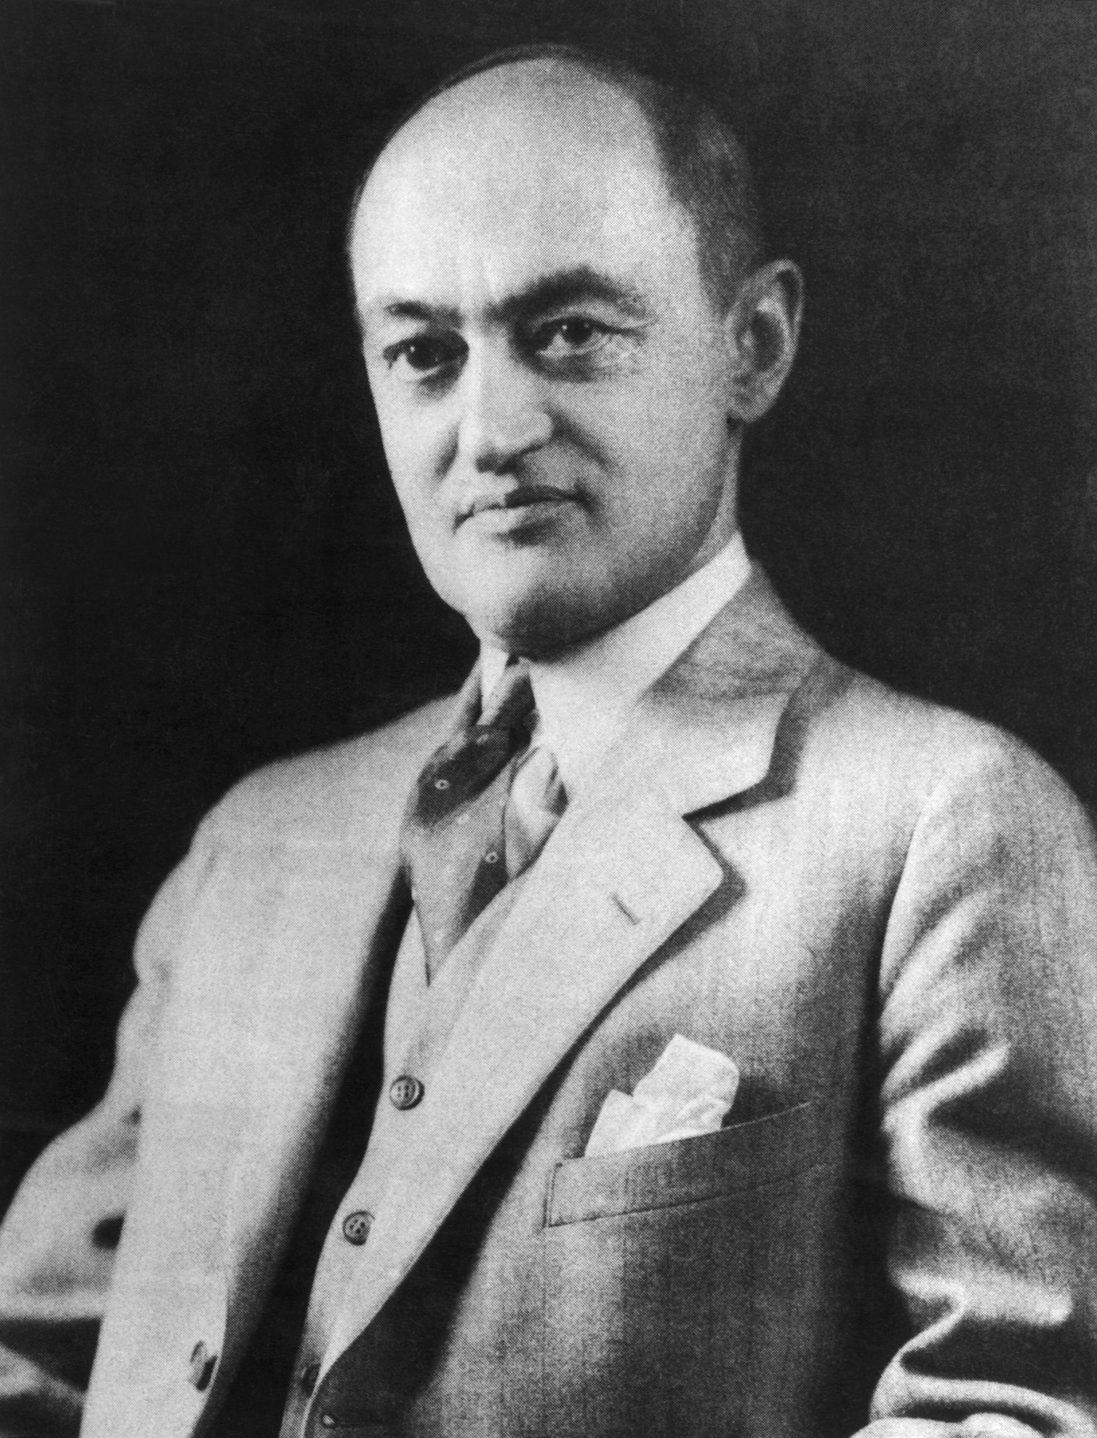
An “Entrepreneur” is a person who acts as an agent for transforming demand into supply
Adam Smith (1778)
An entrepreneur is a person who shifts resources from an area of low productivity to higher productivity
Jean Baptiste Say (1803)
An entrepreneur is the prime mover in the private enterprise. The entrepreneur is the fourth factor of production.
John Stuart Mill (1848)
The entrepreneur is an innovator. The economy moves forward because of their innovations. This process is called ‘Creative Destruction’
Joseph A. Schumpeter (1911)
Notes:
Mill, J. S. (1848). Principles of political economy: With some of their applications to social philosophy (Vol. 1).
Schumpeter, J. A. (1939). Business cycles (Vol. 1, pp. 161–174). McGraw-Hill.
Smith, A. (1776). An inquiry into the nature and the causes of the wealth of nations. The Glasgow edition of the works and correspondence of Adam Smith. Reprint 20.
Palgrave Macmillan. https://doi.org/10.1057/9780230291652
Say, J. B. (1846). Traité d’économie politique: ou simple exposition de la manière dont se forment, se distribuent et se consomment les richesses (Vol. 9). Guillaumin.

Slide 4
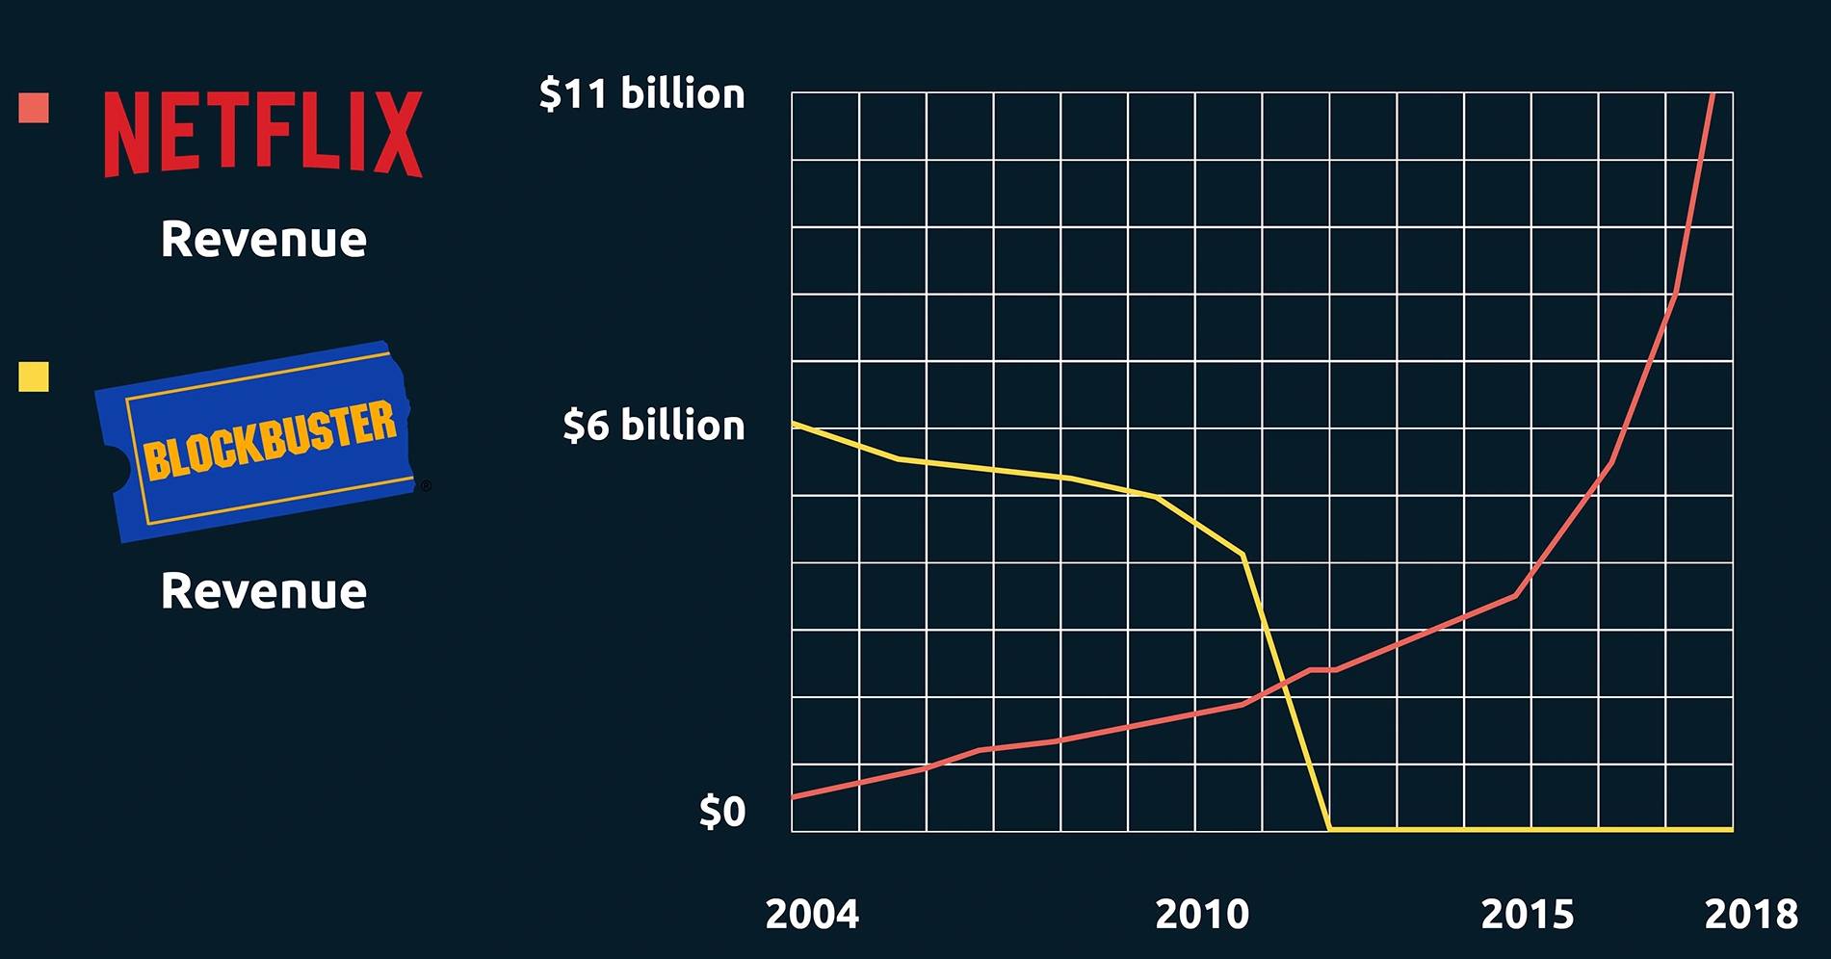



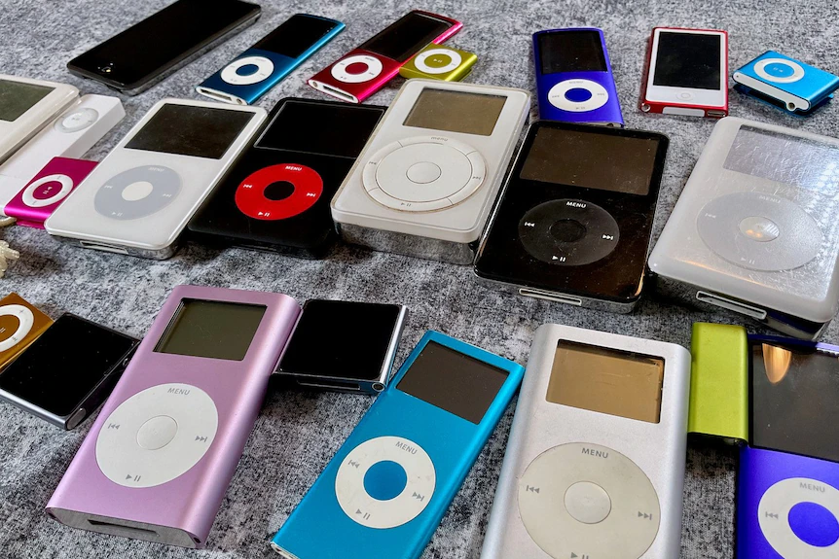
Creative Destruction
A process which “incessantly revolutionizes the economic structure from within, incessantly destroying the old one, incessantly creating a new one.” (Schumpeter, 1942 p. 83)
Notes:
Schumpeter, J. A. (1942). Capitalism, socialism and democracy. Routledge.

Slide 5

Innovation Theory of Entrepreneurship
“the entrepreneur and his function are not difficult to conceptualize: the defining characteristic is simply the doing of things that are already being done in a new way (innovation). It is but natural, and in fact it is an advantage, that such a definition does not draw any sharp line between what is and what is not ‘enterprise’” (Schumpeter, 1947, p. 151).
Entrepreneurs act Entrepreneurially

Slide 6


What is Entrepreneurship?
Entrepreneurs are people who do things themselves (not let other people do it) and do them in Innovative ways

Slide 7





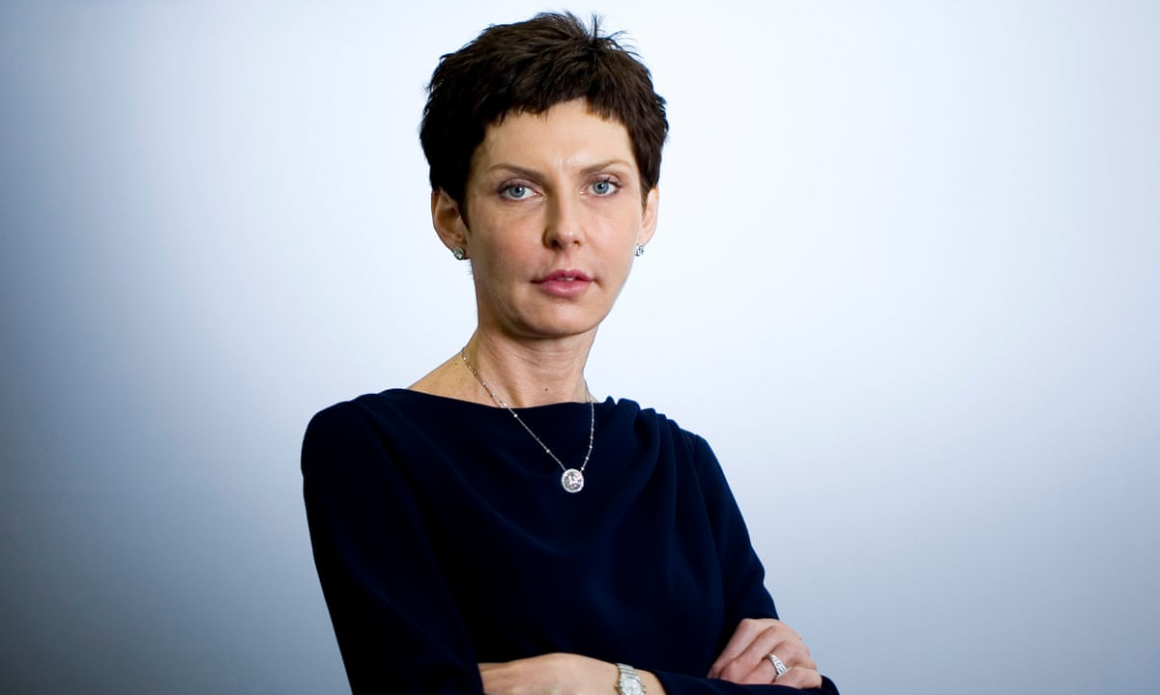
Cher Wang- HTC
Richard Branson- Virgin Empire
Elon Musk- Tesla
Jeff Bezoz- Amazon
Mark Zuckerberg- Facebook
Denise Coates- bet365

Slide 8
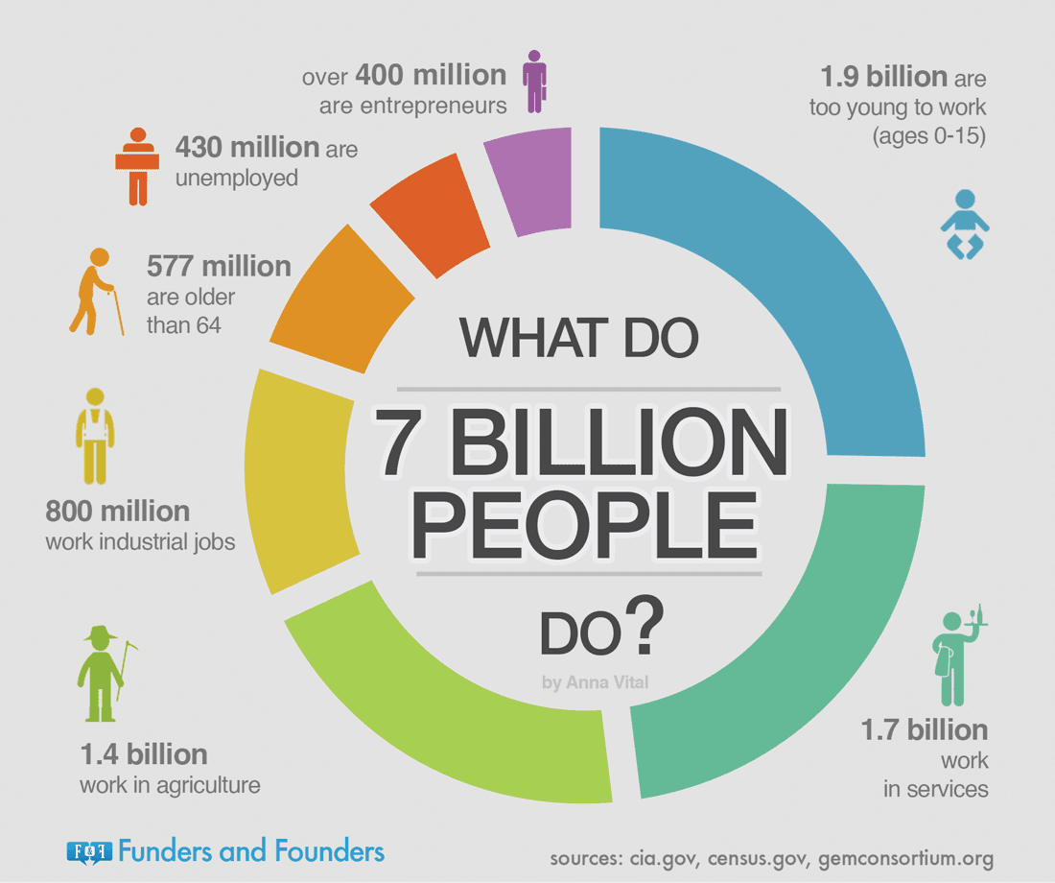
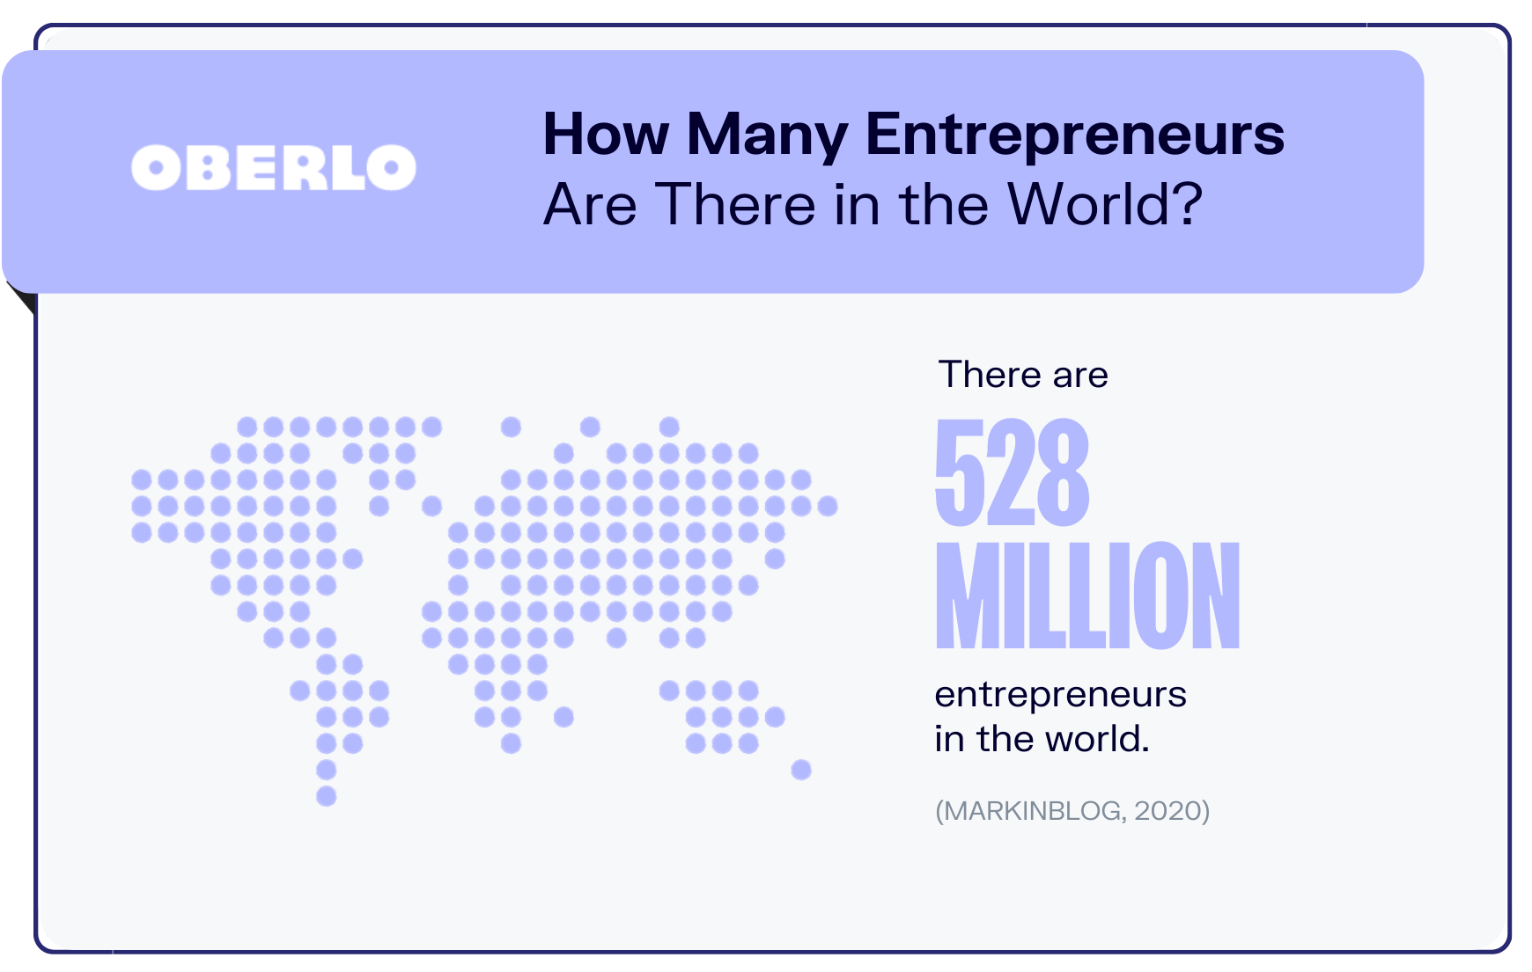
Identifying Entrepreneurs

Slide 9
Idea Generation
Opportunity Evaluation
Planning
Organization Formation
Growth and Scaling
The Entrepreneurial Process
Human Capital
Emotional Support
Expert Knowledge
Networks
Ideas & Feedback
Funding

Slide 10

Entrepreneurial Traits
Independence → desire to be your own boss
Concentration → Avoiding distractions in order to complete set tasks(goals)
Self-Discipline → How we train ourselves to meet our goals
Tenacity → Overcoming discouragement, seeing challenges as opportunities
Creativity → Coming up with clever and workable solutions
Business Acumen → having the knowledge, keenness, and quickness for understanding and dealing with business situations that may emerge (ideation, MVP, Market research, etc).
Hard Work → Ability to do the amount of work necessary
Motivation → Possessing the menta (and physical) drive to accomplish tasks on your own terms.
(Self)Confidence → Believing in your own abilities, the vision for your venture, and chances of success.
Low Aversion to Risks → Willingness to sacrifice security, if necessary, to accomplish set goals.
Human- Relations → Ability to inspire, cooperate, manage, and engage with others.
Communication Skills → Ability to express yourself and understand others in order to effectively share and implement ideas.
Technical Ability → Expertise to produce goods and services your business hopes to provide.
Decision-Making → Ability to analyze complex situations and draw conclusions to the benefit of the business.

Slide 11
What is (International) Entrepreneurship?
Entrepreneurs are people who do things themselves (not let other people do it) and do them in Innovative ways

Slide 12
What do we mean by Innovation?
Innovation is the re-combination of existing elements i.e. Resources, processes, knowledge, products, services, methods and so forth (Schumpeter, 1911)
“the entrepreneur and his function are not difficult to conceptualize: the defining characteristic is simply the doing of things that are already being done in a new way (innovation). It is but natural, and in fact it is an advantage, that such a definition does not draw any sharp line between what is and what is not ‘enterprise’” (Schumpeter, 1947, p. 151).
Notes:
Schumpeter, J. (1911). The theory of economic development. harvard economic studies. vol. xlvi. The theory of economic development. Harvard Economic Studies. Vol. XLVI.
Schumpeter, J. A. (1947). The creative response in economic history. The journal of economic history, 7(2), 149-159.

Slide 13





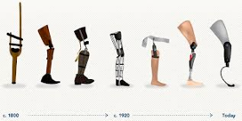



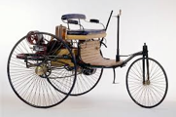
Entrepreneurship – what is innovation?
Innovation represents the various ways of gaining a competitive advantage
There are various types of innovation ranging from incremental (small changes) to radical (large changes).

Slide 14
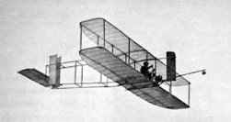




Entrepreneurship – types of innovation
We can differentiate various levels of innovation
Incremental to
Level of innovation
radical
New to a firm / region
Level of innovation
New to the world
Sustaining to
Level of innovation
Disruptive (game change)

Slide 15
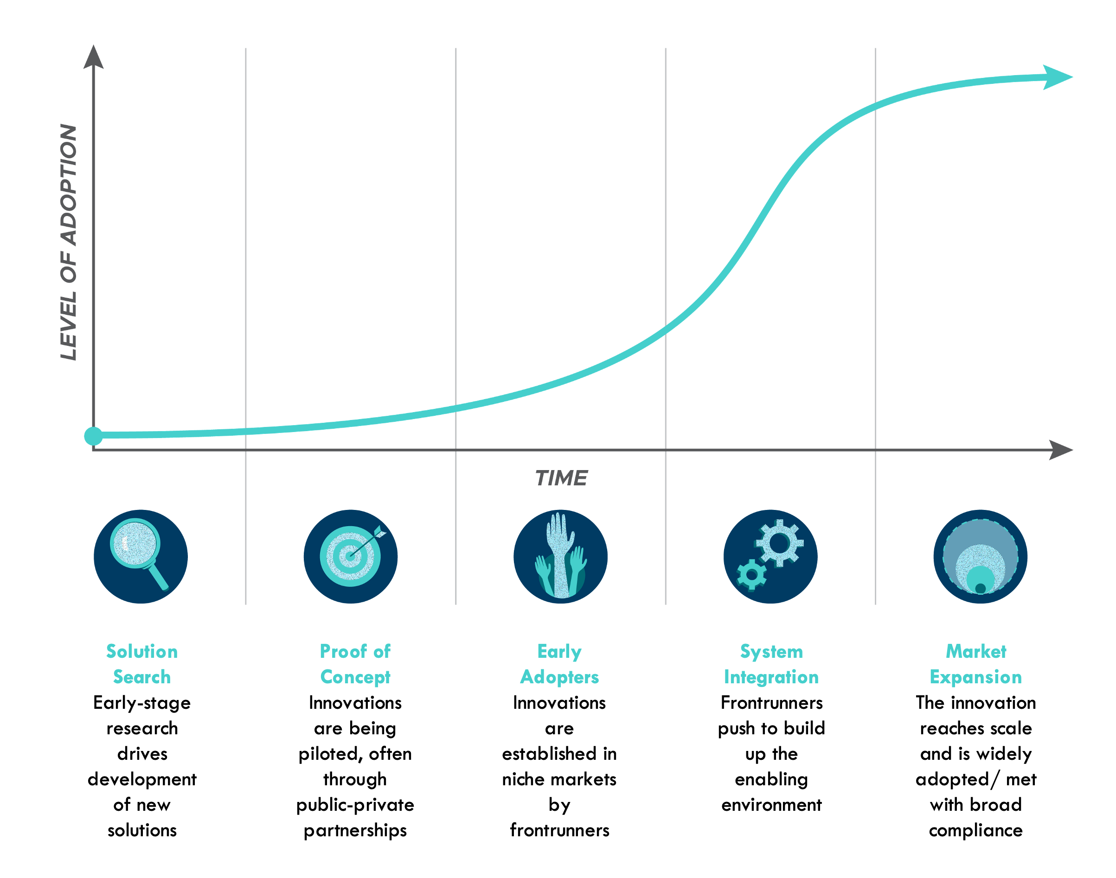
Innovation does not equal Invention
"Many inventors have become entrepreneurs and the relative frequency of this case is no doubt an interesting subject to investigate, but there is no necessary connection between the two functions. The inventor produces ideas, the entrepreneur "gets things done," which may but need not embody anything
that is scientifically new” (Schumpeter, 1947 p. 152)
Source: RMI
Notes:
Schumpeter, J. A. (1947). The creative response in economic history. The journal of economic history, 7(2), 149-159.

Slide 16
Types of Entrepreneurship
Social Entrepreneurship- ”innovative and effective activities that focus strategically on resolving social market failures and creating new opportunities to add social value systematically by using a range of resources and organizational formats to maximize social impact and bring about change”
  The pursuit of social improvement over profit a distinguishing characteristic of social entrepreneurship (Dees, 1998)
Ecopreneurship- “entrepreneurship through an environmental lens… entrepreneurial activities that are oriented less towards management systems or technical procedures and focused more on the personal initiative and skills of the entrepreneurial person or team to realise market success with environmental innovations”(Shaltegger, 2002)
  Entrepreneurship based on the principles of sustainability (Kirkwood and Walton, 2010)
Intrapreneurship- “Entrepreneurship within an existing organization” (Antoncic & Hisrich, 2003)
  An individual employee's agentic and anticipatory behaviors aimed at creating new businesses for the organization (i.e., venture behavior) and enhancing an organization's ability to react to internal and external advancements (i.e., strategic renewal behavior) (Gawke et al., 2017)
International Entrepreneurship- “the discovery, enactment, evaluation, and exploitation of opportunities—across national borders—to create future goods and services.” (Oviatt & McDougall, 2005)
Notes:
Antoncic, B., & Hisrich, R. D. (2003). Clarifying the intrapreneurship concept. Journal of small business and enterprise development, 10(1), 7-24.
Dees, J. G. (1998). The meaning of social entrepreneurship. Fuqua School of Business
Dukes University, 1–6.
Gawke, J. C., Gorgievski, M. J., & Bakker, A. B. (2017). Employee intrapreneurship and work engagement: A latent change score approach. Journal of Vocational Behavior, 100, 88-100.
Kirkwood, J., & Walton, S. (2010). What motivates ecopreneurs to start businesses?. International Journal of Entrepreneurial Behavior & Research, 16(3), 204-228.
Nicholls, A. (Ed.). (2006). Social entrepreneurship: New models of sustainable social change.
OUP Oxford.
Oviatt, B. M., & McDougall, P. P. (2005). Defining international entrepreneurship and modeling the speed of internationalization. Entrepreneurship theory and practice, 29(5), 537-553.
Schaltegger, S. (2002). A framework for ecopreneurship: Leading bioneers and environmental managers to ecopreneurship. Greener management international, (38), 45-58.

Slide 17


Thanks for Listening

